Slide 1
COMP 400: Technical Communication in Computer Science
John Greiner

Slide 2
“An engineer who can’t communicate works for one who can.”
“If you can’t tell them what you are doing, they’ll hire someone else who can.”

Slide 3
Jan 13
Jan 20
Jan 27
Feb 3
Feb 10

Slide 4
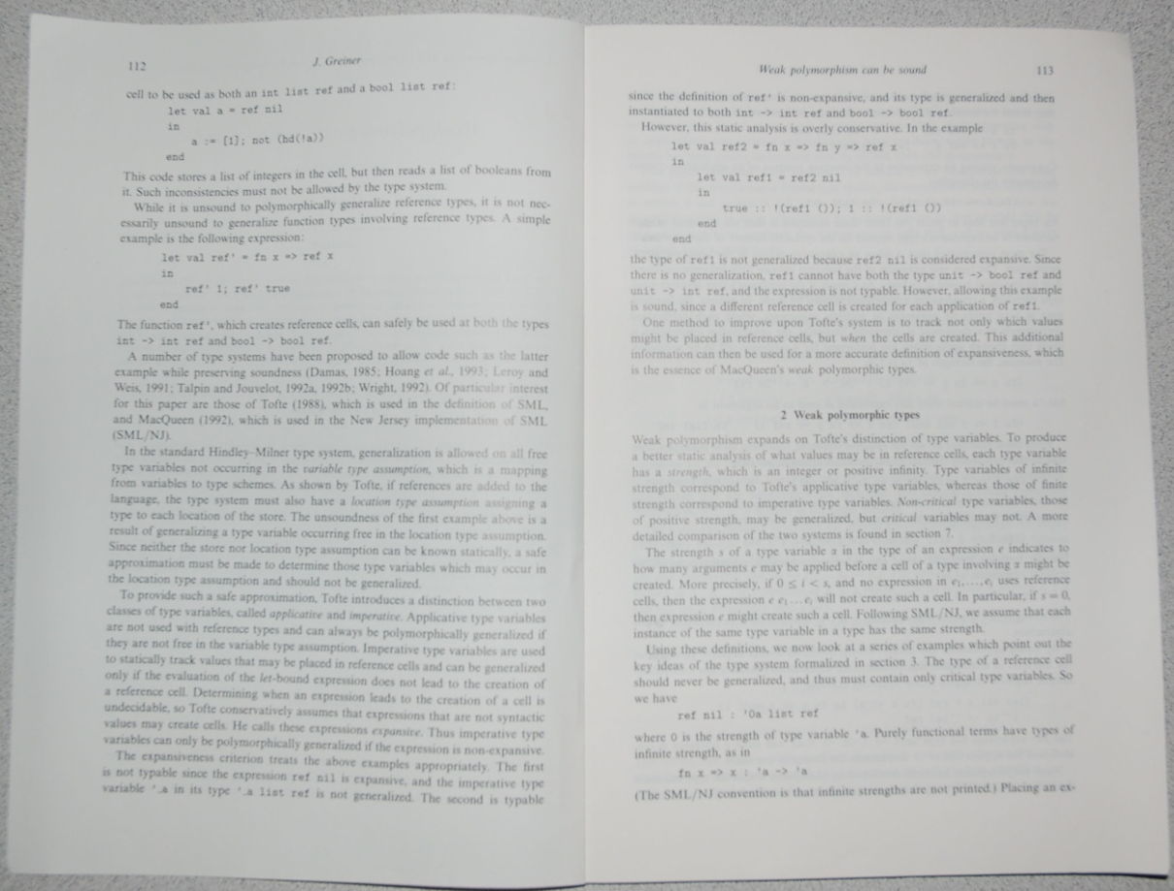
Microbenchmark Performance
Feb 17
Feb 24
Mar 10

Slide 5
Mar 17
Mar 24
Mar 31
Apr 7
Apr 15-16

Slide 6
Critique this experiment
Apr 21

Slide 7
Types of Technical Communication
Reports
Proposals
Instructions
Procedures
Manuals
Brochures
Memos
Emails
Letters
Strategies for Technical Communication in the Workplace, Gurak & Lannon

Slide 8
Expectations
Sit and listen
Do and discuss
Read and prepare
http://www.clear.rice.edu/comp400/

Slide 9
Grading
In-class activities
Participation
Homework/projects
Exams

Slide 10
?

Slide 11
Activity
Introduction
Background
Goals

