Slide 1
Presenting a Technical Poster
John Greiner

Slide 2
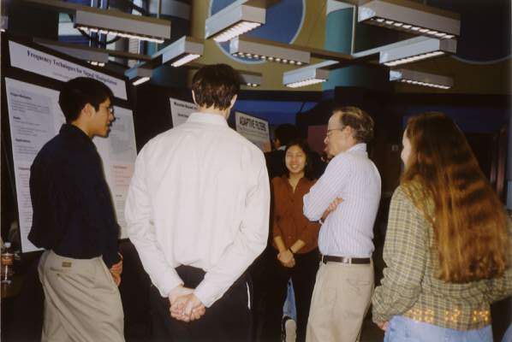
Connect with the Audience
Greet audience.
Why are they interested?
What are their backgrounds?
How will they benefit?
What are their questions?
Prepare 30 second, 2 minute, and 5 minute talks.
Different levels of interest
Different backgrounds
Be able to summarize key points in 2-3 sentences.
Be able to start from any section.
Reinforce key points.

Slide 3
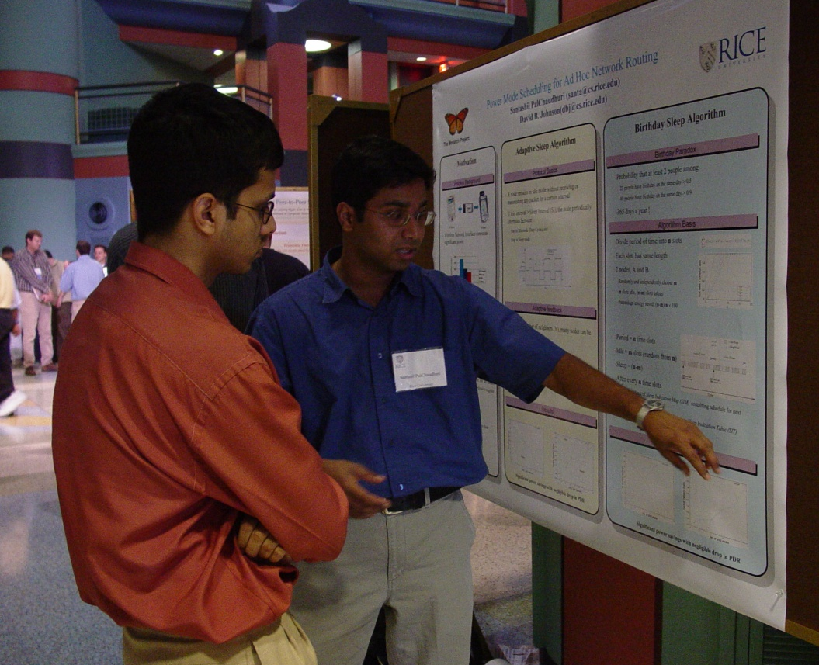
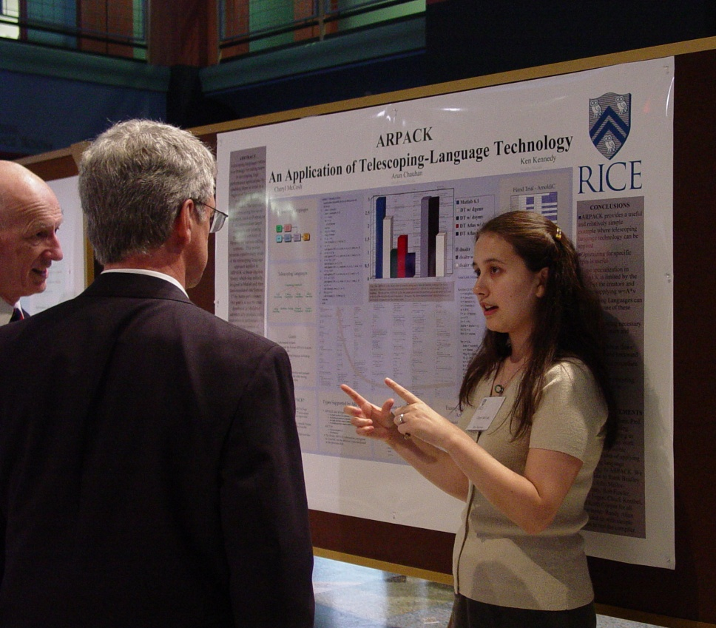
Communicate with Confidence
Stand up straight
Don’t block view of poster
Speak up
Be enthusiastic
Maintain eye contact
Adjust pacing
Integrate gestures

