Slide 1
What did you learn from readings?

Slide 2
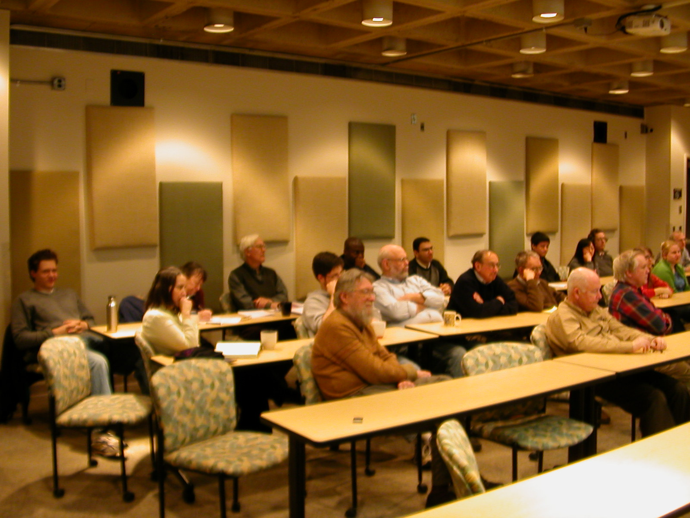
Who is your audience?
Why should your audience care?
What does your audience need to know?

Slide 3
Market yourself.
Current or future bosses and colleagues.

Slide 10
Indices: 25:55, 1:06:00, 1:36:15, 2:09:10

Slide 12
Next class: 3-minute impromptus

