Slide 1
Charts & Tables

Slide 2
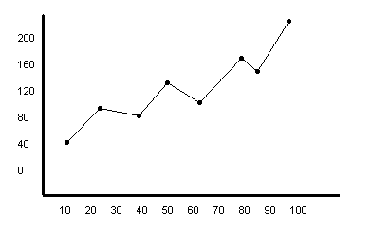
Some Issues
Size
Resolution
Colors
Labels
Units
Chart junk
Continuous vs. discrete data
Significant figures and error bars

Slide 3
Contexts
Formats
Features
Paper
Book
Poster
Presentation
Color
Detail
Labeling
Captions/Headings
Tags

Slide 5
Microbenchmark Performance

Slide 6
Figure 4. Runtimes for each version on each microbenchmark, normalized by the runtime of the original version. The modified classes required at least twice as much time. Optimizing the modified classes only gave a significant benefit on the Loop Method Invocation microbenchmark.

Slide 8
FN Treated Cells
TC Treated Cells
Untreated Cells

Slide 13
1%
2%
0%
13%
0%
1%
1%
1%
17%
8%
3%
2%
13%
2%
0%
1%
4%
2%
2%
0%
12%
9%
2%
2%

Slide 14
More Examples
Figure Bestiary
Common Problems Interpreting and Graphing Data

