Slide 1
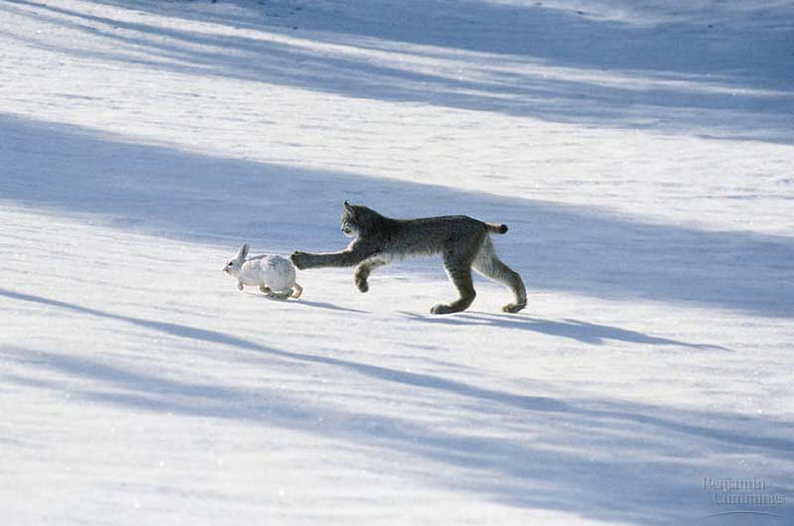
Predicting predator-prey populations
Notes:
Canadian lynx and snowshoe hare.
Arctic implies isolation. Assume no other animals in environment.
Discuss: What factors affect the population?

Slide 2
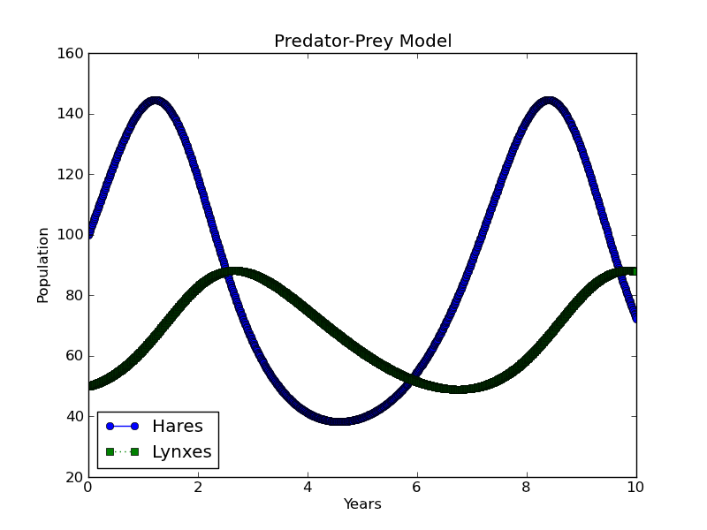
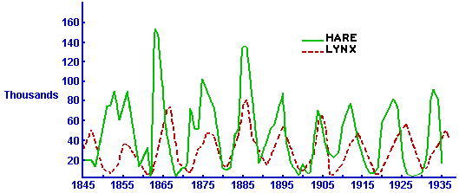
Desired results
Notes:
Predict future populations. Compare to actual data to see if predictions are accurate.
Historical data from Hudson Bay Company.

Slide 3
Here’s an approximation of reality:
The hare birth rate is constant, as their food supply is unlimited. Hares only die when eaten by a lynx, and the number of hares eaten is proportional to how often hares & lynxes meet, i.e., the chance of a lynx catching a hare.
The lynx birth rate is also proportional to how often hares & lynxes meet, i.e., the food available for each lynx family. Lynxes only die from natural causes, and their death rate is constant.
Dr. Siemann, EEB
Lotka & Volterra, 1926
Notes:
How do we solve this problem? Computer scientists don’t necessarily know anything about species populations. Ask a domain expert.
We can’t precisely guess the future, but we can model it.

Slide 4
Computational Thinking
Relevant input
Problem description
Computational goal
Information extraction
Algorithm design
Algorithm implementation
Abstraction
Recipe (Algorithm)
Automation
Answer

Slide 5
Hares’ & Lynxes’ Populations
???
Problem description
Computational goal
Information extraction
Algorithm design
Algorithm implementation
Recipe (Algorithm)
???
Notes:
Discuss: For this specific problem, what are the inputs and outputs?
Inputs: starting populations, various rates of population change, (implicit) how long to model populations
Outputs: all populations

Slide 6
Algorithm Design – Decomposition
Generate population data.
Repeatedly,
Generate next populations of predator & prey.
Display population data.
Notes:
How can we break this overall problem into smaller problems?
Simpler to deal with each part separately.
“Top-down” thinking.

Slide 7
Algorithm Design – Refinement
Store original populations.
Generate population data.
Repeatedly,
Generate next populations of predator & prey.
Store new populations.
Display stored population data.
Notes:
Typically have to refine the algorithm multiple times, adding more detail.

Slide 8
The hare birth rate is constant, as their food supply is unlimited. Hares only die when eaten by a lynx, and the number of hares eaten is proportional to how often hares & lynxes meet, i.e., the chance of a lynx catching a hare.
The lynx birth rate is also proportional to how often hares & lynxes meet, i.e., the food available for each lynx family. Lynxes only die from natural causes, and their death rate is constant.
Hare annual pop. change
$$=h∙\left(hare_birth−hare_predation∙l\right)$$
Lynx annual pop. change
$$=l∙\left(lynx_birth∙h−lynx_death\right)$$
Lotka & Volterra, 1926
Notes:
How do we “generate the next populations”? Directions given in English, but do we understand them?
Want to put these directions in unambiguous, precise form. Math is a good option.

Slide 9
Hare annual pop. change
$$= \frac{Δh}{Δt}=h∙\left(hare_birth−hare_predation∙l\right)$$
.4
.003
Lynx annual pop. change
$$= \frac{Δl}{Δt}=l∙\left(lynx_birth∙h−lynx_death\right)$$
.004
.2
Initially
Year 1
Year 2
Year 3
(Year 0)
# Hares
100
125
152
177
Hares
+
40
50
61
71
born
Hares
-
15
23
36
58
eaten
Rounding all #s.
#
Lynxes
50
60
78
109
Lynxes
10
12
16
22
die
-
Lynxes
+
20
30
47
77
born
Notes:
Do we understand how to use this math? Let’s use these formulas to step through a few years by hand. Our algorithm will be doing the same computations.

Slide 10
Algorithm Design – Refinement
Given $h$, $l$, $hare_birth$, $hare_predation$, $lynx_birth$, $lynx_death$, $years$.
Store $(0, h)$ in $hare_pop$. Store $(0, l)$ in $lynx_pop$.
Repeat for $y=1, …, years$:
Compute $h, l=h+\frac{Δh}{Δt}, l+\frac{Δl}{Δt}$
Add $(y,h)$ to end of $hare_pop$. Add $\left(y, l\right)$ to end of $lynx_pop$.
Plot $hare_pop$ and $lynx_pop$.
Notes:
Core of the algorithm.
Next week: Python for implementing this. Loops, lists, and plotting.

Slide 11
Suggested Readings
Predator-prey models
Lotka-Volterra equation
Wolves & Moose of Isle Royale
Esp. the Data section
A technical paper about population cycles
Notes:
Lotka-Volterra models are also used in economics, but I can’t find any readings for a general audience.

