Slide 1
Cache Memories COMP 222: Introduction to Computer Organization
Carnegie Mellon
Instructor:
Alan L. Cox

Slide 2
Cache Memories
Cache memory organization and operation
Performance impact of caches
The memory mountain
Rearranging loops to improve spatial locality
Using blocking to improve temporal locality

Slide 3
Recall: General Cache Concepts
Smaller, faster, more expensive
memory caches a subset of
the blocks
Cache
8
4
9
14
3
Data is copied in block-sized transfer units
4
Larger, slower, cheaper memory
viewed as partitioned into “blocks”
Memory
0
1
2
3
4
4
5
6
7
8
9
10
11
12
13
14
15

Slide 4
General Cache Concepts: Hit
Request: 14
Data in block b is needed
Block b is in cache:
Hit!
Cache
8
9
14
3
14
Memory
0
1
2
3
4
5
6
7
8
9
10
11
12
13
14
15

Slide 5
General Cache Concepts: Miss
Request: 12
Data in block b is needed
Block b is not in cache:
Miss!
Cache
8
12
9
14
3
Block b is fetched from
memory
12
Request: 12
Block b is stored in cache
Placement policy: determines where b goes
Replacement policy: determines which block gets evicted (victim)
Memory
0
1
2
3
4
5
6
7
8
9
10
11
12
12
13
14
15

Slide 6
Working Set, Locality, and Caches
Working Set: The set of data a program is currently “working on”
Definition of “currently” depends on context, e.g., in this loop
Includes accesses to data and instructions
Principle of Locality: Programs tend to use data and instructions with addresses near or equal to those they have used recently
Nearby addresses: Spatial Locality
Equal addresses: Temporal locality
Caches take advantage of temporal locality by storing recently used data, and spatial locality by copying data in block-sized transfer units
Locality reduces working set sizes
Caches are most effective when the working set fits in the cache

Slide 7
CPU Caches
CPU caches are small, fast (usually SRAM) storage managed automatically by hardware
Hold frequently accessed blocks of main memory
CPU looks first for data in cache
Typical system structure:
CPU chip
Register file
ALU
Cache
memory
Memory bus
Main
memory
Memory controller

Slide 8
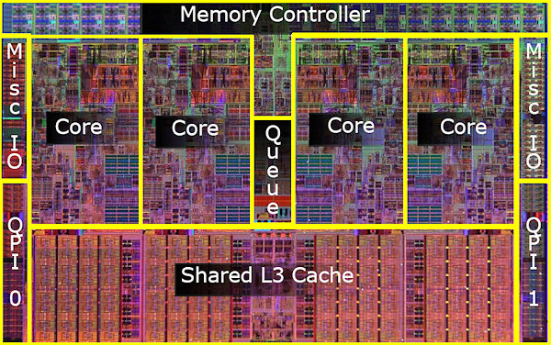
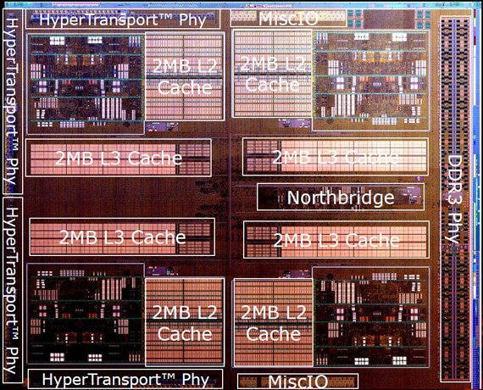
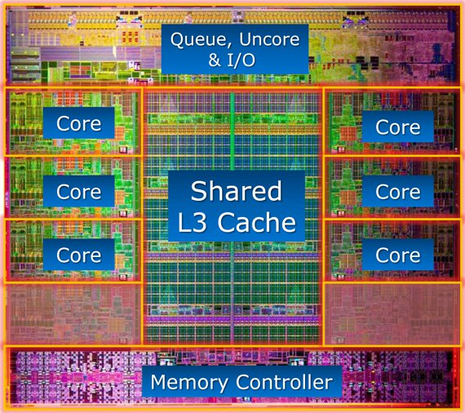
What it Really Looks Like
CPU chip
Register file
ALU
Cache
memory
Memory controller
Nehalem
AMD FX 8150
Core i7-3960X

Slide 9
Set-Associative Cache Organization (S, E, B)
E = 2e lines per set
set
line
S = 2^{s} sets
Cache size
= S x E x B data bytes
v
tag
0
1
2
B-1
valid bit
B = 2^{b} bytes per cache block (the data)

Slide 10
Cache Read
Locate set
Check if any line in set has matching tag
Yes + line valid: hit
Locate data starting at offset
E = 2e lines per set
Address of word:
t bits
s bits
b bits
S = 2^{s} sets
tag
set
index
block
offset
data begins at this offset
v
tag
0
1
2
B-1
valid bit
B = 2^{b} bytes per cache block (the data)

Slide 11
Example: Direct Mapped Cache (E = 1)
Direct mapped: One line per set
Assume: cache block size B=8 bytes
Address of int:
v
tag
0
1
2
3
4
5
6
7
t bits
0…01
100
v
tag
0
1
2
3
4
5
6
7
find set
S = 2^{s} sets
v
tag
0
1
2
3
4
5
6
7
v
tag
0
1
2
3
4
5
6
7

Slide 12
Example: Direct Mapped Cache (E = 1)
Direct mapped: One line per set
Assume: cache block size B=8 bytes
Address of int:
valid? +
match: assume yes (= hit)
t bits
0…01
100
v
tag
0
1
2
3
4
5
6
7
tag
block offset

Slide 13
Example: Direct Mapped Cache (E = 1)
Direct mapped: One line per set
Assume: cache block size B=8 bytes
Address of int:
valid? +
match: assume yes (= hit)
t bits
0…01
100
v
tag
0
1
2
3
4
5
6
7
block offset
int (4 Bytes) is here
If tag doesn’t match (= miss): old line is evicted and replaced

Slide 14
Direct-Mapped Cache Simulation
t=1
s=2
b=1
4-bit addresses (address space size M=16 bytes)
S=4 sets, E=1 Blocks/set, B=2 bytes/block
Address trace (reads, one byte per read):
0 [0000₂],
1 [0001₂],
7 [0111₂],
8 [1000₂],
0 [0000₂]
x
xx
x
miss
(cold)
hit
miss
(cold)
miss
(cold)
miss
(conflict)
v
Tag
Block
Set 0
1
0
M[0-1]
0
0
M[0-1]
1
1
M[8-9]
Set 1
0
Set 2
0
Set 3
1
0
M[6-7]
0
Notes:
Pause at the end of this slide to consider that M[0] and M[8] have nothing to do with one another, but that they interfere with one anothers’ existences in the cache.

Slide 15
E-way Set-Associative Cache (Here: E = 2)
E = 2: Two lines per set
Assume: cache block size B=8 bytes
Address of short int:
2 lines per set
t bits
0…01
100
v
tag
0
1
2
3
4
5
6
7
v
tag
0
1
2
3
4
5
6
7
v
tag
0
1
2
3
4
5
6
7
v
tag
0
1
2
3
4
5
6
7
find set
v
tag
0
1
2
3
4
5
6
7
v
tag
0
1
2
3
4
5
6
7
v
tag
0
1
2
3
4
5
6
7
v
tag
0
1
2
3
4
5
6
7
S sets

Slide 16
E-way Set Associative Cache (Here: E = 2)
E = 2: Two lines per set
Assume: cache block size B=8 bytes
Address of short int:
compare both
t bits
0…01
100
valid? +
match: yes (= hit)
v
tag
0
1
2
3
4
5
6
7
tag
v
tag
0
1
2
3
4
5
6
7
block offset

Slide 17
E-way Set Associative Cache (Here: E = 2)
E = 2: Two lines per set
Assume: cache block size B=8 bytes
Address of short int:
compare both
t bits
0…01
100
valid? +
match: yes (= hit)
v
tag
0
1
2
3
4
4
5
tag
5
6
7
v
tag
0
1
2
3
4
5
6
7
block offset
short int (2 Bytes) is here
No match or not valid (= miss):
One line in set is selected for eviction and replacement
Replacement policies: random, least recently used (LRU), …

Slide 18
2-Way Set Associative Cache Simulation
t=2
s=1
b=1
xx
x
x
4-bit addresses (M=16 bytes)
S=2 sets, E=2 blocks/set, B=2 bytes/block
Address trace (reads, one byte per read):
0 [0000₂],
1 [0001₂],
7 [0111₂],
8 [1000₂],
0 [0000₂]
miss
hit
miss
miss
hit
v
Tag
Block
1
00
M[0-1]
Set 0
0
1
10
M[8-9]
0
1
01
M[6-7]
Set 1
0
0

Slide 19
What about writes?
Multiple copies of data exist:
L1, L2, L3, Main Memory, Disk
What to do on a write-hit?
Write-through (write immediately to memory)
Write-back (defer write to memory until replacement of line)
Each cache line needs a dirty bit (set if data has been written to)
What to do on a write-miss?
Write-allocate (load into cache, update line in cache)
Good if more writes to the location will follow
No-write-allocate (writes straight to memory, does not load into cache)
Typical
Write-through + No-write-allocate
Write-back + Write-allocate
v
d
tag
0
1
2
B-1
valid bit
dirty bit
B = 2^{b} bytes

Slide 20
Practical Write-back Write-allocate
v
d
tag
0
1
2
B-1
A write to address X is issued
If it is a hit
Update the contents of block
Set dirty bit to 1 (bit is sticky and only cleared on eviction)
If it is a miss
Fetch block from memory (per a read miss)
Then perform the write operations (per a write hit)
If a line is evicted and dirty bit is set to 1
The entire block of 2^{b} bytes are written back to memory
Dirty bit is cleared (set to 0)
Line is replaced by new contents
valid bit
dirty bit
B = 2^{b} bytes

Slide 21
Why Index Using Middle Bits?
Direct mapped: One line per set
Assume: cache block size 8 bytes
Standard Method:
Middle bits indexing
Address of int:
v
tag
0
1
2
3
4
5
6
7
t bits
0…01
100
v
tag
0
1
2
3
4
5
6
7
find set
S = 2^{s} sets
v
tag
0
1
2
3
4
5
6
7
Alternative Method:
High bits indexing
Address of int:
v
tag
0
1
2
3
4
5
6
7
1…11
t bits
100
find set

Slide 22
Illustration of Indexing Approaches
0000xx
0001xx
0010xx
64-byte memory
6-bit addresses
16-byte direct-mapped cache
Block size = 4. (Thus, 4 sets; why?)
2 bits tag, 2 bits index, 2 bits offset
0011xx
0100xx
0101xx
0110xx
0111xx
1000xx
1001xx
Set 0
1010xx
Set 1
1011xx
Set 2
1100xx
Set 3
1101xx
1110xx
1111xx
Notes:
16byte direct mapped $, 4B blocks -> must be 4 sets to account for all 16B of cache

Slide 23
Middle Bits Indexing
0000xx
0001xx
0010xx
Addresses of form TTSSBB
TT Tag bits
SS Set index bits
BB Offset bits
Makes good use of spatial locality
0011xx
0100xx
0101xx
0110xx
0111xx
1000xx
1001xx
Set 0
1010xx
Set 1
1011xx
Set 2
1100xx
Set 3
1101xx
1110xx
1111xx

Slide 24
High Bits Indexing
0000xx
0001xx
0010xx
Addresses of form SSTTBB
SS Set index bits
TT Tag bits
BB Offset bits
Program with high spatial locality would generate lots of conflicts
0011xx
0100xx
0101xx
0110xx
0111xx
1000xx
1001xx
Set 0
1010xx
Set 1
1011xx
Set 2
1100xx
Set 3
1101xx
1110xx
1111xx
Notes:
Go from block with set index bits 00 to 01, displace the line sitting in set 0 from the block with set index 00.

Slide 25
Intel Core i7 Cache Hierarchy
Processor package
Core 0
Core 3
L1 i-cache and d-cache:
32 KB, 8-way,
Access: 4 cycles
L2 unified cache:
256 KB, 8-way,
Access: 10 cycles
L3 unified cache:
8 MB, 16-way,
Access: 40-75 cycles
Block size: 64 bytes for all caches.
Regs
Regs
L1
d-cache
L1
i-cache
L1
d-cache
L1
i-cache
…
L2 unified cache
L2 unified cache
L3 unified cache
(shared by all cores)
Main memory

Slide 26
Cache Performance Metrics
Miss Ratio
Fraction of memory references not found in cache (misses / accesses) = 1 – hit ratio
Typical numbers (in percentages):
<1% to 10% for L1
can be quite small (e.g., < 1%) for L2, depending on size, etc.
“Miss rate”: misses per unit time = miss ratio x access rate
Hit Time
Time to deliver a line in the cache to the processor
includes time to determine whether the line is in the cache
Typical numbers:
4+ clock cycles for L1
10+ clock cycles for L2
Miss Penalty
Additional time required because of a miss
typically 50-200 cycles for main memory (Trend: increasing!)

Slide 27
Let’s think about those numbers
Huge difference between a hit and a miss
Could be 100x, if just L1 and main memory
Would you believe 99% hits is twice as good as 97%?
Consider this simplified example: cache hit time of 1 cycle miss penalty of 100 cycles
Average access time:
97% hits: 1 cycle + 0.03 x 100 cycles = 4 cycles
99% hits: 1 cycle + 0.01 x 100 cycles = 2 cycles
This is why “miss rate” is used instead of “hit rate”

Slide 28
Writing Cache Friendly Code
Make the common case go fast
Focus on the inner loops of the core functions
Minimize the misses in the inner loops
Repeated references to variables are good (temporal locality)
Stride-1 reference patterns are good (spatial locality)
Key idea: Our qualitative notion of locality is quantified through our understanding of cache memories

Slide 29
Cache Memories
Cache organization and operation
Performance impact of caches
The memory mountain
Rearranging loops to improve spatial locality
Using blocking to improve temporal locality

Slide 30
The Memory Mountain
Read throughput (read bandwidth)
Number of bytes read from memory per second (MB/s)
Memory mountain: Measured read throughput as a function of spatial and temporal locality.
Compact way to characterize memory system performance.

Slide 31
Memory Mountain Test Function
long data[MAXELEMS]; /* Global array to traverse */
/* test - Iterate over first "elems" elements of
* array "data" with stride of "stride“,
* using 4x4 loop unrolling.
*/
int test(int elems, int stride) {
long i, sx2=stride*2, sx3=stride*3, sx4=stride*4;
long acc0 = 0, acc1 = 0, acc2 = 0, acc3 = 0;
long length = elems, limit = length - sx4;
/* Combine 4 elements at a time */
for (i = 0; i < limit; i += sx4) {
acc0 = acc0 + data[i];
acc1 = acc1 + data[i+stride];
acc2 = acc2 + data[i+sx2];
acc3 = acc3 + data[i+sx3];
}
/* Finish any remaining elements */
for (; i < length; i++) {
acc0 = acc0 + data[i];
}
return ((acc0 + acc1) + (acc2 + acc3));
}
Call test() with many combinations of elems
and stride.
For each elems and stride:
1. Call test() once to warm up the caches.
2. Call test() again and measure the read throughput(MB/s)
mountain/mountain.c

Slide 32
The Memory Mountain
Core i7 Haswell
2.1 GHz
32 KB L1 d-cache
256 KB L2 cache
8 MB L3 cache
64 B block size
Aggressive prefetching
L1
Ridges
of temporal locality
L2
L3
Slopes
of spatial locality
Mem
Notes:
Slopes of spatial locality – increase stride, degrade throughput because burn through blocks faster
Ridges of temporal – if after warm up, whole dataset in cache, every thing’s a hit.
Prefetching – do better than we expect.

Slide 33
Closer Look at Stride Effects
128K
Miss ratio = stride/8
Miss ratio = 1.0
8 elems per cache block
stride

Slide 34
Cache Memories
Cache organization and operation
Performance impact of caches
The memory mountain
Rearranging loops to improve spatial locality
Using blocking to improve temporal locality

Slide 35
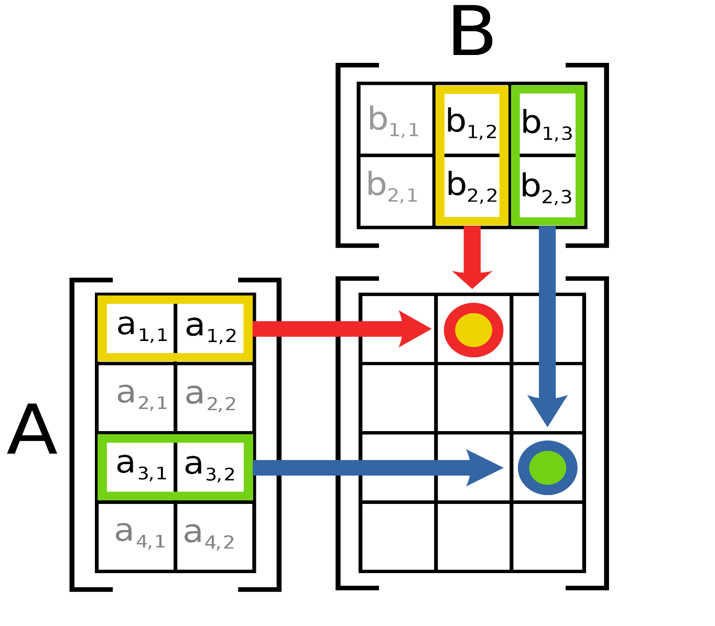
Remember matrix multiplication
Out[i, j] = dot product(A[i, ..], B[..,j])
= sum(a[i, 0] * b[0, j],
a[i, 1] * b[1, j],
…
a[i, n] * b[n, j])
Notes:
Matrix Multiplication image from Wikimedia, attribution: By File:Matrix multiplication diagram.svg:User:BilouSee below. - This file was derived from: Matrix multiplication diagram.svg, CC BY-SA 3.0, https://commons.wikimedia.org/w/index.php?curid=15175268

Slide 36
Matrix Multiplication Example
Description:
Multiply N x N matrices
Matrix elements are doubles (8 bytes)
O(N³) total operations
N reads per source element
N values summed per destination
but may be able to hold in register
Variable sum
held in register
/* ijk */
for (i=0; i<n; i++) {
for (j=0; j<n; j++) {
sum = 0.0;
for (k=0; k<n; k++)
sum += a[i][k] * b[k][j];
c[i][j] = sum;
}
}
matmult/mm.c

Slide 37
Miss Rate Analysis for Matrix Multiply
Assume:
Block size = 32B (big enough for four doubles)
Matrix dimension (N) is very large
Approximate 1/N as 0.0
Cache is not even big enough to hold multiple rows
Analysis Method:
Look at access pattern of inner loop
j
k
j
=
x
i
i
k
C
A
B

Slide 38
Layout of C Arrays in Memory (review)
C arrays allocated in row-major order
each row in contiguous memory locations
a[i][j] = a[i*N + j] where N is the number of columns
Stepping through columns in one row:
for (i = 0; i < N; i++)
sum += a[0][i];
accesses successive elements
if block size (B) > sizeof(a_{ij}) bytes, exploit spatial locality
miss ratio = sizeof(a_{ij}) / B
Stepping through rows in one column:
for (i = 0; i < n; i++)
sum += a[i][0];
accesses distant elements: no spatial locality!
miss ratio = 1 (i.e. 100%)

Slide 39
Matrix Multiplication (ijk)
/* ijk */
for (i=0; i<n; i++) {
for (j=0; j<n; j++) {
sum = 0.0;
for (k=0; k<n; k++)
sum += a[i][k] * b[k][j];
c[i][j] = sum;
}
}
Inner loop:
(*,j)
(i,j)
(i,*)
A
B
C
matmult/mm.c
Row-wise
Column-
wise
Fixed
Miss rate for inner loop iterations:
A B C
Block size = 32B (four doubles)

Slide 40
Matrix Multiplication (ijk)
/* ijk */
for (i=0; i<n; i++) {
for (j=0; j<n; j++) {
sum = 0.0;
for (k=0; k<n; k++)
sum += a[i][k] * b[k][j];
c[i][j] = sum;
}
}
Inner loop:
(*,j)
(i,j)
(i,*)
A
B
C
matmult/mm.c
Row-wise
Column-
wise
Fixed
Miss rate for inner loop iterations:
A B C
0.25 1.0 0.0
Block size = 32B (four doubles)

Slide 41
Matrix Multiplication (kij)
/* kij */
for (k=0; k<n; k++) {
for (i=0; i<n; i++) {
r = a[i][k];
for (j=0; j<n; j++)
c[i][j] += r * b[k][j];
}
}
Inner loop:
(i,k)
(k,*)
(i,*)
A
B
C
matmult/mm.c
Fixed
Row-wise
Row-wise
Miss rate for inner loop iterations:
A B C
Block size = 32B (four doubles)

Slide 42
Matrix Multiplication (kij)
/* kij */
for (k=0; k<n; k++) {
for (i=0; i<n; i++) {
r = a[i][k];
for (j=0; j<n; j++)
c[i][j] += r * b[k][j];
}
}
Inner loop:
(i,k)
(k,*)
(i,*)
A
B
C
matmult/mm.c
Fixed
Row-wise
Row-wise
Miss rate for inner loop iterations:
A B C
0.0 0.25 0.25
Block size = 32B (four doubles)

Slide 43
Matrix Multiplication (jki)
Inner loop:
/* jki */
for (j=0; j<n; j++) {
for (k=0; k<n; k++) {
r = b[k][j];
for (i=0; i<n; i++)
c[i][j] += a[i][k] * r;
}
}
(*,k)
(*,j)
(k,j)
A
B
C
matmult/mm.c
Column-
wise
Fixed
Column-
wise
Miss rate for inner loop iterations:
A B C
Block size = 32B (four doubles)

Slide 44
Matrix Multiplication (jki)
Inner loop:
/* jki */
for (j=0; j<n; j++) {
for (k=0; k<n; k++) {
r = b[k][j];
for (i=0; i<n; i++)
c[i][j] += a[i][k] * r;
}
}
(*,k)
(*,j)
(k,j)
A
B
C
matmult/mm.c
Column-
wise
Fixed
Column-
wise
Miss rate for inner loop iterations:
A B C
1.0 0.0 1.0
Block size = 32B (four doubles)

Slide 45
Summary of Matrix Multiplication
for (i=0; i<n; i++) {
for (j=0; j<n; j++) {
sum = 0.0;
for (k=0; k<n; k++)
sum += a[i][k] * b[k][j];
c[i][j] = sum;
}
}
ijk (& jik):
2 loads, 0 stores
avg misses/iter = 1.25
for (k=0; k<n; k++) {
for (i=0; i<n; i++) {
r = a[i][k];
for (j=0; j<n; j++)
c[i][j] += r * b[k][j];
}
}
kij (& ikj):
2 loads, 1 store
avg misses/iter = 0.5
for (j=0; j<n; j++) {
for (k=0; k<n; k++) {
r = b[k][j];
for (i=0; i<n; i++)
c[i][j] += a[i][k] * r;
}
}
jki (& kji):
2 loads, 1 store
avg misses/iter = 2.0

Slide 46
Core i7 Matrix Multiply Performance
Cycles per inner loop iteration
jki / kji (2.0)
ijk / jik (1.25)
kij / ikj (0.5)

Slide 47
Cache Memories
Cache organization and operation
Performance impact of caches
The memory mountain
Rearranging loops to improve spatial locality
Using blocking to improve temporal locality

Slide 48
Example: Matrix Multiplication
double *c = calloc(sizeof(double), n*n);
/* Multiply n x n matrices a and b */
void mmm(double *a, double *b, double *c, int n)
{
for (int i = 0; i < n; i++)
for (int j = 0; j < n; j++)
for (int k = 0; k < n; k++)
c[i*n + j] += a[i*n + k] * b[k*n + j];
}
j
c
a
b
=
x
i

Slide 49
Cache Miss Analysis
Assume:
Matrix elements are doubles
Cache block = 8 doubles
Cache size C << n (much smaller than n)
First iteration:
n/8 + n = 9n/8 misses
Afterwards in cache: (schematic)
n
=
x
=
x
8 wide
Notes:
n/8 – comes from taking n and doing it in chunks of 8 tha fit in a cache line, with perfect stride 1 accesses.
N – comes from missing on everything but the 1 double needed going down a column

Slide 50
Cache Miss Analysis
Assume:
Matrix elements are doubles
Cache block = 8 doubles
Cache size C << n (much smaller than n)
Second iteration:
Again: n/8 + n = 9n/8 misses
Total misses:
9n/8 n² = (9/8) n³
n
=
x
8 wide

Slide 51
Blocked Matrix Multiplication
double *c = calloc(sizeof(double), n*n);
/* Multiply n x n matrices a and b */
void mmm(double *a, double *b, double *c, int n)
{
for (int i = 0; i < n; i += B)
for (int j = 0; j < n; j += B)
for (int k = 0; k < n; k += B)
/* B x B mini matrix multiplications */
for (int i1 = i; i1 < i+B; i1++)
for (int j1 = j; j1 < j+B; j1++)
for (int k1 = k; k1 < k+B; k1++)
c[i1*n + j1] += a[i1*n + k1] * b[k1*n + j1];
}
matmult/bmm.c
j1
c
a
b
c
=
x
+
i1
Block size B x B

Slide 52
Cache Miss Analysis
Assume:
Cache block = 8 doubles
Cache size C << n (much smaller than n)
Three blocks fit into cache: 3B² < C
First (block) iteration:
B*B/8 misses for each block
2n/B x B²/8 = nB/4 (omitting matrix c)
Afterwards in cache (schematic)
n/B blocks
=
x
Block size B x B
=
x
Notes:
2n/B comes from doing n/B blocks of size B^2 in each source matrix
B^2 / 8 comes from taking B^2 bytes per block and perfectly caching them 8 doubles at a time.

Slide 53
Cache Miss Analysis
Assume:
Cache block = 8 doubles
Cache size C << n (much smaller than n)
Three blocks fit into cache: 3B² < C
Second (block) iteration:
Same as first iteration
2n/B x B²/8 = nB/4
Total misses:
nB/4 * (n/B)² = n³/(4B)
n/B blocks
=
x
Block size B x B
Notes:
n/B is the dimension of the matrix in blocks. (n/B)^2 is the number of iterations. nB/4 is the misses per iteration. N^3/4B is the total miss count.

Slide 54
Blocking Summary
No blocking: (9/8) n³ misses
Blocking: (1/(4B)) n³ misses
Use largest block size B, such that B satisfies 3B² < C
Fit three blocks in cache! Two input, one output.
Reason for dramatic difference:
Matrix multiplication has inherent temporal locality:
Input data: 3n², computation 2n³
Every array elements used O(n) times!
But program has to be written properly
Notes:
3B^2 to accommodate M3 = M1 x M2, with M1,2,3 all supplying blocks of dim B^2

Slide 55
Cache Summary
Cache memories can have significant performance impact
You can write your programs to exploit this!
Focus on the inner loops, where bulk of computations and memory accesses occur.
Try to maximize spatial locality by reading data objects sequentially with stride 1.
Try to maximize temporal locality by using a data object as often as possible once it’s read from memory.

