Slide 1
Virtual Memory (VM)
Address spaces
VM as a tool for caching
VM as a tool for memory management
VM as a tool for memory protection
Address translation
Simple memory system example

Slide 2
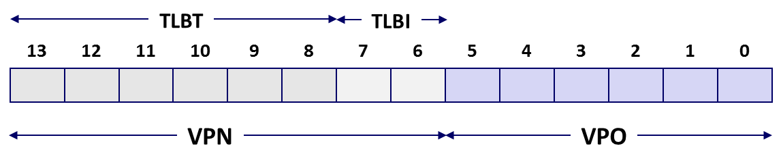
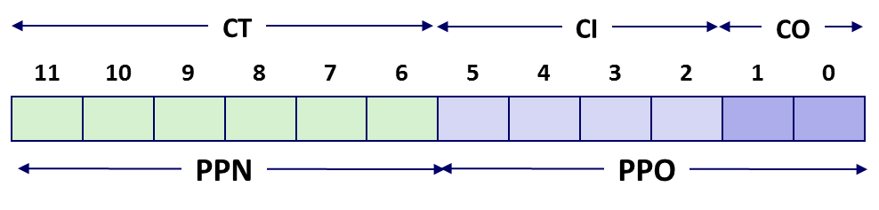

Conceptual Question
How does virtual memory interact with the CPU cache(s)?
The cache’s function is to speed up access to whatever data is most frequently used. The MMU sits “in between” the CPU and the cache; the cache works only with physical addresses. This means data from multiple processes may coexist in the cache (or compete for cache space).
1. MMU uses VA to find PTE & get PA
2. PA is used to look in cache for data

Slide 3
Simple Memory System Example
Addressing
  14-bit virtual addresses
  12-bit physical address
  Page size = 64 bytes
Why is the
VPO 6 bits?
Why is the
PPO 6 bits?
Why is the
VPN 8 bits?
Why is the
PPN 6 bits?
13
12
11
10
9
8
7
6
5
4
3
2
1
0
VPN
VPO
Virtual Page Number
Virtual Page Offset
11
10
9
8
7
6
5
4
3
2
1
0
PPN
PPO
Physical Page Number
Physical Page Offset
Notes:
Understanding these Why questions will be relevant for today’s quiz.

Slide 4
Simple Memory System TLB
16 entries
4-way associative
TLBT
TLBI
13
12
11
10
9
8
7
6
5
4
3
2
1
0
0
0
0
0
1
1
0
1
VPN
VPO
VPN = 0b1101 = 0x0D
Translation Lookaside Buffer (TLB)
Set
Tag
PPN
Valid
Tag
PPN
Valid
Tag
PPN
Valid
Tag
PPN
Valid
Set
Tag
PPN
Valid
Tag
PPN
Valid
Tag
PPN
Valid
Tag
PPN
Valid
0
03
–
0
09
0D
1
00
–
0
07
02
1
0
03
–
0
09
0D
1
00
–
0
07
02
1
1
03
2D
1
02
–
0
04
–
0
0A
–
0
1
03
2D
1
02
–
0
04
–
0
0A
–
0
2
02
–
0
08
–
0
06
–
0
03
–
0
2
02
–
0
08
–
0
06
–
0
03
–
0
3
07
–
0
03
0D
1
0A
34
1
02
–
0
3
07
–
0
03
0D
1
0A
34
1
02
–
0

Slide 5
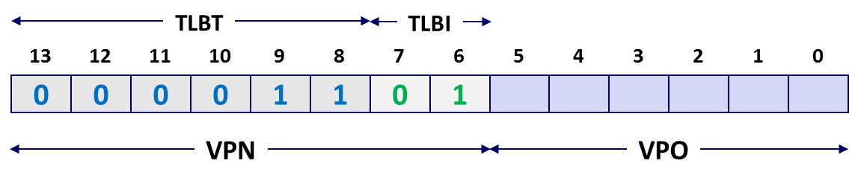
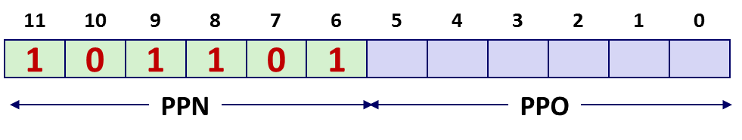
Simple Memory System Page Table
Only showing the first 16 entries (out of 256)
VPN
PPN
Valid
VPN
PPN
Valid
00
28
1
08
13
1
01
–
0
09
17
1
02
33
1
0A
09
1
03
02
1
0B
–
0
04
–
0
0C
–
0
05
16
1
0D
2D
1
0x0D → 0x2D
06
–
0
0E
11
1
07
–
0
0F
0D
1

Slide 6
Simple Memory System Cache
16 lines, 4-byte cache line size
Physically addressed
Direct mapped
V[0b00001101101001] = V[0x369]
P[0b101101101001] = P[0xB69] = 0x15
CT
CI
CO
11
10
9
8
7
6
5
4
3
2
1
0
1
0
1
1
0
1
1
0
1
0
0
1
PPN
PPO
Idx
Tag
Valid
B0
B1
B2
B3
Idx
Tag
Valid
B0
B1
B2
B3
Idx
Tag
Valid
B0
B1
B2
B3
Idx
Tag
Valid
B0
B1
B2
B3
0
19
1
99
11
23
11
8
24
1
3A
00
51
89
0
19
1
99
11
23
11
8
24
1
3A
00
51
89
1
15
0
–
–
–
–
9
2D
0
–
–
–
–
1
15
0
–
–
–
–
9
2D
0
–
–
–
–
2
1B
1
00
02
04
08
A
2D
1
93
15
DA
3B
2
1B
1
00
02
04
08
A
2D
1
93
15
DA
3B
3
36
0
–
–
–
–
B
0B
0
–
–
–
–
3
36
0
–
–
–
–
B
0B
0
–
–
–
–
4
32
1
43
6D
8F
09
C
12
0
–
–
–
–
4
32
1
43
6D
8F
09
C
12
0
–
–
–
–
5
0D
1
36
72
F0
1D
D
16
1
04
96
34
15
5
0D
1
36
72
F0
1D
D
16
1
04
96
34
15
6
31
0
–
–
–
–
E
13
1
83
77
1B
D3
6
31
0
–
–
–
–
E
13
1
83
77
1B
D3
7
16
1
11
C2
DF
03
F
14
0
–
–
–
–
7
16
1
11
C2
DF
03
F
14
0
–
–
–
–
Notes:
Click to reveal PPO. Then run through lookup that retrieves 0x15 before clicking again to reveal the answer.

Slide 7
Address Translation Example
Virtual Address: 0x03D4
  VPN ___ TLBI ___ TLBT ____ TLB Hit? __ Page Fault? __ PPN: ____
Physical Address
  CO ___ CI___ CT ____ Hit? __ Byte: ____
TLBT
TLBI
13
12
11
10
9
8
7
6
5
4
3
2
1
0
0
0
0
0
1
1
1
1
0
1
0
1
0
0
VPN
VPO
0x0F
0x3
0x03
Y
N
0x0D
TLB
Set
Tag
PPN
Valid
Tag
PPN
Valid
Tag
PPN
Valid
Tag
PPN
Valid
0
03
–
0
09
0D
1
00
–
0
07
02
1
1
03
2D
1
02
–
0
04
–
0
0A
–
0
2
02
–
0
08
–
0
06
–
0
03
–
0
3
07
–
0
03
0D
1
0A
34
1
02
–
0
03
0D
1
11
10
9
8
7
6
5
4
3
2
1
0
0
0
1
1
0
1
0
1
0
1
0
0
PPN
PPO

Slide 8
Address Translation Example
Physical Address
  CO ___ CI___ CT ____ Hit? __ Byte: ____
CT
CI
CO
11
10
9
8
7
6
5
4
3
2
1
0
0
0
1
1
0
1
0
1
0
1
0
0
PPN
PPO
0
0x5
0x0D
Y
0x36
Cache
Idx
Tag
Valid
B0
B1
B2
B3
Idx
Tag
Valid
B0
B1
B2
B3
0
19
1
99
11
23
11
8
24
1
3A
00
51
89
1
15
0
–
–
–
–
9
2D
0
–
–
–
–
2
1B
1
00
02
04
08
A
2D
1
93
15
DA
3B
3
36
0
–
–
–
–
B
0B
0
–
–
–
–
4
32
1
43
6D
8F
09
C
12
0
–
–
–
–
5
0D
1
36
72
F0
1D
D
16
1
04
96
34
15
6
31
0
–
–
–
–
E
13
1
83
77
1B
D3
7
16
1
11
C2
DF
03
F
14
0
–
–
–
–

Slide 9
Address Translation Example: TLB/Cache Miss
Virtual Address: 0x0020
  VPN ___ TLBI ___ TLBT ____ TLB Hit? __ Page Fault? __ PPN: ____
Physical Address
  CO___ CI___ CT ____ Hit? __ Byte: ____
TLBT
TLBI
13
12
11
10
9
8
7
6
5
4
3
2
1
0
0
0
0
0
0
0
0
0
1
0
0
0
0
0
VPN
VPO
0x00
0
0x00
N
N
0x28
Page table
VPN
PPN
Valid
CT
CI
CO
00
28
1
11
10
9
8
7
6
5
4
3
2
1
0
01
–
0
1
0
1
0
0
0
1
0
0
0
0
0
02
33
1
03
02
1
PPN
PPO
04
–
0
0
0x8
0x28
05
16
1
06
–
0
07
–
0
Notes:
We are not showing the TLB on the slide, but by assumption it’s a TLB miss, so we need to look at the Page Table for the translation.

Slide 10
Address Translation Example: TLB/Cache Miss
Cache
Physical Address
  CO___ CI___ CT ____ Hit? __ Byte: ____
Idx
Tag
Valid
B0
B1
B2
B3
Idx
Tag
Valid
B0
B1
B2
B3
0
19
1
99
11
23
11
8
24
1
3A
00
51
89
1
15
0
–
–
–
–
9
2D
0
–
–
–
–
2
1B
1
00
02
04
08
A
2D
1
93
15
DA
3B
3
36
0
–
–
–
–
B
0B
0
–
–
–
–
4
32
1
43
6D
8F
09
C
12
0
–
–
–
–
5
0D
1
36
72
F0
1D
D
16
1
04
96
34
15
6
31
0
–
–
–
–
E
13
1
83
77
1B
D3
7
16
1
11
C2
DF
03
F
14
0
–
–
–
–
CT
CI
CO
11
10
9
8
7
6
5
4
3
2
1
0
1
0
1
0
0
0
1
0
0
0
0
0
PPN
PPO
0
0x8
0x28
N
Mem

Slide 11
Summary
Programmer’s view of virtual memory
  Each process has its own private linear address space
  Cannot be corrupted by other processes
System view of virtual memory
  Uses memory efficiently by caching virtual memory pages
    Efficient only because of locality
  Simplifies memory management and programming
  Simplifies protection by providing a convenient interpositioning point to check permissions
Implemented via combination of hardware & software
  MMU, TLB, exception handling mechanisms part of hardware
  Page fault handlers, TLB management performed in software

Slide 12
Y86-64 Processor Architecture:
Logic Design
COMP 222: Introduction to Computer Organization
Carnegie Mellon
Instructor:
Alan L. Cox

Slide 13
Overview of Logic Design
Fundamental Hardware Requirements
  Communication
    How to get values from one place to another
  Computation
  Storage
Bits are Our Friends
  Everything expressed in terms of values 0 and 1
  Communication
    Low or high voltage on wire
  Computation
    Compute Boolean functions
  Storage
    Store bits of information

Slide 14
Digital Signals
0
1
0
Voltage
Time
  Use voltage thresholds to extract discrete values from continuous signal
  Simplest version: 1-bit signal
    Either high range (1) or low range (0)
    With guard range between them
  Not strongly affected by noise or low quality circuit elements
    Can make circuits simple, small, and fast

Slide 15
Computing with Logic Gates
  Outputs are Boolean functions of inputs
  Respond continuously to changes in inputs
    With some, small delay
Rising Delay
Falling Delay
a && b
b
Voltage
a
Time

Slide 16
Combinational Circuits
Acyclic Network
Primary
Inputs
Primary
Outputs
Acyclic Network of Logic Gates
  Continously responds to changes on primary inputs
  Primary outputs become (after some delay) Boolean functions of primary inputs

Slide 17
Bit Equality
Bit equal
a
HCL Expression
eq
bool eq = (a&&b)||(!a&&!b)
b
  Generate 1 if a and b are equal
Hardware Control Language (HCL)
  Very simple hardware description language
    Boolean operations have syntax similar to C logical operations
  We’ll use it to describe control logic for processors

Slide 18
Word Equality
Word-Level Representation
b₆₃
Bit equal
eq₆₃
B
=
Eq
a₆₃
b₆₂
Bit equal
eq₆₂
A
a₆₂
HCL Representation
Eq
bool Eq = (A == B)
b₁
Bit equal
eq₁
a₁
  64-bit word size
  HCL representation
    Equality operation
    Generates Boolean value
b₀
Bit equal
eq₀
a₀

Slide 19
Bit-Level Multiplexor
s
Bit MUX
HCL Expression
bool out = (s&&a)||(!s&&b)
b
out
a
  Control signal s
  Data signals a and b
  Output a when s=1, b when s=0

Slide 20
Word Multiplexor
s
Word-Level Representation
s
B
MUX
b₆₃
Out
out₆₃
A
a₆₃
HCL Representation
b₆₂
int Out = [
s : A;
1 : B;
];
out₆₂
a₆₂
  Select input word A or B depending on control signal s
  HCL representation
    Case expression
    Series of test : value pairs
    Output value for first successful test
b₀
out₀
a₀

Slide 21
HCL Word-Level Examples
Minimum of 3 Words
  Find minimum of three input words
  HCL case expression
  Final case guarantees match
int Min3 = [
A < B && A < C : A;
B < A && B < C : B;
1 : C;
];
C
MIN3
B
Min3
A
4-Way Multiplexor
s1
s0
  Select one of 4 inputs based on two control bits
  HCL case expression
  Simplify tests by assuming sequential matching
MUX4
int Out4 = [
!s1&&!s0: D0;
!s1 : D1;
!s0 : D2;
1 : D3;
];
D0
D1
Out4
D2
D3

Slide 22
Arithmetic Logic Unit
0
1
2
3
Y
A
Y
A
Y
A
Y
A
A
L
U
A
L
U
A
L
U
A
L
U
X + Y
X - Y
X & Y
X ^ Y
X
B
OF
X
B
OF
X
B
OF
X
B
OF
ZF
ZF
ZF
ZF
CF
CF
CF
CF
  Combinational logic
    Continuously responding to inputs
  Control signal selects function computed
    Corresponding to 4 arithmetic/logical operations in Y86-64
  Also computes values for condition codes

Slide 23
Storing 1 Bit
Bistable Element
q
Q+
!q
Q–
q = 0 or 1
V₂
V_{in}
V₁

Slide 24
Storing 1 Bit (cont.)
Bistable Element
q
Q+
!q
Q–
q = 0 or 1
Stable 1
V_{in} = V₂
V₂
V₂
Metastable
V_{in}
V_{in}
V₁
V₁
Stable 0

Slide 25
Physical Analogy
Stable 1
Metastable
Stable 0
Metastable
.
Stable left
Stable right
.
.

Slide 26
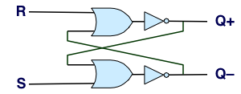
Storing and Accessing 1 Bit
Bistable Element
R-S Latch
q
R
Q+
Q+
!q
Q–
Q–
S
q = 0 or 1
Resetting
Setting
Storing
1
1
0
0
0
1
0
!q
q
0
0
1
1
1
0
0
q
!q

Slide 27
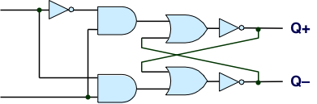
1-Bit Latch
D Latch
D
R
Data
Q+
C
Q–
Clock
S
Latching
Storing
d
!d
!d
!d
d
d
!d
0
!q
q
1
0
!q
d
d
!d
0
q

Slide 28
Transparent 1-Bit Latch
Latching
Changing D
d
!d
!d
!d
d
C
D
1
Q+
d
d
!d
Time
  When in latching mode, combinational propogation from D to Q+ and Q–
  Value latched depends on value of D as C falls

Slide 29
Edge-Triggered Latch
D
R
Data
Q+
Q–
C
S
T
Clock
Trigger
  Only in latching mode for brief period
    Rising clock edge
  Value latched depends on data as clock rises
  Output remains stable at all other times
C
T
D
Q+
Time

Slide 30
Registers
Structure
i₇
D
o₇
C
Q+
i₆
D
o₆
C
Q+
i₅
D
o₅
C
Q+
i₄
D
o₄
C
Q+
I
O
i₃
D
o₃
C
Q+
i₂
D
o₂
C
Q+
i₁
D
o₁
Clock
C
Q+
i₀
D
o₀
C
Q+
Clock
  Stores word of data
    Different from program registers seen in assembly code
  Collection of edge-triggered latches
  Loads input on rising edge of clock

Slide 31
Register Operation
State = x
State = y
x
Rising
clock
y
Input = y
Output = x


Output = y
  Stores data bits
  For most of time acts as barrier between input and output
  As clock rises, loads input

Slide 32
State Machine Example
Comb. Logic
0
  Accumulator circuit
  Load or accumulate on each cycle
A
L
U
MUX
0
Out
In
1
Load
Clock
Clock
Load
In
x₀
x₁
x₂
x₃
x₄
x₅
Out
x₀
x₀+x₁
x₀+x₁+x₂
x₃
x₃+x₄
x₃+x₄+x₅

Slide 33
Random-Access Memory
valA
Register
file
srcA
A
valW
Read ports
W
dstW
Write port
valB
srcB
B
Clock
  Stores multiple words of memory
    Address input specifies which word to read or write
  Register file
    Holds values of program registers
    %rax, %rsp, etc.
    Register identifier serves as address
      ID 15 (0xF) implies no read or write performed
  Multiple Ports
    Can read and/or write multiple words in one cycle
      Each has separate address and data input/output

Slide 34
Register File Timing
Reading
  Like combinational logic
  Output data generated based on input address
    After some delay
Writing
  Like register
  Update only as clock rises
valA
Register
file
2
x
srcA
A
x
valB
srcB
B
2
Register
file
2
x
Register
file
valW
2
y
y
Rising
clock
valW
W
dstW


2
W
dstW
Clock
Clock

Slide 35
Hardware Control Language
  Very simple hardware description language
  Can only express limited aspects of hardware operation
    Parts we want to explore and modify
Data Types
  bool: Boolean
    a, b, c, …
  int: words
    A, B, C, …
    Does not specify word size---bytes, 64-bit words, …
Statements
  bool a = bool-expr ;
  int A = int-expr ;

Slide 36
HCL Operations
  Classify by type of value returned
Boolean Expressions
  Logic Operations
    a && b, a || b, !a
  Word Comparisons
    A == B, A != B, A < B, A <= B, A >= B, A > B
  Set Membership
    A in { B, C, D }
      Same as A == B || A == C || A == D
Word Expressions
  Case expressions
    [ a : A; b : B; c : C ]
    Evaluate test expressions a, b, c, … in sequence
    Return word expression A, B, C, … for first successful test

Slide 37
Summary
Computation
  Performed by combinational logic
  Computes Boolean functions
  Continuously reacts to input changes
Storage
  Registers
    Hold single words
    Loaded as clock rises
  Random-access memories
    Hold multiple words
    Possible multiple read or write ports
    Read word when address input changes
    Write word as clock rises

