Slide 1
Y86-64 Processor Architecture:
Pipelined Implementation
COMP 222: Introduction to Computer Organization
Carnegie Mellon
Instructor:
Alan L. Cox

Slide 2
Overview
General Principles of Pipelining
  Goal
  Difficulties
Creating a Pipelined Y86-64 Processor
  Rearranging SEQ
  Inserting pipeline registers
  Problems with data and control hazards

Slide 3
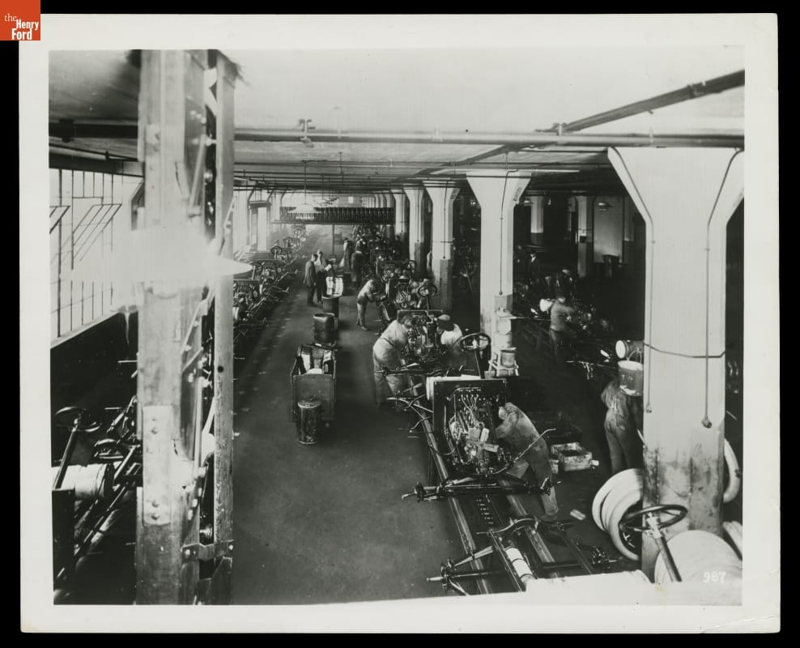
Real-World Pipelines: Ford Model T Moving Assembly Line
Idea
  Divide process into independent stages
  Move objects through stages in sequence
  At any given times, multiple objects being processed

Slide 4
Computational Example
300 ps
20 ps
Combinational
logic
R
e
g
Delay = 320 ps
Throughput = 3.12 GIPS
Clock
System
  Computation requires total of 300 picoseconds
  Additional 20 picoseconds to save result in register
  Must have clock cycle of at least 320 ps

Slide 5
3-Way Pipelined Version
100 ps
20 ps
100 ps
20 ps
100 ps
20 ps
Comb.
logic
A
R
e
g
Comb.
logic
B
R
e
g
Comb.
logic
C
R
e
g
Delay = 360 ps
Throughput = 8.33 GIPS
Clock
System
  Divide combinational logic into 3 blocks of 100 ps each
  Can begin new operation as soon as previous one passes through stage A.
    Begin new operation every 120 ps
  Overall latency increases
    360 ps from start to finish

Slide 6
Pipeline Diagrams
Unpipelined
  Cannot start new operation until previous one completes
3-Way Pipelined
  Up to 3 operations in process simultaneously
OP1
OP2
OP3
Time
OP1
A
B
C
OP2
A
B
C
OP3
A
B
C
Time

Slide 7
Operating a Pipeline
239
241
300
359
Clock
OP1
A
B
C
OP2
A
B
C
OP3
A
B
C
0
120
240
360
480
640
Time
100 ps
20 ps
100 ps
20 ps
100 ps
20 ps
100 ps
100 ps
100 ps
20 ps
20 ps
20 ps
100 ps
100 ps
100 ps
20 ps
20 ps
20 ps
100 ps
100 ps
100 ps
20 ps
20 ps
20 ps
Comb.
logic
A
R
e
g
Comb.
logic
B
R
e
g
Comb.
logic
C
Comb.
logic
A
R
e
g
Comb.
logic
B
R
e
g
Comb.
logic
C
R
e
g
Comb.
logic
A
Comb.
logic
A
R
e
g
R
e
g
Comb.
logic
B
Comb.
logic
B
R
e
g
R
e
g
Comb.
logic
C
Comb.
logic
C
R
e
g
R
e
g
R
e
g
Clock
Clock
Clock
Clock

Slide 8
Limitations: Nonuniform Delays
50 ps
20 ps
150 ps
20 ps
100 ps
20 ps
Comb.
logic
A
R
e
g
Comb.
logic
B
R
e
g
Comb.
logic
C
R
e
g
Delay = 510 ps
Throughput = 5.88 GIPS
Clock
OP1
A
B
C
OP2
A
B
C
OP3
A
B
C
Time
  Throughput limited by slowest stage
  Other stages sit idle for much of the time
  Challenging to partition system into balanced stages

Slide 9
Limitations: Register Overhead
50 ps
20 ps
50 ps
20 ps
50 ps
20 ps
50 ps
20 ps
50 ps
20 ps
50 ps
20 ps
Comb.
logic
R
e
g
Comb.
logic
R
e
g
Comb.
logic
R
e
g
Comb.
logic
R
e
g
Comb.
logic
R
e
g
Comb.
logic
R
e
g
Clock
Delay = 420 ps, Throughput = 14.29 GIPS
  As try to deepen pipeline, overhead of loading registers becomes more significant
  Percentage of clock cycle spent loading register:
    1-stage pipeline: 6.25%
    3-stage pipeline: 16.67%
    6-stage pipeline: 28.57%
  High speeds of modern processor designs obtained through very deep pipelining

Slide 10
Data Dependencies
Combinational
logic
R
e
g
Clock
OP1
OP2
OP3
Time
System
  Each operation depends on result from preceding one

Slide 11
Data Hazards
Comb.
logic
A
R
e
g
Comb.
logic
B
R
e
g
Comb.
logic
C
R
e
g
Clock
OP1
A
B
C
OP2
A
B
C
OP3
A
B
C
OP4
A
B
C
Time
  Result does not feed back around in time for next operation
  Pipelining has changed behavior of system

Slide 12
Data Dependencies in Processors
1 irmovq $50, %rax
2 addq %rax , %rbx
3 mrmovq 100( %rbx ), %rdx
  Result from one instruction used as operand for another
    Read-after-write (RAW) dependency
  Very common in actual programs
  Must make sure our pipeline handles these properly
    Get correct results
    Minimize performance impact

Slide 13
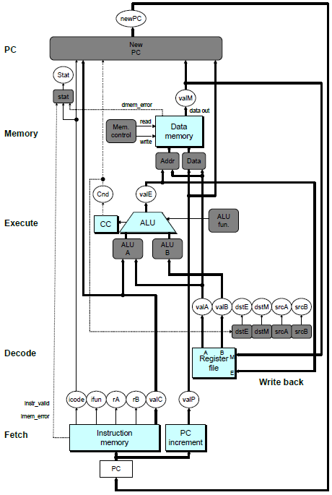
SEQ Hardware
  Stages occur in sequence
  One operation in process at a time

Slide 14
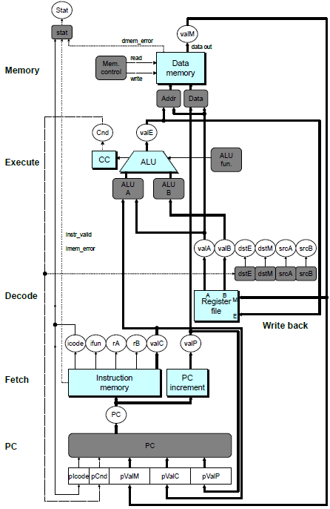
SEQ+ Hardware
  Still sequential implementation
  Reorder PC stage to put at beginning
PC Stage
  Task is to select PC for current instruction
  Based on results computed by previous instruction
Processor State
  PC is no longer stored in register
  But, can determine PC based on other stored information

Slide 15
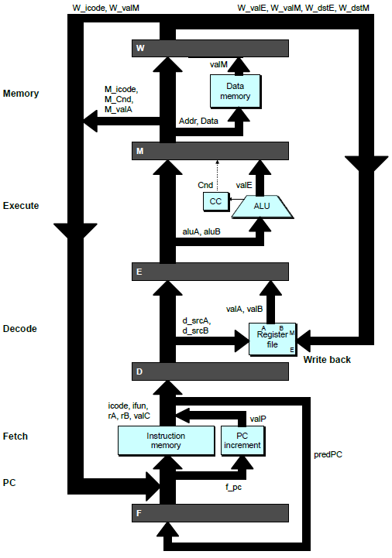
Adding Pipeline Registers
PC
newPC
valE
,
valM
Write back
valM
Data
Memory
Data
memory
memory
Addr
, Data
valE
CC
CC
ALU
Execute
Cnd
ALU
aluA
,
aluB
valA
,
valB
Decode
srcA
,
srcB
A
A
B
dstA
,
dstB
B
M
Register
M
Register
Register
Register
file
file
file
file
E
E
icode
,
ifun
valP
rA
,
rB
valC
Instruction
PC
Instruction
PC
Fetch
memory
increment
memory
increment
PC

Slide 16
Pipeline Stages
Fetch
  Select current PC
  Read instruction
  Compute incremented PC
Decode
  Read program registers
Execute
  Operate ALU
Memory
  Read or write data memory
Write Back
  Update register file

Slide 17
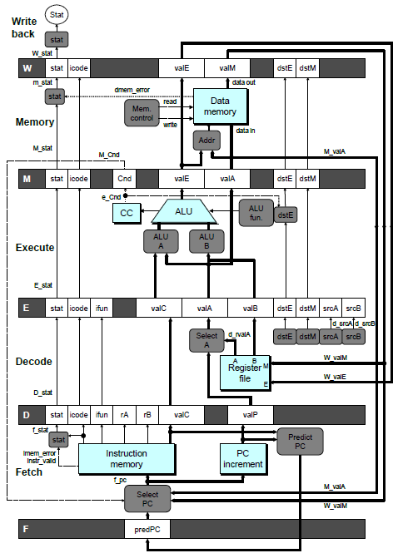
PIPE- Hardware
  Pipeline registers hold intermediate values from instruction execution
Forward (Upward) Paths
  Values passed from one stage to next
  Cannot jump past stages
    e.g., valC passes through decode

Slide 18
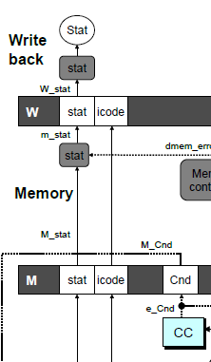
Signal Naming Conventions
S_Field
  Value of Field held in stage S pipeline register
s_Field
  Value of Field computed in stage S

Slide 19
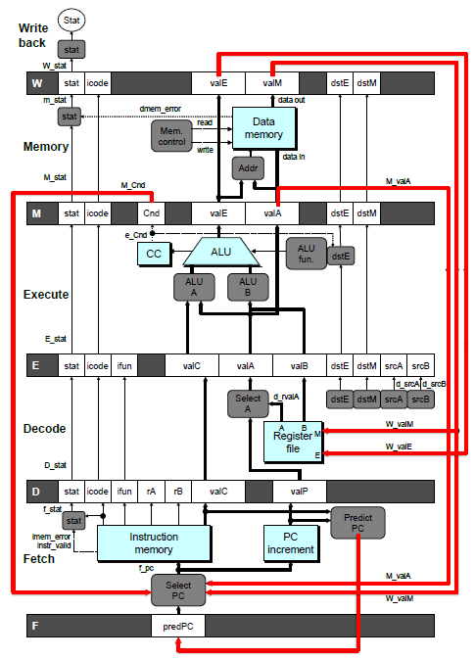
Feedback Paths
Predicted PC
  Guess value of next PC
Branch information
  Jump taken/not-taken
  Fall-through or target address
Return point
  Read from memory
Register updates
  To register file write ports

Slide 20
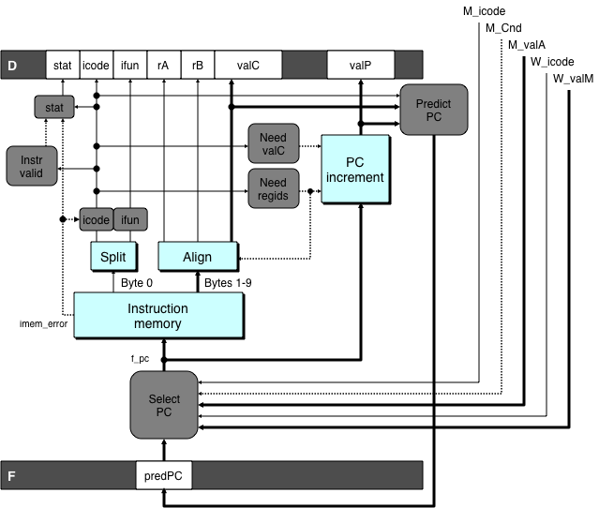
Predicting the PC
  Start fetch of new instruction after current one has completed fetch stage
    Not enough time to reliably determine next instruction
  Guess which instruction will follow
    Recover if prediction was incorrect

Slide 21
Our Prediction Strategy
Instructions that Don’t Transfer Control
  Predict next PC to be valP
  Always reliable
Call and Unconditional Jumps
  Predict next PC to be valC (destination)
  Always reliable
Conditional Jumps
  Predict next PC to be valC (destination)
  Only correct if branch is taken
    Typically right 60% of time
Return Instruction
  Don’t try to predict

Slide 22
Recovering from PC Misprediction
  Mispredicted Jump
    Will see branch condition flag once instruction reaches memory stage
    Can get fall-through PC from valA (value M_valA)
  Return Instruction
    Will get return PC when ret reaches write-back stage (W_valM)

Slide 23
Pipeline Demonstration
1
2
3
4
5
6
7
8
9
irmovq $1,%rax #I1
F
D
E
M
W
irmovq $2,%rcx #I2
F
D
E
M
W
irmovq $3,%rdx #I3
F
D
E
M
W
irmovq $4,%rbx #I4
F
D
E
M
W
halt #I5
F
D
E
M
W
Cycle 5
File: demo-basic.ys
W
I1
M
I2
E
I3
D
I4
F
I5

Slide 24
Data Dependencies: 3 Nop’s
# demo-h3.ys
1
2
3
4
5
6
7
8
9
10
11
F
F
D
D
E
E
M
M
W
0x000:
irmovq
$10,%
rdx
W
F
F
D
D
E
E
M
M
W
0x00a:
irmovq
$3,%
rax
W
F
F
D
D
E
E
M
M
W
0x014:
nop
W
F
F
D
D
E
E
M
M
W
0x015:
nop
W
F
F
D
D
E
E
M
M
W
0x016:
nop
W
F
F
D
D
E
E
M
M
W
0x017:
addq
%
rdx
,%
rax
W
F
F
D
D
E
E
M
M
W
0x019: halt
W
Cycle 6
W
W
f
R[
f
R[
]
]
3
%
3
%
rax
rax
Cycle 7
D
D
f
valA
f
valA
R[
R[
]
]
=
=
10
%
10
%
rdx
rdx
f
valB
f
valB
R[
R[
]
]
=
=
3
%
3
%
rax
rax

Slide 25
Data Dependencies: 2 Nop’s
# demo-h2.ys
1
2
3
4
5
6
7
8
9
10
F
F
D
D
E
E
M
M
W
0x000:
irmovq
$10,%
rdx
W
F
F
D
D
E
E
M
M
W
0x00a:
irmovq
$3,%
rax
W
F
F
D
D
E
E
M
M
W
0x014:
nop
W
F
F
D
D
E
E
M
M
W
0x015:
nop
W
F
F
D
D
E
E
M
M
W
0x016:
addq
%
rdx
,%
rax
W
F
F
D
D
E
E
M
M
W
0x018: halt
W
Cycle 6
W
W
W
f
f
R[
f
R[
R[
]
]
]
3
3
%
3
%
%
rax
rax
rax
•
•
•
•
•
•
D
D
D
f
f
valA
f
valA
valA
R[
R[
R[
]
]
]
=
=
=
10
10
%
10
Error
%
%
rdx
rdx
rdx
f
f
valB
f
valB
valB
R[
R[
R[
]
]
]
=
=
=
0
0
%
0
%
%
rax
rax
rax

Slide 26
Data Dependencies: 1 Nop
# demo-h1.ys
1
2
3
4
5
6
7
8
9
0x000:
irmovq
$10,%
rdx
F
D
E
M
W
0x00a:
irmovq
$3,%
rax
F
D
E
M
W
F
F
D
D
E
E
M
M
W
0x014:
nop
W
F
F
D
D
E
E
M
M
W
0x015:
addq
%
rdx
,%
rax
W
F
F
D
D
E
E
M
M
W
0x017: halt
W
Cycle 5
W
W
f
R[
f
R[
]
]
10
%
10
%
rdx
rdx
M
M_
valE
= 3
M_
dstE
=
%
rax
•
•
•
D
D
Error
f
valA
f
valA
R[
R[
]
]
=
=
0
%
0
%
rdx
rdx
f
valB
f
valB
R[
R[
]
]
=
=
0
%
0
%
rax
rax

Slide 27
Data Dependencies: No Nop
# demo-h0.ys
1
2
3
4
5
6
7
8
0x000:
irmovq
$10,%
rdx
F
D
E
M
W
0x00a:
irmovq
$3,%
rax
F
D
E
M
W
0x014:
addq
%
rdx
,%
rax
F
D
E
M
W
0x016: halt
F
D
E
M
W
Cycle 4
M
M_
valE
= 10
M_
dstE
=
%
rdx
E
e_
valE
f
0 + 3 = 3
E_
dstE
=
%
rax
D
D
Error
f
valA
f
valA
R[
R[
]
]
=
=
0
%
0
%
rdx
rdx
f
valB
f
valB
R[
R[
]
]
=
=
0
%
0
%
rax
rax

Slide 28
Branch Misprediction Example
demo-j.ys
0x000: xorq %rax,%rax
0x002: jne t # Not taken
0x00b: irmovq $1, %rax # Fall through
0x015: nop
0x016: nop
0x017: nop
0x018: halt
0x019: t: irmovq $3, %rdx # Target (Should not execute)
0x023: irmovq $4, %rcx # Should not execute
0x02d: irmovq $5, %rdx # Should not execute
  Should only execute first 8 instructions

Slide 29
Branch Misprediction Trace
# demo
-
j
1
2
3
4
5
6
7
8
9
0x000:
xorq
%
F
D
E
M
W
rax
,%
rax
0x002:
jne
t # Not taken
F
D
E
M
W
0x019: t:
irmovq
$3, %
rdx
# Target
F
D
E
M
W
0x023:
irmovq
$4, %
rcx
# Target+1
F
D
E
M
W
F
F
D
D
E
E
M
M
W
0x00b:
irmovq
$1, %
rax
# Fall Through
W
Cycle 5
  Incorrectly execute two instructions at branch target
M
M_Cnd =
0
M_
valA
= 0x007
E
E
f
valE
f
valE
3
3
dstE
dstE
=
=
%
%
rdx
rdx
D
D
valC
valC
=
=
4
4
dstE
dstE
=
=
%
%
ecx
rcx
F
F
f
valC
f
valC
1
1
f
rB
f
rB
%
%
rax
rax

Slide 30
Return Example
demo-ret.ys
0x000: irmovq Stack,%rsp # Intialize stack pointer
0x00a: nop # Avoid hazard on %rsp
0x00b: nop
0x00c: nop
0x00d: call p # Procedure call
0x016: irmovq $5,%rsi # Return point
0x020: halt
0x020: .pos 0x20
0x020: p: nop # procedure
0x021: nop
0x022: nop
0x023: ret
0x024: irmovq $1,%rax # Should not be executed
0x02e: irmovq $2,%rcx # Should not be executed
0x038: irmovq $3,%rdx # Should not be executed
0x042: irmovq $4,%rbx # Should not be executed
0x100: .pos 0x100
0x100: Stack: # Initial stack pointer
  Require lots of nops to avoid data hazards

Slide 31
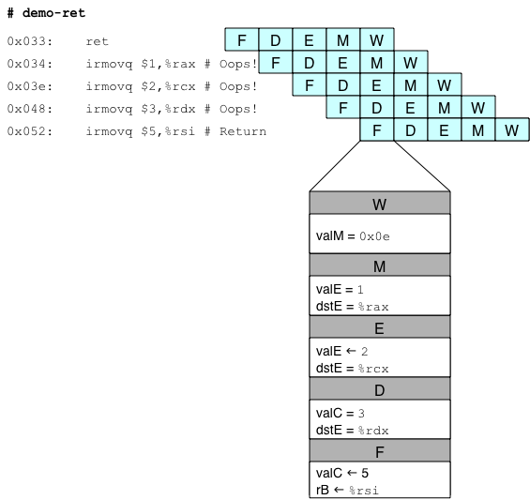
Incorrect Return Example
  Incorrectly execute 3 instructions following ret

Slide 32
Pipeline Summary
Concept
  Break instruction execution into 5 stages
  Run instructions through in pipelined mode
Limitations
  Can’t handle dependencies between instructions when instructions follow too closely
  Data dependencies
    One instruction writes register, later one reads it
  Control dependency
    Instruction sets PC in way that pipeline did not predict correctly
    Mispredicted branch and return
Fixing the Pipeline
  We’ll do that next time

Slide 33
Part Two Overview
  Make the pipelined processor work!
Data Hazards
  Instruction having register R as source follows shortly after instruction having register R as destination
  Common condition, don’t want to slow down pipeline
Control Hazards
  Mispredict conditional branch
    Our design predicts all branches as being taken
    Naïve pipeline executes two extra instructions
  Getting return address for ret instruction
    Naïve pipeline executes three extra instructions
Making Sure It Really Works
  What if multiple special cases happen simultaneously?

Slide 34
Pipeline Stages
Fetch
  Select current PC
  Read instruction
  Compute incremented PC
Decode
  Read program registers
Execute
  Operate ALU
Memory
  Read or write data memory
Write Back
  Update register file

Slide 35
PIPE- Hardware
  Pipeline registers hold intermediate values from instruction execution
Forward (Upward) Paths
  Values passed from one stage to next
  Cannot jump past stages
    e.g., valC passes through decode

Slide 36
Data Dependencies: 2 Nop’s
# demo-h2.ys
1
2
3
4
5
6
7
8
9
10
F
F
D
D
E
E
M
M
W
0x000:
irmovq
$10,%
rdx
W
F
F
D
D
E
E
M
M
W
0x00a:
irmovq
$3,%
rax
W
F
F
D
D
E
E
M
M
W
0x014:
nop
W
F
F
D
D
E
E
M
M
W
0x015:
nop
W
F
F
D
D
E
E
M
M
W
0x016:
addq
%
rdx
,%
rax
W
F
F
D
D
E
E
M
M
W
0x018: halt
W
Cycle 6
W
W
W
f
f
R[
f
R[
R[
]
]
]
3
3
%
3
%
%
rax
rax
rax
•
•
•
•
•
•
D
D
D
f
f
valA
f
valA
valA
R[
R[
R[
]
]
]
=
=
=
10
10
%
10
Error
%
%
rdx
rdx
rdx
f
f
valB
f
valB
valB
R[
R[
R[
]
]
]
=
=
=
0
0
%
0
%
%
rax
rax
rax

Slide 37
Data Dependencies: No Nop
# demo-h0.ys
1
2
3
4
5
6
7
8
0x000:
irmovq
$10,%
rdx
F
D
E
M
W
0x00a:
irmovq
$3,%
rax
F
D
E
M
W
0x014:
addq
%
rdx
,%
rax
F
D
E
M
W
0x016: halt
F
D
E
M
W
Cycle 4
M
M_
valE
= 10
M_
dstE
=
%
rdx
E
e_
valE
f
0 + 3 = 3
E_
dstE
=
%
rax
D
D
Error
f
valA
f
valA
R[
R[
]
]
=
=
0
%
0
%
rdx
rdx
f
valB
f
valB
R[
R[
]
]
=
=
0
%
0
%
rax
rax

Slide 38
Stalling for Data Dependencies
# demo-h2.ys
1
2
3
4
5
6
7
8
9
10
11
0x000: irmovq $10,%rdx
F
D
E
M
W
0x00a: irmovq $3,%rax
F
D
E
M
W
0x014: nop
F
D
E
M
W
0x015: nop
F
D
E
M
W
bubble
E
M
W
0x016: addq %rdx,%rax
F
D
D
E
M
W
0x018: halt
F
F
D
E
M
W
  If instruction follows too closely after one that writes register, slow it down
  Hold instruction in decode
  Dynamically inject nop into execute stage

Slide 39
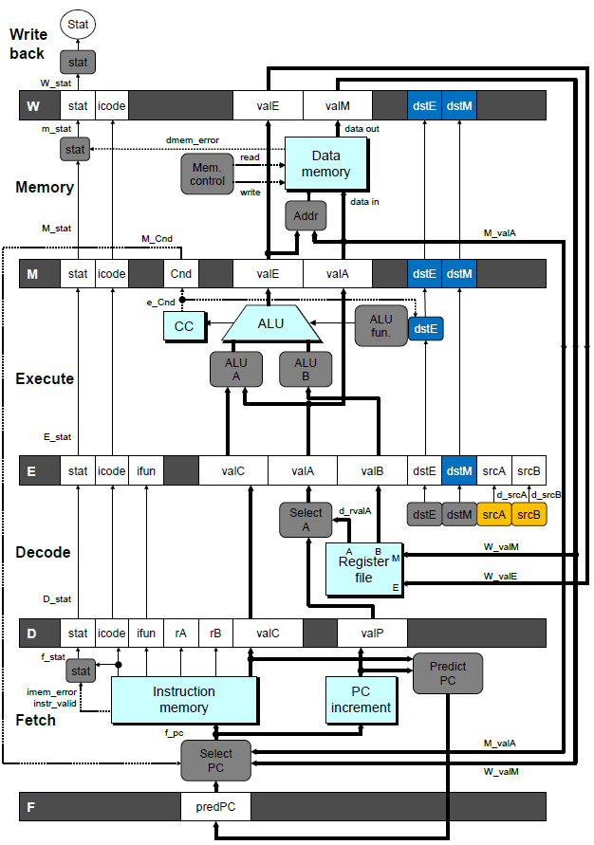
Stall Condition
Source Registers
  srcA and srcB of current instruction in decode stage
Destination Registers
  dstE and dstM fields
  Instructions in execute, memory, and write-back stages
Special Case
  Don’t stall for register ID 15 (0xF)
    Indicates absence of register operand
    Or failed cond. move

Slide 40
Detecting Stall Condition
# demo-h2.ys
1
2
3
4
5
6
7
8
9
10
11
0x000: irmovq $10,%rdx
F
D
E
M
W
0x00a: irmovq $3,%rax
F
D
E
M
W
0x014: nop
F
D
E
M
W
0x015: nop
F
D
E
M
W
bubble
E
M
W
0x016: addq %rdx,%rax
F
D
D
E
M
W
0x018: halt
F
F
D
E
M
W
Cycle 6
W
W_dstE = %rax
W_valE = 3
•
•
•
D
srcA = %rdx
srcB = %rax

Slide 41
Stalling X3
# demo-h0.ys
1
2
3
4
5
6
7
8
9
10
11
0x000: irmovq $10,%rdx
F
D
E
M
W
0x00a: irmovq $3,%rax
F
D
E
M
W
bubble
E
M
W
bubble
E
M
W
bubble
E
M
W
0x014: addq %rdx,%rax
F
D
D
D
D
E
M
W
0x016: halt
F
F
F
F
D
E
M
W
Cycle 6
W
Cycle 5
W_dstE = %rax
M
Cycle 4
M_dstE = %rax
•
•
•
E
•
•
•
e_dstE = %rax
D
D
D
srcA = %rdx
srcB = %rax
srcA = %rdx
srcB = %rax
srcA = %rdx
srcB = %rax

Slide 42
What Happens When Stalling?
# demo-h0.ys
Cycle 4
Cycle 5
Cycle 6
Cycle 7
Cycle 8
0x000: irmovq $10,%rdx
0x000: irmovq $10,%rdx
0x00a: irmovq $3,%rax
bubble
Write Back
bubble
0x00a: irmovq $3,%rax
0x000: irmovq $10,%rdx
0x00a: irmovq $3,%rax
bubble
bubble
Memory
bubble
0x014: addq %rdx,%rax
0x00a: irmovq $3,%rax
bubble
bubble
bubble
Execute
0x014: addq %rdx,%rax
0x016: halt
0x014: addq %rdx,%rax
0x014: addq %rdx,%rax
0x014: addq %rdx,%rax
0x014: addq %rdx,%rax
Decode
0x016: halt
0x016: halt
0x016: halt
0x016: halt
Fetch
0x016: halt
  Stalling instruction held back in decode stage
  Following instruction stays in fetch stage
  Bubbles injected into execute stage
    Like dynamically generated nop’s
    Move through later stages

Slide 43
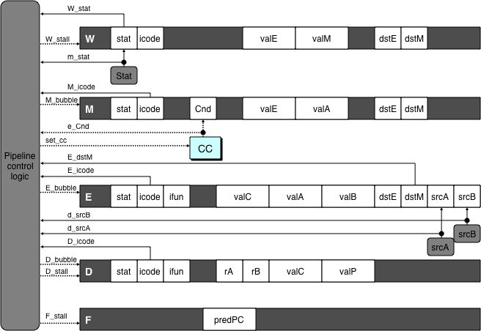
Implementing Stalling
Pipeline Control
  Combinational logic detects stall condition
  Sets mode signals for how pipeline registers should update
Pipeline
control
logic
Pipeline
control
logic
Pipeline
control
logic
Pipeline
control
logic

Slide 44
Pipeline Register Modes
Rising
Rising
Input = y
Output = x
_
clock
_
Output = y
clock
Normal
x
x
y
y
stall
bubble
= 0
= 0
Rising
Rising
Input = y
Output = x
_
clock
_
Output = x
clock
Stall
x
x
x
x
stall
bubble
= 1
= 0
Rising
Rising
Input = y
Output = x
_
clock
_
Output =
nop
clock
n
Bubble
x
x
o
p
stall
bubble
= 0
= 1

Slide 45
Data Forwarding
Naïve Pipeline
  Register isn’t written until completion of write-back stage
  Source operands read from register file in decode stage
    Needs to be in register file at start of stage
Observation
  Value generated in execute or memory stage
Trick
  Pass value directly from generating instruction to decode stage
  Needs to be available at end of decode stage

Slide 46
Data Forwarding Example
# demo-h2.ys
1
2
3
4
5
6
7
8
9
10
F
F
D
D
E
E
M
M
W
0x000:
irmovq
$10,%
rdx
W
F
F
D
D
E
E
M
M
W
0x00a:
irmovq
$3,%
rax
W
F
F
D
D
E
E
M
M
W
0x014:
nop
W
F
F
D
D
E
E
M
M
W
0x015:
nop
W
F
F
D
D
E
E
M
M
W
0x016:
addq
%
rdx
,%
rax
W
F
F
D
D
E
E
M
M
W
0x018: halt
W
  irmovq in write-back stage
  Destination value in W pipeline register
  Forward as valB for decode stage
Cycle 6
W
W_
dstE
=
%
rax
R[
%
rax
]
f
3
W_
valE
= 3
•
•
•
D
srcA
=
%
rdx
valA
f
R[
%
rdx
]
=
10
srcB
=
%
rax
valB
f
W_
valE
=
3

Slide 47
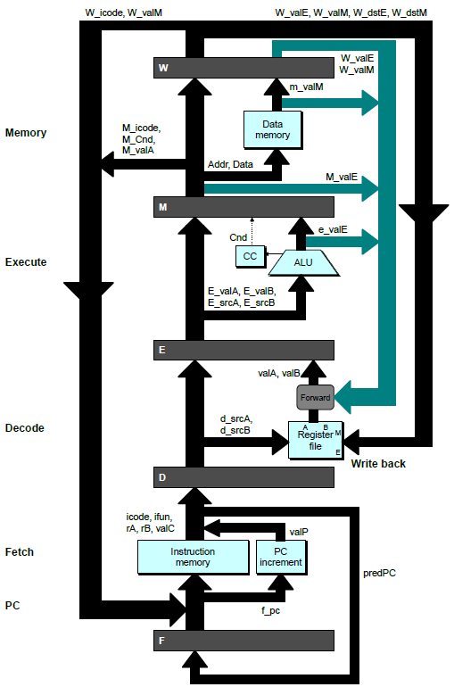
Bypass Paths
Decode Stage
  Forwarding logic selects valA and valB
  Normally from register file
  Forwarding: get valA or valB from later pipeline stage
Forwarding Sources
  Execute: valE
  Memory: valE, valM
  Write back: valE, valM

Slide 48
Data Forwarding Example #2
# demo-h0.ys
1
2
3
4
5
6
7
8
0x000: irmovq $10,%rdx
F
D
E
M
W
0x00a: irmovq $3,%rax
F
D
E
M
W
0x014: addq %rdx,%rax
F
D
E
M
W
0x016: halt
F
D
E
M
W
Register %rdx
  Generated by ALU during previous cycle
  Forward from memory as valA
Register %rax
  Value just generated by ALU
  Forward from execute as valB
Cycle 4
M
M_dstE = %rdx
M_valE = 10
E
E_dstE = %rax
e_valE f 0 + 3 = 3
D
srcA = %rdx
srcB = %rax
valA f M_valE = 10
valB f e_valE = 3

Slide 49
Forwarding Priority
# demo-priority.ys
1
2
3
4
5
6
7
8
9
10
F
F
D
D
E
E
M
M
W
0x000: irmovq $1, %rax
W
F
F
D
D
E
E
M
M
W
0x00a: irmovq $2, %rax
W
F
F
D
D
E
E
M
M
W
0x014: irmovq $3, %rax
W
F
F
D
D
E
E
M
M
W
0x01e: rrmovq %rax, %rdx
W
F
F
D
D
E
E
M
M
W
0x020: halt
W
Multiple Forwarding Choices
  Which one should have priority
  Match serial semantics
  Use matching value from earliest pipeline stage
Cycle 5
W
W
f
R[
f
R[
]
]
3
%
1
%
rax
rax
W
M
f
R[
f
R[
]
]
3
%
2
%
rax
rax
W
E
f
R[
f
R[
]
]
3
%
3
%
rax
rax
D
D
D
f
f
valA
f
valA
valA
R[
R[
R[
]
]
]
=
=
=
10
10
%
?
%
%
rax
rdx
rdx
f
f
valB
f
valB
valB
R[
R[
0
%
rax
]
=
0

Slide 50
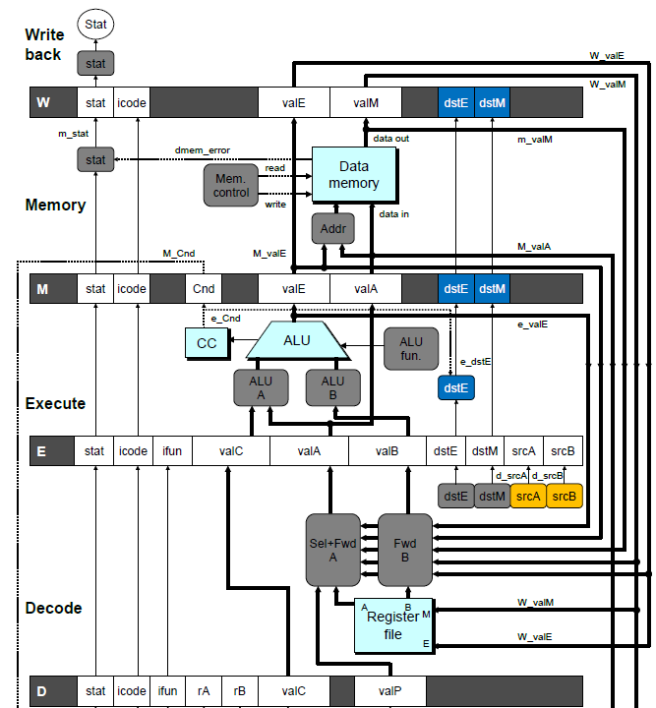
Implementing Forwarding
  Add additional feedback paths from E, M, and W pipeline registers into decode stage
  Create logic blocks to select from multiple sources for valA and valB in decode stage

Slide 51
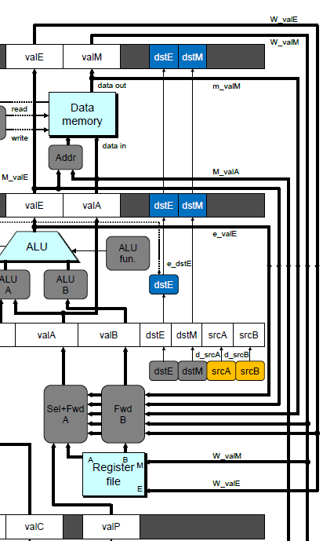
Implementing Forwarding
## What should be the A value?
int d_valA = [
# Use incremented PC
D_icode in { ICALL, IJXX } : D_valP;
# Forward valE from execute
d_srcA == e_dstE : e_valE;
# Forward valM from memory
d_srcA == M_dstM : m_valM;
# Forward valE from memory
d_srcA == M_dstE : M_valE;
# Forward valM from write back d_srcA == W_dstM : W_valM;
# Forward valE from write back
d_srcA == W_dstE : W_valE;
# Use value read from register file
1 : d_rvalA;
];

Slide 52
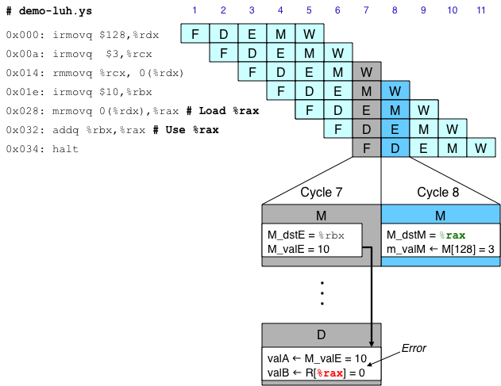
Limitation of Forwarding
Load-use dependency
  Value needed by end of decode stage in cycle 7
  Value read from memory in memory stage of cycle 8

Slide 53
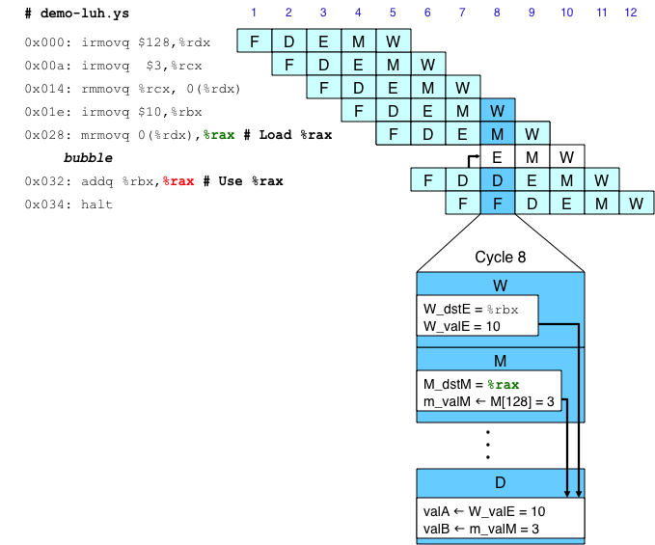
Avoiding Load/Use Hazard
  Stall using instruction for one cycle
  Can then pick up loaded value by forwarding from memory stage

Slide 54
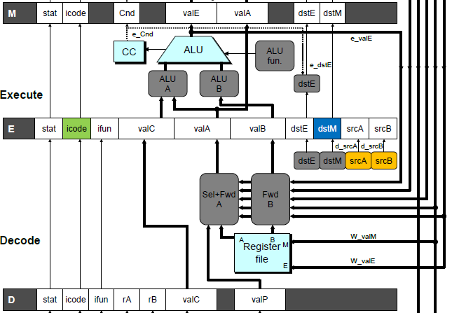
Detecting Load/Use Hazard
Condition | Trigger
Load/Use Hazard | E_icode in { IMRMOVQ, IPOPQ } && E_dstM in { d_srcA, d_srcB }

Slide 55
Control for Load/Use Hazard
# demo
-
luh
.
ys
1
2
3
4
5
6
7
8
9
10
11
12
F
F
D
D
E
E
M
M
W
0x000:
irmovq
$128,%
rdx
W
F
F
D
D
E
E
M
M
W
0x00a:
irmovq
$3,%
rcx
W
F
F
D
D
E
E
M
M
W
0x014:
rmmovq
%
rcx
, 0(%
rdx
)
W
F
F
D
D
E
E
M
M
W
0x01e:
irmovq
$10,%
ebx
W
%
rax
# Load %
rax
F
F
F
D
D
D
E
E
E
M
M
M
W
W
0x028:
mrmovq
0(%
rdx
),
W
bubble
E
M
W
0x032:
addq
%
ebx
,
%
rax
# Use %
rax
F
D
D
E
M
W
0x034: halt
F
F
D
E
M
W
  Stall instructions in fetch and decode stages
  Inject bubble into execute stage
Condition | F | D | E | M | W
Load/Use Hazard | stall | stall | bubble | normal | normal

Slide 56
Branch Misprediction Example
demo-j.ys
0x000: xorq %rax,%rax
0x002: jne t # Not taken
0x00b: irmovq $1, %rax # Fall through
0x015: nop
0x016: nop
0x017: nop
0x018: halt
0x019: t: irmovq $3, %rdx # Target
0x023: irmovq $4, %rcx # Should not execute
0x02d: irmovq $5, %rdx # Should not execute
  Should only execute first 8 instructions

Slide 57
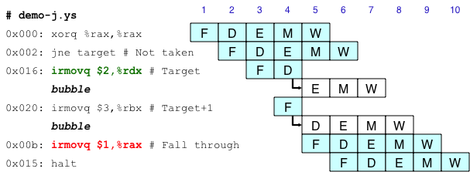
Handling Misprediction
Predict branch as taken
  Fetch 2 instructions at target
Cancel when mispredicted
  Detect branch not-taken in execute stage
  On following cycle, replace instructions in execute and decode by bubbles
  No side effects have occurred yet

Slide 58
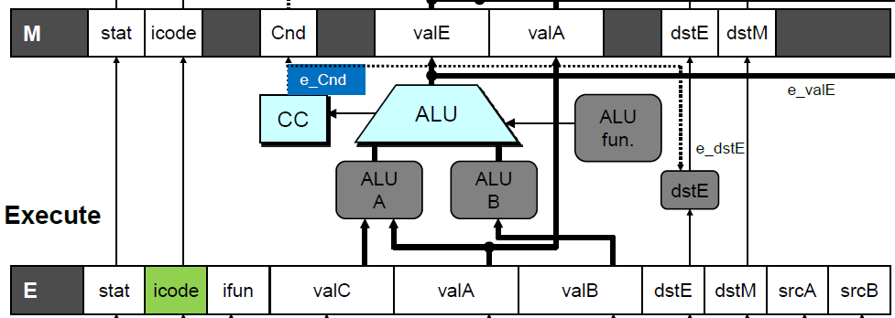
Detecting Mispredicted Branch
Condition | Trigger
Mispredicted Branch | E_icode = IJXX & !e_Cnd

Slide 59
Control for Misprediction
Condition | F | D | E | M | W
Mispredicted Branch | normal | bubble | bubble | normal | normal

Slide 60
Return Example
demo-retb.ys
0x000: irmovq Stack,%rsp # Intialize stack pointer
0x00a: call p # Procedure call
0x013: irmovq $5,%rsi # Return point
0x01d: halt
0x020: .pos 0x20
0x020: p: irmovq $-1,%rdi # procedure
0x02a: ret
0x02b: irmovq $1,%rax # Should not be executed
0x035: irmovq $2,%rcx # Should not be executed
0x03f: irmovq $3,%rdx # Should not be executed
0x049: irmovq $4,%rbx # Should not be executed
0x100: .pos 0x100
0x100: Stack: # Stack: Stack pointer
  Previously executed three additional instructions

Slide 61
Correct Return Example
# demo
-
retb
0x026: ret
F
D
E
M
W
bubble
F
D
E
M
W
bubble
F
D
E
M
W
bubble
F
D
E
M
W
F
F
D
D
E
E
M
M
W
0x013:
irmovq
$5,%
rsi
# Return
W
  As ret passes through pipeline, stall at fetch stage
    While in decode, execute, and memory stage
  Inject bubble into decode stage
  Release stall when reach write-back stage
W
W
valM
valM
=
=
0x0b
0x013
•
•
•
F
F
f
valC
f
valC
5
5
f
rB
f
rB
%
%
rsi
esi

Slide 62
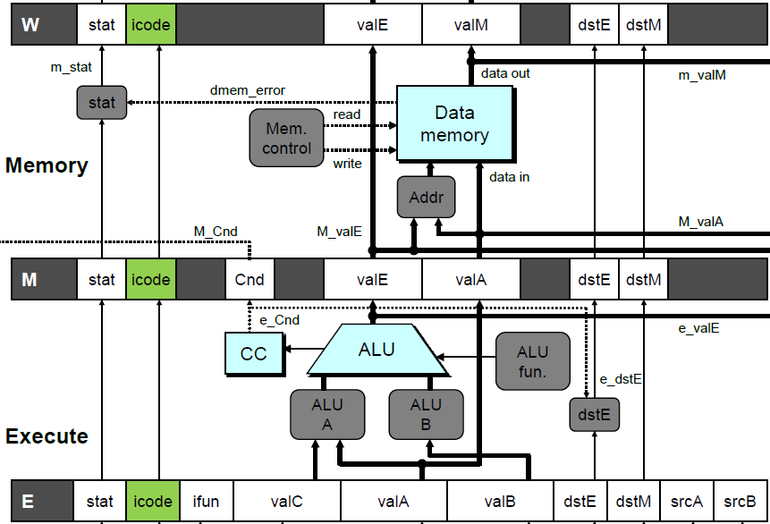
Detecting Return
Condition | Trigger
Processing ret | IRET in { D_icode, E_icode, M_icode }

Slide 63
Control for Return
# demo
-
retb
0x026: ret
F
D
E
M
W
bubble
F
D
E
M
W
bubble
F
D
E
M
W
bubble
F
D
E
M
W
F
F
D
D
E
E
M
M
W
0x014:
irmovq
$5,%
rsi
# Return
W
Condition | F | D | E | M | W
Processing ret | stall | bubble | normal | normal | normal

Slide 64
Special Control Cases
Detection
Action (on next cycle)
Condition | Trigger
Processing ret | IRET in { D_icode, E_icode, M_icode }
Load/Use Hazard | E_icode in { IMRMOVQ, IPOPQ } && E_dstM in { d_srcA, d_srcB }
Mispredicted Branch | E_icode = IJXX & !e_Cnd
Condition | F | D | E | M | W
Processing ret | stall | bubble | normal | normal | normal
Load/Use Hazard | stall | stall | bubble | normal | normal
Mispredicted Branch | normal | bubble | bubble | normal | normal

Slide 65
Implementing Pipeline Control
  Combinational logic generates pipeline control signals
  Action occurs at start of following cycle

Slide 66
Initial Version of Pipeline Control
bool F_stall =
# Conditions for a load/use hazard
E_icode in { IMRMOVQ, IPOPQ } && E_dstM in { d_srcA, d_srcB } ||
# Stalling at fetch while ret passes through pipeline
IRET in { D_icode, E_icode, M_icode };
bool D_stall =
# Conditions for a load/use hazard
E_icode in { IMRMOVQ, IPOPQ } && E_dstM in { d_srcA, d_srcB };
bool D_bubble =
# Mispredicted branch
(E_icode == IJXX && !e_Cnd) ||
# Stalling at fetch while ret passes through pipeline
IRET in { D_icode, E_icode, M_icode };
bool E_bubble =
# Mispredicted branch
(E_icode == IJXX && !e_Cnd) ||
# Load/use hazard
E_icode in { IMRMOVQ, IPOPQ } && E_dstM in { d_srcA, d_srcB };

Slide 67
Control Combinations
  Special cases that can arise on same clock cycle
Combination A
  Not-taken branch
  ret instruction at branch target
Combination B
  Instruction that reads from memory to %rsp
  Followed by ret instruction

Slide 68
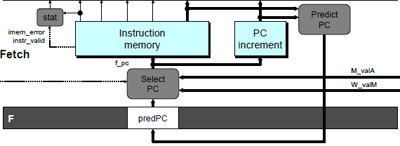
Control Combination A
1
1
Mispredict
1
Mispredict
ret
ret
ret
M
M
M
M
M
JXX
E
JXX
E
E
E
E
ret
ret
D
ret
D
D
D
D
Combination A
Condition | F | D | E | M | W
Processing ret | stall | bubble | normal | normal | normal
Mispredicted Branch | normal | bubble | bubble | normal | normal
Combination | stall | bubble | bubble | normal | normal
  Should handle as mispredicted branch
  Stalls F pipeline register
  But PC selection logic will be using M_valM anyhow

Slide 69
Control Combination B
1
1
Load/use
ret
1
ret
ret
M
M
M
M
E
Load
E
E
E
Use
ret
ret
D
D
ret
D
D
Combination B
Condition | F | D | E | M | W
Processing ret | stall | bubble | normal | normal | normal
Load/Use Hazard | stall | stall | bubble | normal | normal
Combination | stall | bubble + stall | bubble | normal | normal
  Would attempt to bubble and stall pipeline register D
  Signaled by processor as pipeline error

Slide 70
Handling Control Combination B
1
1
Load/use
ret
1
ret
ret
M
M
M
M
E
Load
E
E
E
Use
ret
ret
D
D
ret
D
D
Combination B
Condition | F | D | E | M | W
Processing ret | stall | bubble | normal | normal | normal
Load/Use Hazard | stall | stall | bubble | normal | normal
Combination | stall | stall | bubble | normal | normal
  Load/use hazard should get priority
  ret instruction should be held in decode stage for additional cycle

Slide 71
Corrected Pipeline Control Logic
bool D_bubble =
# Mispredicted branch
(E_icode == IJXX && !e_Cnd) ||
# Stalling at fetch while ret passes through pipeline
IRET in { D_icode, E_icode, M_icode }
# but not condition for a load/use hazard
&& !(E_icode in { IMRMOVQ, IPOPQ }
&& E_dstM in { d_srcA, d_srcB });
Condition | F | D | E | M | W
Processing ret | stall | bubble | normal | normal | normal
Load/Use Hazard | stall | stall | bubble | normal | normal
Combination | stall | stall | bubble | normal | normal
  Load/use hazard should get priority
  ret instruction should be held in decode stage for additional cycle

Slide 72
Pipeline Summary
Data Hazards
  Most handled by forwarding
    No performance penalty
  Load/use hazard requires one cycle stall
Control Hazards
  Cancel instructions when detect mispredicted branch
    Two clock cycles wasted
  Stall fetch stage while ret passes through pipeline
    Three clock cycles wasted
Control Combinations
  Must analyze carefully
  First version had subtle bug
    Only arises with unusual instruction combination

