Slide 1
Networking
(not the social kind ☺)
Alan L. Cox
alc@rice.edu
Some slides adapted from CMU 15.213 slides

Slide 2
Objectives
Be exposed to the basic underpinnings of the Internet
Be able to use network socket interfaces effectively
Be exposed to the basic underpinnings of the World Wide Web
Cox
Networking
2

Slide 3
The 2004 A. M. Turing Award Goes to...
Cox
Networking
3

Slide 4
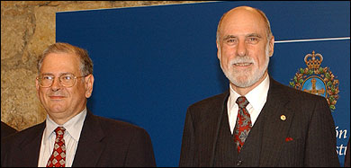
The 2004 A. M. Turing Award Goes to...
Bob Kahn
Vint Cerf
"For pioneering work on internetworking, including the design and implementation of the Internet's basic communications protocols, TCP/IP, and for inspired leadership in networking."
The first Turing Award given to recognize work in computer networking
Cox
Networking
4

Slide 5
Telephony
Interactive telecommunication between people
Analog voice
  Transmitter/receiver continuously in contact with electronic circuit
  Electric current varies with acoustic pressure
Over electrical circuits
Analog/Continuous Signal
Cox
Networking
5

Slide 6
Telephony Milestones
1876: Alexander Bell invented telephone
1878: Public switches installed at New Haven and San Francisco, public switched telephone network is born
  People can talk without being on the same wire!
Without Switch
With Switch
Cox
Networking
6

Slide 7
Telephony Milestones
1878: First telephone directory; White House line
1881: Insulated, balanced twisted pair as local loop
1885: AT&T formed
1892: First automatic commercial telephone switch
1903: 3 million telephones in U.S.
1915: First transcontinental telephone line
1927: First commercial transatlantic commercial service
Cox
Networking
7

Slide 8
Telephony Milestones
1937: Multiplexing introduced for inter-city calls
  One link carries multiple conversations
With Multiplexing
Without Multiplexing
Cox
Networking
8

Slide 9
Data or Computer Networks
Networks designed for computers to computers or devices
  vs. communication between human beings
Digital information
  vs. analog voice
Not a continuous stream of bits, rather, discrete “packets” with lots of silence in between
  Dedicated circuit hugely inefficient
  Packet switching invented
Digital/Discrete Signal
Cox
Networking
9

Slide 10
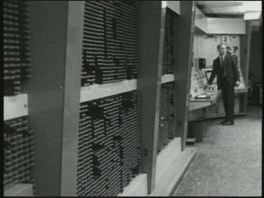
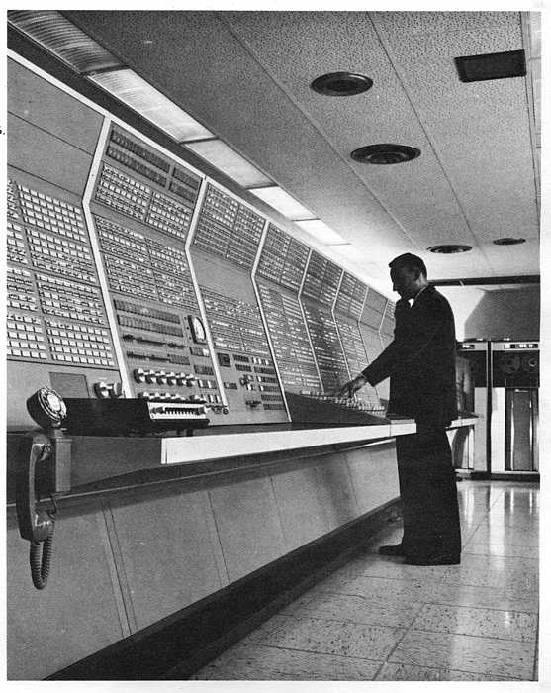
Major Internet Milestones
1960-1964 Basic concept of “packet switching” was independently developed by Baran (RAND), Kleinrock (MIT)
  AT&T insisted that packet switching would never work!
1965 First time two computers talked to each other using packets (Roberts, MIT; Marill, SDC)
dial-up
MIT TX-2
SDC Q32
Cox
Networking
10

Slide 11
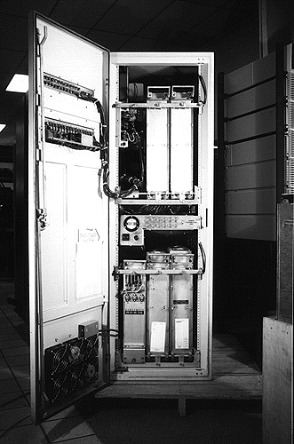
Major Internet Milestones
1968 BBN group proposed to use Honeywell 516 mini-computers for the Interface Message Processors (i.e. packet switches)
1969 The first ARPANET message transmitted between UCLA (Kleinrock) and SRI (Engelbart)
  We sent an “L”, did you get the “L”? Yep!
  We sent an “O”, did you get the “O”? Yep!
  We sent a “G”, did you get the “G”?
Crash!
Cox
Networking
11

Slide 12
Major Internet Milestones
1970 First packet radio network ALOHANET (Abramson, U Hawaii)
1973 Ethernet invented (Metcalfe, Xerox PARC)
Why is it called the “Inter-net”?
1974 “A protocol for Packet Network Interconnection” published by Cerf and Kahn
  First internetworking protocol TCP
  This paper was cited for their Turing Award
1977 First TCP operation over ARPANET, Packet Radio Net, and SATNET
1985 NSF commissions NSFNET backbone
1991 NSF opens Internet to commercial use
Cox
Networking
12

Slide 13

Internet Hourglass Architecture
Email, Web, ssh,...
TCP, UDP, …
IP
Ethernet, WiFi,
3G, bluetooth,...
Cox
Networking
13

Slide 14
Network Hardware
register file
ALU
CPU chip
system bus
memory bus
main
memory
Bus Interface
I/O
bridge
Expansion slots
I/O bus
USB
controller
graphics
adapter
disk
controller
network
adapter
mouse
keyboard
monitor
disk
network
Cox
Networking
14

Slide 15
Computer Networks
A network is a hierarchical system of “boxes” and “wires” organized by geographical proximity
  Cluster network spans a rack or room
    Ethernet, Infiniband, WiFi, …
  LAN (local area network) spans a building or campus
    Switched Ethernet is most prominent example
  WAN (wide-area network) spans very long distance
    A high-speed point-to-point link
    Leased line or SONET/SDH circuit, or MPLS/ATM circuit
An internetwork (internet) is an interconnected set of networks
  The Global IP Internet (uppercase “I”) is the most famous example of an internet (lowercase “i”)
Cox
Networking
15

Slide 16
Lowest Level: Ethernet Segment
Ethernet segment consists of a collection of hosts connected by wires (twisted pairs) to a hub
Operation
  Each Ethernet adapter has a unique 48-bit address
  Hosts send bits to any other host in chunks called frames
  Hub slavishly copies each bit from each port to every other port
    Every host sees every bit
  Note: Hubs are obsolete
    Bridges (switches, routers) became cheap enough to replace them (don’t broadcast all traffic)
host
host
host
100 Mb/s
100 Mb/s
hub
ports
Cox
Networking
16

Slide 17
Next Level: Bridged Ethernet Segment
Spans room, building, or campus
Bridges cleverly learn which hosts are reachable from which ports and then selectively copy frames from port to port
host
host
host
host
host
hub
bridge
hub
100 Mb/s
100 Mb/s
1-10 Gb/s
host
host
host
1 Gb/s
bridge
1 Gb/s
bridge
host
1 Gb/s
host
host
host
Cox
Networking
17

Slide 18
Conceptual View of LANs
For simplicity, hubs, bridges, and wires are often shown as a collection of hosts attached to a single wire:
host
host
...
host
Cox
Networking
18

Slide 19
Next Level: internets
Multiple incompatible LANs can be physically connected by specialized computers called routers
The connected networks are called an internet
host
host
...
host
host
host
...
host
LAN 1
LAN 2
router
router
router
WAN
WAN
LAN 1 and LAN 2 might be completely different, totally incompatible LANs (e.g., Ethernet and WiFi, 802.11*, T1-links, DSL, …)
Cox
Networking
19

Slide 20
The Internet Circa 1986
In 1986, the Internet consisted of one backbone
(NSFNET) that connected 13 sites via 45 Mbps T3 links
  Merit (Univ of Mich)
  NCSA (Illinois)
  Cornell Theory Center
  Pittsburgh Supercomputing Center
  San Diego Supercomputing Center
  John von Neumann Center (Princeton)
  BARRNet (Palo Alto)
  MidNet (Lincoln, NE)
  WestNet (Salt Lake City)
  NorthwestNet (Seattle)
  SESQUINET (Rice)
  SURANET (Georgia Tech)
Connecting to the Internet involved connecting one of
your routers to a router at a backbone site, or to a
regional network that was already connected to the
backbone
Cox
Networking
20

Slide 21
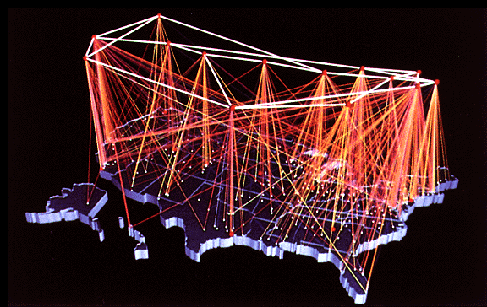
NSFNET Internet Backbone
source: www.eef.org
Cox
Networking
21

Slide 22
After NSFNET
Early 90s
  Commercial enterprises began building their own high-speed backbones
  Backbone would connect to NSFNET, sell access to companies, ISPs, and individuals
1995
  NSFNET decommissioned
  NSF fostered the creation of network access points (NAPs) to interconnect the commercial backbones
Cox
Networking
22

Slide 23
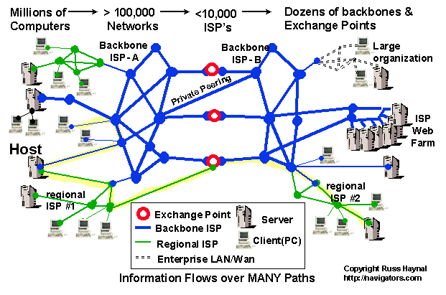
Current Internet Architecture
Cox
Networking
23

Slide 24
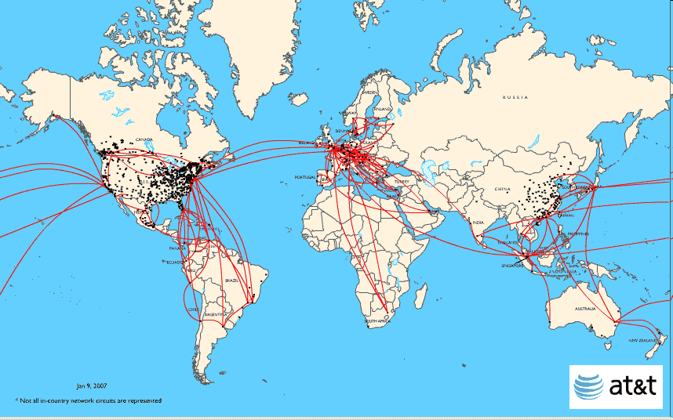
AT&T Backbone
Cox
Networking
24

Slide 25
The Notion of an internet Protocol
How is it possible to send bits across incompatible LANs and WANs?
Solution: protocol software running on each host and router smoothes out the differences between the different networks
Implements an internet protocol (i.e., set of rules) that governs how hosts and routers should cooperate when they transfer data from network to network
  TCP/IP is the protocol for the global IP Internet
Cox
Networking
25

Slide 26
What Does an internet Protocol Do?
1. Provides a naming scheme
  An internet protocol defines a uniform format for host addresses
  Each host (and router) is assigned at least one of these internet addresses that uniquely identifies it
2. Provides a delivery mechanism
  An internet protocol defines a standard transfer unit (packet)
  Packet consists of header and payload
    Header: contains info such as packet size, source and destination addresses
    Payload: contains data bits sent from source host
Cox
Networking
26

Slide 27
Transferring Data Over an internet
Host A
Host B
client
server
(1)
data
(8)
data
protocol
software
protocol
software
internet packet
(2)
data
PH
FH1
(7)
data
PH
FH2
LAN1 frame
LAN1
adapter
LAN2
adapter
Router
(3)
data
PH
FH1
(6)
data
PH
FH2
LAN1
adapter
LAN2
adapter
LAN1
LAN2 frame
LAN2
(4)
data
PH
FH1
(5)
data
PH
FH2
protocol
software
Cox
Networking
27

Slide 28
Other Issues
We are glossing over a number of important questions:
  What if different networks have different maximum frame sizes? (segmentation)
  How do routers know where to forward frames?
  How are routers informed when the network topology changes?
  What if packets get lost?
We’ll leave the discussion of these question to computer networking classes (COMP 429)
Cox
Networking
28

Slide 29
Global IP Internet
Based on the TCP/IP protocol family
  IP (Internet protocol) :
    Provides basic naming scheme and unreliable delivery capability of packets (datagrams) from host-to-host
  UDP (Unreliable Datagram Protocol)
    Uses IP to provide unreliable datagram delivery from process-to-process
  TCP (Transmission Control Protocol)
    Uses IP to provide reliable byte streams from process-to-process over connections
Accessed via a mix of Unix file I/O and functions from the sockets interface
Cox
Networking
29

Slide 30
A Client-Server Transaction
Most network applications are based on the client-server model:
  A server process and one or more client processes
  Server manages some resource
  Server provides service by manipulating resource for clients
1. Client sends request
Client
process
Server
process
Resource
4. Client
handles
response
3. Server sends response
2. Server
handles
request
Note: clients and servers are processes running on hosts
(can be the same or different hosts)
Cox
Networking
30

Slide 31
Organization of an Internet Application
Internet client
Internet server
Client
User code
Server
Sockets interface
(system calls)
TCP/IP
Kernel code
TCP/IP
Hardware interface
(interrupts)
Network
adapter
Hardware
and firmware
Network
adapter
Global IP Internet
Cox
Networking
31

Slide 32
A Programmer’s View of the Internet
Hosts are mapped to a set of 32-bit IP addresses
  128.42.128.17 (4 * 8 bits)
A set of identifiers called Internet domain names are mapped to the set of IP addresses for convenience
  www.cs.rice.edu is mapped to 128.42.128.17
A process on one Internet host can communicate with a process on another Internet host over a connection
Cox
Networking
32

Slide 33
Internet Connections
Clients and servers communicate by sending streams of bytes over connections:
  Point-to-point, full-duplex (2-way communication), and reliable
A socket is an endpoint of a connection
  Socket address is an IP address, port pair
A port is a 16-bit integer that identifies a process:
  Ephemeral port: Assigned automatically on client when client makes a connection request
  Well-known port: Associated with some service provided by a server (e.g., port 80 is associated with Web servers)
A connection is uniquely identified by the socket addresses of its endpoints (socket pair)
  (cliaddr:cliport, servaddr:servport)
Cox
Networking
33

Slide 34
Putting it all Together:
Anatomy of an Internet Connection
Client socket address
128.2.194.242:51213
Server socket address
208.216.181.15:80
Client
Server
(port 80)
Connection socket pair
(128.2.194.242:51213, 208.216.181.15:80)
Client host address
128.2.194.242
Server host address
208.216.181.15
Cox
Networking
34

Slide 35
Clients
Examples of client programs
  Web browsers, email, ssh
How does a client find the server?
  The IP address in the server socket address identifies the host (more precisely, an adapter on the host)
  The (well-known) port in the server socket address identifies the service, and thus implicitly identifies the server process that performs that service
  Examples of well known ports
    Port 7: Echo server
    Port 22: Ssh server
    Port 25: Mail server
    Port 80: Web server
Cox
Networking
35

Slide 36
Using Ports to Identify Services
Server host 128.2.194.242
Client host
Service request for
128.2.194.242:80
(i.e., the Web server)
Web server
(port 80)
Client
Kernel
Echo server
(port 7)
Service request for
128.2.194.242:7
(i.e., the echo server)
Web server
(port 80)
Client
Kernel
Echo server
(port 7)
Cox
Networking
36

Slide 37
Servers
Servers are long-running processes (daemons)
  Created at boot-time (typically) by the init process (process 1)
  Run continuously until the machine is turned off
Each server waits for requests to arrive on a well-known port associated with a particular service
  Port 7: echo server
  Port 22: ssh server
  Port 25: mail server
  Port 80: HTTP (“Web”) server
A machine that runs a server process is also often referred to as a “server”
Cox
Networking
37

Slide 38
Server Examples
Web server (port 80)
  Resource: files/compute cycles (CGI programs)
  Service: retrieves files and runs CGI programs on behalf of the client
Ssh server (port 22)
  Resource: terminal
  Service: proxies a terminal on the server machine
Mail server (port 25)
  Resource: email “spool” file
  Service: stores mail messages in spool file
See /etc/services for a comprehensive list of the services available on a UNIX machine
Cox
Networking
38

Slide 39
Sockets Interface
Created in the early 80’s as part of the original Berkeley distribution of Unix that contained an early version of the Internet protocols
Provides a user-level interface to the network
Underlying basis for all Internet applications
Based on client/server programming model
Cox
Networking
39

Slide 40
Sockets
What is a socket?
  To the kernel, a socket is an endpoint of communication
  To an application, a socket is a file descriptor that lets the application read/write from/to the network
    Remember: all Unix I/O devices, including networks, are modeled as files
Clients and servers communicate with each other by reading from and writing to socket descriptors
The main distinction between regular file I/O and socket I/O is how the application “opens” the socket descriptors
Cox
Networking
40

Slide 41
Overview of the Sockets Interface
Client
Server
socket
socket
bind
open_listenfd
open_clientfd
listen
Connection
request
connect
accept
rio_writen
rio_readlineb
Await connection
request from
next client
rio_readlineb
rio_writen
close
EOF
rio_readlineb
Cox
close
Networking
41

Slide 42
Echo Server: accept Illustrated
listenfd(3)
1. Server blocks in accept, waiting for connection request on listening descriptor listenfd
Client
Server
clientfd
Connection
request
listenfd(3)
Client
Server
2. Client makes connection request by calling and blocking in connect
clientfd
listenfd(3)
3. Server returns connfd from accept. Client returns from connect. Connection is now established between clientfd and connfd
Client
Server
clientfd
connfd(4)
Cox
Networking
42

Slide 43
Connected vs. Listening Descriptors
Listening descriptor
  End point for client connection requests
  Created once and exists for lifetime of the server
Connected descriptor
  End point of the connection between client and server
  A new descriptor is created each time the server accepts a connection request from a client
  Exists only as long as it takes to service client
Why the distinction?
  Allows for concurrent servers that can communicate over many client connections simultaneously
    E.g., Each time we receive a new request, we fork a child to handle the request
Cox
Networking
43

Slide 44
Web History
1945:
  Vannevar Bush, “As we may think”, Atlantic Monthly, July, 1945
    Describes the idea of a distributed hypertext system
    A “memex” that mimics the “web of trails” in our minds
1989:
  Tim Berners-Lee (CERN) writes internal proposal to develop a distributed hypertext system
    Connects “a web of notes with links”
    Intended to help CERN physicists in large projects share and manage information
1990:
  Tim Berners-Lee writes a graphical browser for Next machines
Cox
Networking
44

Slide 45
Web History (cont)
1992
  NCSA server released
  26 WWW servers worldwide
1993
  Marc Andreessen releases first version of NCSA Mosaic browser
  Mosaic version released for (Windows, Mac, Unix)
  Web (port 80) traffic at 1% of NSFNET backbone traffic
  Over 200 WWW servers worldwide
1994
  Andreessen and colleagues leave NCSA to form "Mosaic Communications Corp" (became Netscape, then part of AOL)
Cox
Networking
45

Slide 46
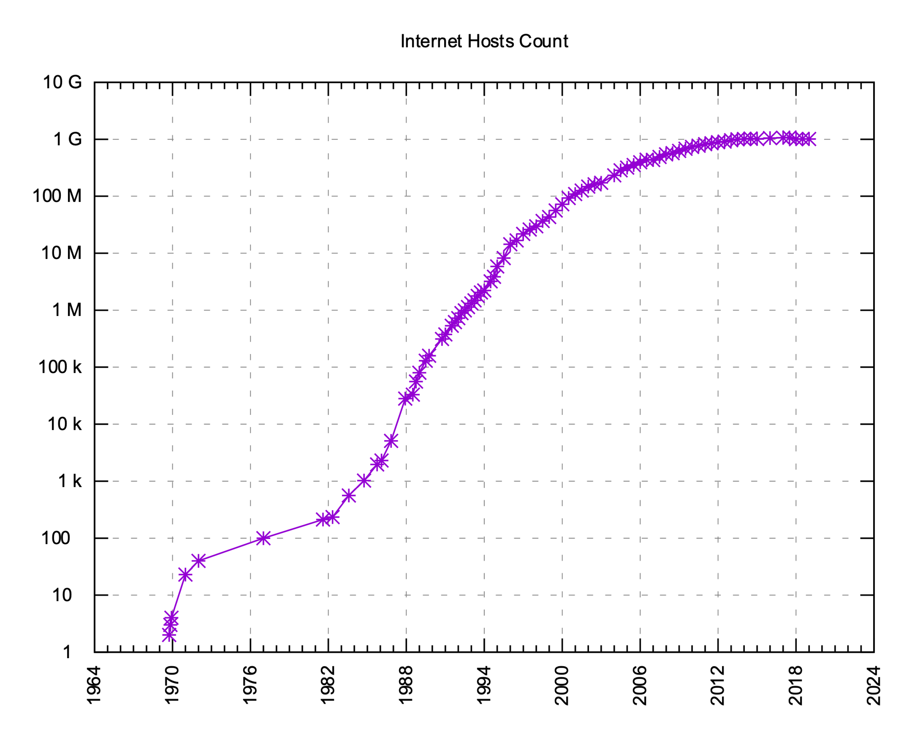
Internet Hosts
Source: Internet Systems Consortium
Cox
Networking
46

Slide 47
Web Servers
Clients and servers communicate using the HyperText Transfer Protocol (HTTP)
  Client and server establish TCP connection
  Client requests content
  Server responds with requested content
  Client and server (may) close connection
HTTP/1.1 is still the most widely used
  RFC 2616, 1999
  HTTP/2, 2015
Web
client
(browser)
HTTP request
Web
server
HTTP response
(content)
Cox
Networking
47

Slide 48
Web Content
Web servers return content to clients
  content: a sequence of bytes with an associated MIME (Multipurpose Internet Mail Extensions) type
Example MIME types
  text/html HTML document
  text/plain Unformatted text
  application/pdf PDF document
  image/gif Binary image (GIF format)
  image/jpeg Binary image (JPEG format)
Cox
Networking
48

Slide 49
Static and Dynamic Content
The content returned in HTTP responses can be either static or dynamic
  Static content: content stored in files and retrieved in response to an HTTP request
    Examples: HTML files, images, audio clips
  Dynamic content: content produced on-the-fly in response to an HTTP request
    Example: content produced by a program executed by the server on behalf of the client (i.e., search results)
Bottom line: All Web content is associated with a file or program that is managed by the server
Cox
Networking
49

Slide 50
URLs
Each file managed by a server has a unique name called a URL (Universal Resource Locator)
URLs for static content:
  http://www.rice.edu:80/index.html
  http://www.rice.edu/index.html
  http://www.rice.edu
    Identifies a file called index.html, managed by a Web server at www.rice.edu that is listening on port 80
URLs for dynamic content:
  http://www.cs.cmu.edu:8000/cgi-bin/adder?15000&213
    Identifies an executable file called adder, managed by a Web server at www.cs.cmu.edu that is listening on port 8000, that should be called with two argument strings: 15000 and 213
Cox
Networking
50

Slide 51
How Clients and Servers Use URLs
Example URL: http://www.aol.com:80/index.html
Clients use prefix (http://www.aol.com:80) to infer:
  What kind of server to contact (http (Web) server)
  Where the server is (www.aol.com)
  What port the server is listening on (80)
Servers use suffix (/index.html) to:
  Determine if request is for static or dynamic content
    No hard and fast rules for this
    Historically executables resided in cgi-bin directory
  Find file on file system
    Initial “/” in suffix denotes home directory for requested content
    Minimal suffix is “/”, which servers expand to some default home page (e.g., index.html)
Cox
Networking
51

Slide 52
Testing Servers Using telnet
The telnet program is invaluable for testing servers that transmit ASCII strings over Internet connections
  Our simple echo server
  Web servers
  Mail servers
Usage:
  unix> telnet <host> <portnumber>
  Creates a connection with a server running on <host> and listening on port <portnumber>
Cox
Networking
52

Slide 53
Anatomy of an HTTP Transaction
unix> telnet www.rice.edu 80 Client: open connection to server
Trying 128.42.206.11... Telnet prints 3 lines to the terminal
Connected to www.netfu.rice.edu.
Escape character is '^]'.
GET / HTTP/1.1 Client: request line
Host: www.rice.edu Client: required HTTP/1.1 HOST header
Client: empty line terminates headers
HTTP/1.1 200 OK Server: response line
Date: Thu, 5 Apr 2018 <..snip..> Server: followed by 8 response headers
Server: Apache/2.4.6 (Red Hat Enterprise Linux) <..snip..>
Accept-Ranges: bytes
<..snip..>
Transfer-Encoding: chunked
Content-Type: text/html; charset=UTF-8
Server: empty line (“\r\n”) terminates hdrs
15e3 Server: first line in response body
<..snip..> Server: HTML content not shown.
0 Server: last line in response body
Connection closed by foreign host. Server: closes connection
unix> Client: closes connection and terminates
Cox
Networking
53

Slide 54
HTTP Requests
HTTP request is a request line, followed by zero or more request headers
Request line: <method> <uri> <version>
  <method> is either GET, POST, OPTIONS, HEAD, PUT, DELETE, or TRACE
  <uri> is typically URL for proxies, URL suffix for servers
  <version> is HTTP version of request (HTTP/1.0 or HTTP/1.1)
Cox
Networking
54

Slide 55
HTTP Requests (cont)
HTTP methods:
  GET: Retrieve static or dynamic content
    Arguments for dynamic content are in URI
    Workhorse method (99% of requests)
  POST: Retrieve dynamic content
    Arguments for dynamic content are in the request body
  OPTIONS: Get server or file attributes
  HEAD: Like GET but no data in response body
  PUT: Write a file to the server!
  DELETE: Delete a file on the server!
  TRACE: Echo request in response body
    Useful for debugging
Cox
Networking
55

Slide 56
HTTP Requests (cont)
Request headers: <header name>: <header data>
  Provide additional information to the server
Major differences between HTTP/1.1 and HTTP/1.0
  HTTP/1.0 uses a new connection for each transaction
  HTTP/1.1 also supports persistent connections
    Multiple transactions over the same connection
    Connection: Keep-Alive
  HTTP/1.1 requires HOST header
    Host: www.rice.com
  HTTP/1.1 adds additional support for caching
Cox
Networking
56

Slide 57
HTTP Responses
HTTP response is a response line followed by zero or more response headers
Response line: <version> <status code> <status msg>
  <version> is HTTP version of the response
  <status code> is numeric status
  <status msg> is corresponding English text
    200 OK Request was handled without error
    403 Forbidden Server lacks permission to access file
    404 Not found Server couldn’t find the file
Response headers: <header name>: <header data>
  Provide additional information about response
  Content-Type: MIME type of content in response body
  Content-Length: Length of content in response body
Cox
Networking
57

Slide 58
Proxies
A proxy is an intermediary between a client and an origin server
  To the client, the proxy acts like a server
  To the server, the proxy acts like a client
HTTP request
HTTP request
Client
Proxy
Origin
Server
HTTP response
HTTP response
Cox
Networking
58

Slide 59
Why Proxies?
Can perform useful functions as requests and responses pass through
  Examples: Caching, logging, anonymization
Client
A
Request foo.html
foo.html
Request foo.html
Origin
Server
Proxy
cache
foo.html
Request foo.html
Slower more
expensive
global network
Client
B
foo.html
Fast inexpensive local network
Cox
Networking
59

Slide 60
A Client’s Request Line To A Proxy
GET http://www.rice.edu/ HTTP/1.1
Host: www.rice.edu
Accept: text/html,application/xhtml+xml,application/xml;
q=0.9,*/*;q=0.8
Proxy-Connection: keep-alive
Upgrade-Insecure-Requests: 1
Cookie: SS_MID=4bff7079-1d9b-464e-a3ab-bee5762488a6i69kf1o6;
__unam=bf980eb-15c0e074c94-a631ba-8;
_ga=GA1.2.1181809510.1416263362; _gid=GA1.2.179111272.1523312176
User-Agent: Mozilla/5.0 (Macintosh; Intel Mac OS X 10_11_6)
AppleWebKit/605.1.15 (KHTML, like Gecko) Version/11.1
Safari/605.1.15
Accept-Language: en-us
Accept-Encoding: gzip, deflate
Connection: keep-alive
CRLF (\r\n)
The client’s request line to a proxy must specify the full URL
Cox
Networking
60

Slide 61
For More Information
W. Richard Stevens, “Unix Network Programming: Networking APIs: Sockets and XTI”, Volume 1, Second Edition, Prentice Hall, 1998.
  THE network programming bible
Complete versions of the echo client and server are developed in the text
  Available on the course web site
  You should compile and run them for yourselves to see how they work
  Feel free to borrow any of this code
Cox
Networking
61

Slide 62
Next Time
Concurrency
Cox
Networking
62

Slide 63
Dotted Decimal Notation
By convention, each byte in a 32-bit IP address is represented by its decimal value and separated by a period
    IP address 0x8002C2F2 = 128.2.194.242
Functions for converting between binary IP addresses and dotted decimal strings:
  inet_pton: converts a dotted decimal string to an IP address in network byte order
  inet_ntop: converts an IP address in network by order to its corresponding dotted decimal string
  “n” denotes network representation, “p” denotes presentation representation
Cox
Networking
63

Slide 64
IP Address Structure
IP (V4) Address space divided into classes:
Special Addresses for routers and gateways (all 0/1’s)
Loop-back address: 127.0.0.1
Unrouted (private) IP addresses:
  10.0.0.0/8, 172.16.0.0/12, 192.168.0.0/16
Dynamic IP addresses (DHCP)
0 1 2 3 8 16 24 31
Class A
0
Net ID
Host ID
Class B
1
0
Net ID
Host ID
Class C
1
1
0
Net ID
Host ID
Class D
1
1
1
0
Multicast address
Class E
1
1
1
1
Reserved for experiments
Cox
Networking
64

Slide 65
Domain Naming System (DNS)
The Internet maintains a mapping between IP addresses and domain names in a huge worldwide distributed database called DNS
  Conceptually, programmers can view the DNS database as a collection of millions of addrinfo structures:
Functions for retrieving host entries from DNS:
  getaddrinfo: query DNS using domain name or IP
  getnameinfo: query DNS using sockaddr struct
struct addrinfo {
int ai_flags; /* flags for getaddrinfo */
int ai_family; /* address type (AF_INET or AF_INET6) */
int ai_socktype; /* the socket type */
int ai_protocol; /* the type of protocol */
size_t ai_addrlen; /* length of ai_addr */
struct sockaddr *ai_addr; /* pointer to a sockaddr struct */
char *ai_canonname;/* the canonical name */
struct addrinfo *ai_next; /* pointer to the next addrinfo struct */
};
Cox
Networking
65

Slide 66
Properties of DNS Host Entries
Each host entry is an equivalence class of domain names and IP addresses
Each host has a locally defined domain name localhost which always maps to the loopback address 127.0.0.1
Different kinds of mappings are possible:
  Simple case: 1 domain name maps to one IP address:
    water.clear.rice.edu maps to 128.42.208.6
  Multiple domain names mapped to the same IP address:
    www.cs.rice.edu, ececs.cs.rice.edu, and bianca.cs.rice.edu all map to 128.42.128.17
  Multiple domain names mapped to multiple IP addresses:
    aol.com and www.aol.com map to multiple IP addresses
  Some valid domain names don’t map to any IP address:
    for example: clear.rice.edu
Cox
Networking
66

