Slide 1
Technical Poster Design
COMP 400

Slide 2
Poster Session Challenges
Challenges
Solutions
Audiences make decisions quickly
Posters sometimes stand alone
Audiences come and go as presenters talk
Poster must be accessible
Show overall organization
Show comparisons
Poster must be comprehensible
Speaker must attract others, adapt to situation

Slide 3
Similar to a Technical Paper
Tell an interesting story
What’s your “news”?
What problem are you solving?
What are your results/conclusions?
What sets your work apart?
E.g., new algorithm or theoretical approach
Why does your work matter?
How can your work be applied?

Slide 4
Similar to a Technical Paper
Structure your story
Say what you’re going to say Abstract
Say it Body & Results
Say what you said Conclusion

Slide 5
Different From a Technical Paper
Space is at a premium
Interactivity is key
Be concise – word choice, sentence fragments
Be precise – word choice
Pictures are often more effective than words
Omit unnecessary details
MUST KNOW Use as your main focus
Good to know Add some
Nice to know Leave details for oral presentation

Slide 6
Textual Presentation Guides the Reader
Scale expresses relative importance
Indenting shows subordination
As in this example
Color adds emphasis or coherence
Meaningless font and color changes are distracting
Avoid low-contrast colors
White space directs gaze
Notes:
=

Slide 7
Font Style and Size
Title – about 4-8 words
90 – 120 pt
Headings – about 3 words
36 – 48 pt
Text
30 – 36 pt
Sans serif fonts best in large scale – posters
Serif fonts best on small scale – papers

Slide 15
Details Matter!
Use consistent formatting
Check grammar & spelling
Include contact info
Use a correct bibliography
Give credit to others

Slide 17
Practicalities
Editing:
LaTeX, PowerPoint, …
Many templates online, or use a friend’s
Printing:
Plotters in Earth Science: http://terra.rice.edu/videos/
Plotter in library: http://library.rice.edu/services/dmc/resources/peripherals/printers/hp-5500ps-guidelines/
Plotters in Mudd Building: https://docs.rice.edu/confluence/display/ITTUT/Plotters
University Copy Center in the RMC
Relatively expensive! (roughly $50 for smaller poster with white background)
One plot/student paid for course – use fund #A1-739000
Takes time – plan ahead.

Slide 18
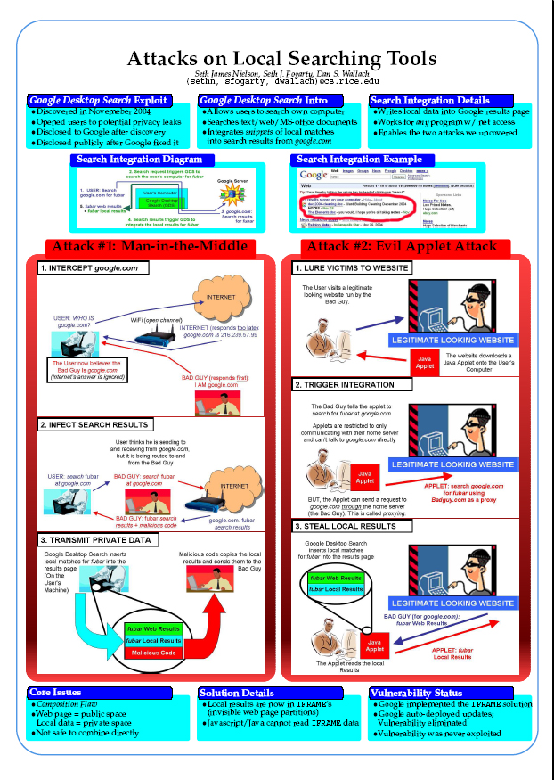

Slide 19
Better organization
But distracting color contrasts

