Slide 1
Parsing & Scanning
Lecture 1
COMP 202
10/25/2004
Derek Ruths
druths@rice.edu
Office: DH Rm #3010

Slide 2


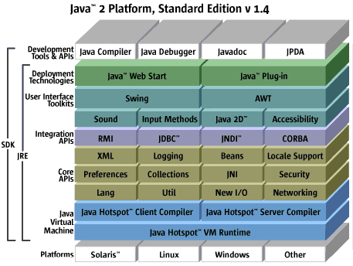
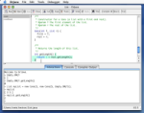

Speech-Recognition
Games
IDEs
Compilers/Interpreters

Slide 3
What is Parsing?
parse (v.) to break down into its component parts of speech with an explanation of the form, function, and syntactical relationship of each part. --The American Heritage Dictionary
Scanning
Parsing

Slide 4
High-Level View
Text, Source Code, Speech
Structured
Representation
(e.g. Abstract
Syntax Tree)
Scanner
Parser

Slide 5
Overview
Lecture 1:
  Intro to scanning
  Intro to parsing
  Basics of building a scanner in Java
Lab: Implementing a scanner
Lecture 2:
  Basic Parsing Theory
  Design of an Object-Oriented Parser

Slide 6
High-Level View
Text, Source Code, Speech
Structured
Representation
(e.g. Abstract
Syntax Tree)
Scanner
Parser

Slide 7
Scanning:
Breaking Things Down
Token List
Token Type
Token Value
<NUM, “3”>,
<PLUS, “+”>,
<ID, “x”>,
<EOF>
“3 + x”
Scanner
Character Stream
Tokens

Slide 8
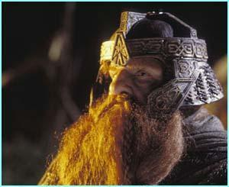
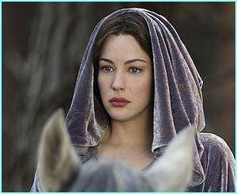

Scanning: Token List
Tolkien List
Token List
Token Type
Token
Descriptor
<NUM: [(”0” - “9”)+]>
<OP: [”+”, “*”]>
<ID: [alpha (alphaNum)*]>
Tolkien Descriptor = Magical Powers
Tolkien Type = Wizard

Slide 9
High-Level View
(you saw this earlier)
Text, Source Code, Speech
Structured
Representation
(e.g. Abstract
Syntax Tree)
Scanner
Parser

Slide 10
Parsing:
Organizing Things
Grammar
<NUM, “3”>,
<PLUS, “+”>,
<ID, “x”>,
<EOF>
+
Parser
3
x
Abstract Syntax Tree
Tokens

Slide 11
Manual Scanning in Java
Token Type
Token Value
Token List
<NUM, “3”>,
<PLUS, “+”>,
<ID, “x”>,
<EOF>
“3 + x”
Scanner
Character Stream
Tokens

Slide 12
Tokenizing Example
public static final int PLUS = ‘+’;
public void tokenize(String str) {
  StreamTokenizer stok = new StreamTokenizer(new StringReader(str));
  int token;
  stok.ordinaryChar(PLUS);
  stok.parseNumbers();
  while((token = stok.nextToken()) != StreamTokenizer.TT_EOF) {
    switch(token) {
    case TT_WORD:
      System.out.println(”WORD = “ + stok.sval); break;
    case TT_NUMBER:
      System.out.println(”NUM = “ + stok.nval); break;
    case PLUS:
      System.out.printlN(”PLUS”); break;
    }
  }
}
Initialization
Configuration
Scanning

Slide 13
Tokenizing Example
public static final int PLUS = ‘+’;
public void tokenize(String str) {
  StreamTokenizer stok = new StreamTokenizer(new StringReader(str));
  int token;
  stok.ordinaryChar(PLUS);
  stok.parseNumbers();
  while((token = stok.nextToken()) != StreamTokenizer.TT_EOF) {
    switch(token) {
    case TT_WORD:
      System.out.println(”WORD = “ + stok.sval); break;
    case TT_NUMBER:
      System.out.println(”NUM = “ + stok.nval); break;
    case PLUS:
      System.out.printlN(”PLUS”); break;
    }
  }
}
Initialization
Configuration
Scanning

Slide 14
java.io.StreamTokenizer
Configuration: It’s like programming a VCR!
Token Type (int) | Token Desc. | How to Customize
StreamTokenizer.TT_WORD | a word (no spaces) | void wordChars(int low, int high)
int qch e.g. :hello there: is a quoted string | a string quoted by ‘qch’ | void quoteChar(int qch) e.g. quoteChar(’:’)
StreamTokenizer.TT_NUMBER | Numbers | void parseNumbers()
int ch e.g. (int) ‘+’ | the character value of ch | void ordinaryChar(int ch) e.g. ordinaryChar(’+’)

Slide 15
Tokenizing Example
public static final int PLUS = ‘+’;
public void tokenize(String str) {
  StreamTokenizer stok = new StreamTokenizer(new StringReader(str));
  int token;
  stok.ordinaryChar(PLUS);
  stok.parseNumbers();
  while((token = stok.nextToken()) != StreamTokenizer.TT_EOF) {
    switch(token) {
    case TT_WORD:
      System.out.println(”WORD = “ + stok.sval); break;
    case TT_NUMBER:
      System.out.println(”NUM = “ + stok.nval); break;
    case PLUS:
      System.out.printlN(”PLUS”); break;
    }
  }
}
Initialization
Configuration
Scanning

Slide 16
java.io.StreamTokenizer
Scanning: It’s like calling “nextToken” over and over!
Call int StreamTokenizer.nextToken() to get the next token.
  String StreamTokenizer.sval (public field) holds the token value for TT_WORD and quote token types
  double StreamTokenizer.nval (public field) holds the token value for TT_NUMBER token type

Slide 17
Tokenizing Example
public static final int PLUS = ‘+’;
public void tokenize(String str) {
  StreamTokenizer stok = new StreamTokenizer(new StringReader(str));
  int token;
  stok.ordinaryChar(PLUS);
  stok.parseNumbers();
  while((token = stok.nextToken()) != StreamTokenizer.TT_EOF) {
    switch(token) {
    case TT_WORD:
      System.out.println(”WORD = “ + stok.sval); break;
    case TT_NUMBER:
      System.out.println(”NUM = “ + stok.nval); break;
    case PLUS:
      System.out.printlN(”PLUS”); break;
    }
  }
}
Initialization
Configuration
Scanning

Slide 18
java.io.StreamTokenizer
Initialization: It’s like using Java I/O!
Constructor: StreamTokenizer(Reader r)
java.io.Reader - class for reading bytes
  FileReader - read bytes from a File
  StringReader - read bytes from a String

Slide 19
Questions?

