Slide 1

Topic Models for Feature Selection in Document Clustering
Anna Drummond*
Zografoula Vagena**
Chris Jermaine*
*Department of Computer Science, Rice University
** LogicBlox Inc
Extended version of a conference talk for
SIAM International Conference on Data Mining (SDM13)
May 2-4, 2013
Austin, TX

Slide 2
Motivation
The goal: unsupervised document clustering
Motivation is two-fold:
  Are topic models useful for document clustering?
  Are there any better options than traditional Latent Dirichlet Allocation (LDA)[1]?
Notes:
Our goal is unsupervised clustering of documents
We were interested in checking if topic models are good for unsupervised clustering: as a preprocessing step for future selection (if its better than not using topic models at all)
Apart from checking if it is good we also wanted to see if there are better options than traditional version to do it

Slide 3
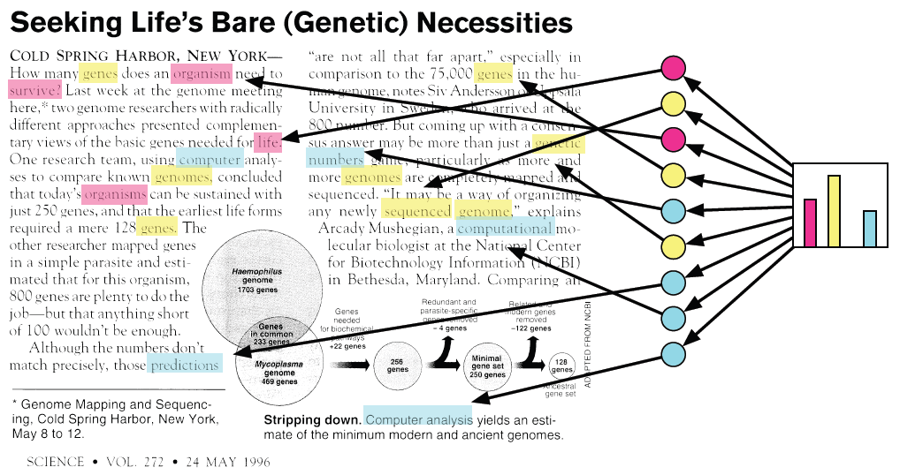
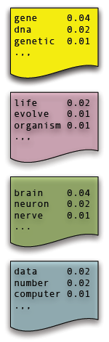
Intuition Behind Topic Models (LDA) [1]
Document
Topics
assignments
Topics
proportion
Topics
Main concern: Dirichlet prior on topic proportion vector is well behaved; does not encourage a “bumpy” distribution
Notes:
Topic models such as LDA are statistical models most often used for analyzing document corpora. A topic in a topic model is a set of words that tend to appear together in a corpus, and the documents in the corpus are viewed as being produced by some mixture of topics. There are many reasons to build a topic model for a corpus. The modeling process typically results in each document being represented as a vector of topic proportions, where each entry of this vector describes the importance of a particular topic in the document. Thus, topic modeling is useful as a pre-processing step for any number of other mining or information retrieval tasks. One can first build a topic model, and then use this vector as a list of features describing the document.
One concern with using “vanilla” LDA as a feature selection method for input to a clustering algorithm is that the Dirichlet prior on the topic mixing proportions is too smooth and well-behaved. It does not encourage a “bumpy” distribution of topic mixing proportion vectors, which is what one would desire as input to a clustering algorithm.

Slide 4
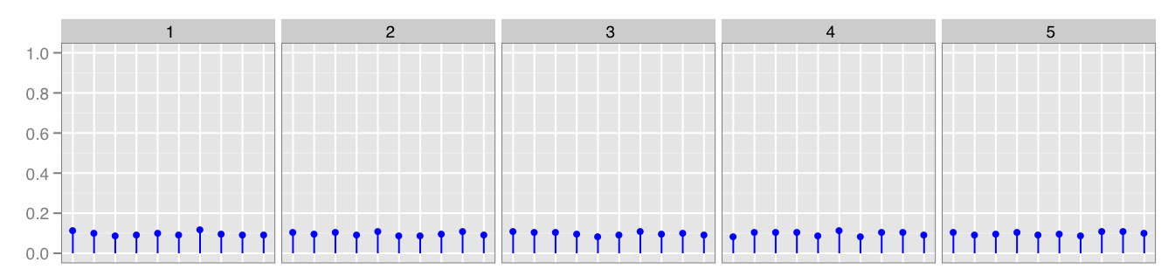
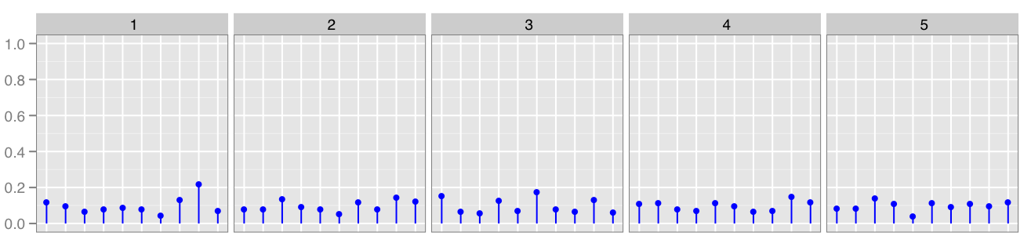
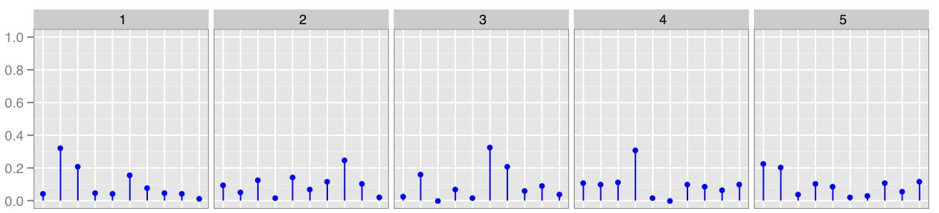
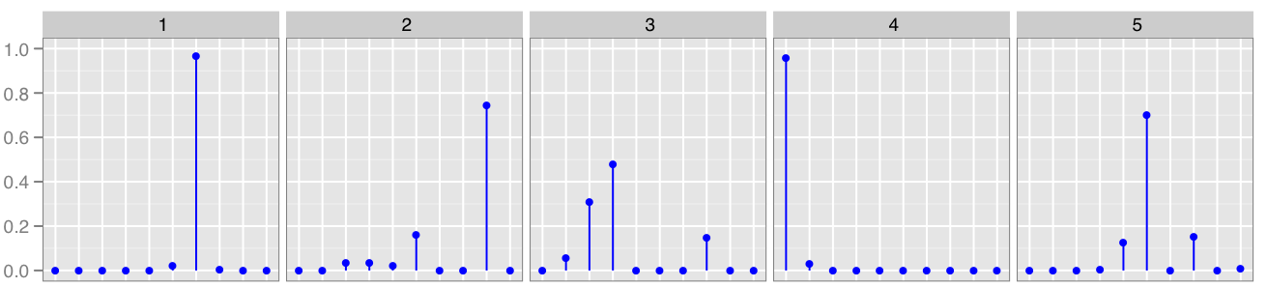
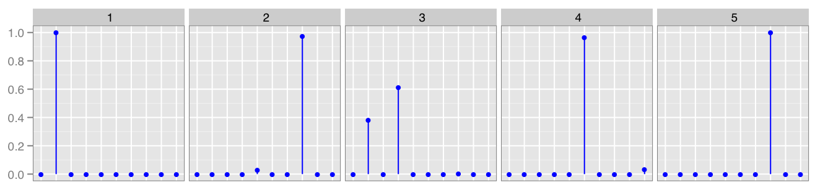
Dirichlet distribution
(random samples)
α = 100
Large
L1-norm
paremeter α controls the mean and the spread from the mean
α = 10
α = 1
α = 0.1
α = 0.01
Small
L1-norm
Notes:
LDA makes use of a Dirichlet prior on the θ vectors which govern the mixture of topics that are found in each document. This prior has a parameter α that controls the mean of the various θ vectors, as well as how widely the vectors are dispersed from that mean. The problem is that the Dirichlet prior is quite well- behaved: it does not encourage a “bumpy” distribution of θ vectors, which is what one would desire as input to a clustering algorithm. Instead, if α has a large L1-norm, the prior has a single mode, which tends to force all documents to have the same proportion of each topic. Or, if the prior has a small L1-norm, it tends to push all of the probability mass to the edges of the simplex—that is, the prior favors documents that have a few topics at the exclusion of all of the others. We might expect that a prior which favors such a distribution of topic mixing proportions would not lead to the best clustering results.

Slide 5
Contribution
Development and evaluation of alternative topic models over several document clustering tasks
Two alternatives to “vanilla” LDA to preprocess a corpus as input to a clustering algorithm
Notes:
Rather than proposing and advocating a particular approach to topic modeling for document clustering, we instead seek to develop and rigorously evaluate a few representative alternatives and objectively evaluate how well they perform over several document clustering tasks.
Because of Dirichlet prior properties, we consider two alternatives to “vanilla” LDA that can be used to pre-process a corpus as input to a clustering algorithm.

Slide 6
Outline
Probabilistic modeling
Proposed models:
  Mixture of priors (MoP)
  Directional Topic Mixture Model
Experimental study
  Methodology
  Results

Slide 7
Probabilistic Modeling
# 1. Treat data as observations that arise from a generative
probabilistic process that includes hidden variables
  It defines a joint probability distribution (over observed and hidden variables)
# 2. Infer the posterior distribution - the conditional distribution
of hidden variables given the observed variables
(“reversing” the generative process)
  What is the hidden structure that likely generated that observed collection?

Slide 8
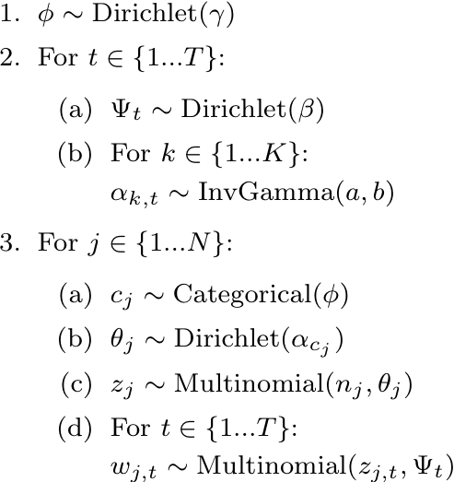
Mixture of Priors (MoP)
Different non-symmetric Dirichlet prior vectors α for each cluster
Gives more flexibility
Should result in data that is more amenable to clustering.
1. Generate mixing proportion vector
2. For each topic:
  a) Generate topic (distribution of words)
  b) For each cluster:
    Generate parameter α
3. For each document:
a) Draw cluster membership
b) Generate topic proportions vector
c) Draw topic assignments for words
d) For each topic:
draw words from the dictionary
Notes:
MoP is simple modification to the LDA model. Rather than each document sharing the same prior on its topic mixing proportions, in the MoP alternative, a document chooses its prior from a mixture of K different priors. This naturally allows for a bumpy prior on the distribution of the θ vectors, and our hypothesis is that this would result in data that are more amenable to clustering.

Slide 9
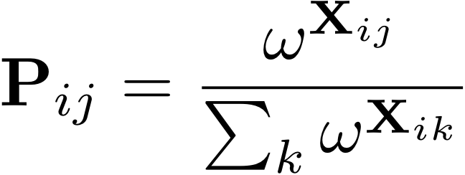
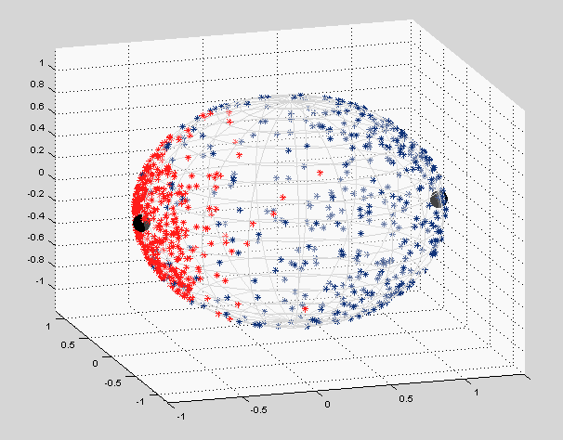
Directional Topic Mixture Model (DTMM)
Does not rely on a Dirichlet distribution to govern the topic mixing vector;
Instead, uses a mixture of von Misses-Fisher distributions (vMF) over a unit sphere
Latent position in “topic space” X_{i} assigned to each document;
X_{i} mapped to each probability vector P_{i} on the (d-1) simplex:
The position on the unit sphere controls
how topics are mixed together
It allows for correlation between topics
[3]
[3]
Notes:
A second alternative (unlike LDA) does not rely on a Dirichlet distribution to govern to what extent the various topics influence production of a document. DTMM relies on a spherical distribution to place documents on a unit sphere; the position of a document on the sphere controls how topics are mixed within the document. By utilizing K mixture components in the spherical distribution, we obtain a “bumpy” prior on the topic mixing proportions. The hoped-for benefit of this approach is that the spherical distribution allows for a document’s cluster membership to have a more direct influence on the topic mixing proportions than in the MoP alternative, where cluster membership supplies only a prior to a document’s topic mixing proportion.

Slide 10
Directional Topic Mixture Model (2)
von Misses-Fisher distribution (vMF)
Paramaters:
  m – mean
  κ – concentration parameter
  (if κ=0 -> uniform distribution over the unit sphere)
vMF₀(m₀, κ₀)
m₀ = (1, 0, 0)
κ₀ = 1
vMF₁(m₁, κ₁)
m₁ = (-1, 0, 0)
κ₁ = 10

Slide 11
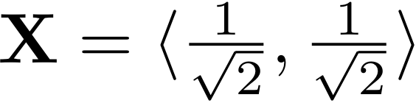
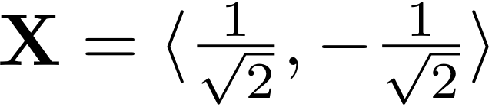
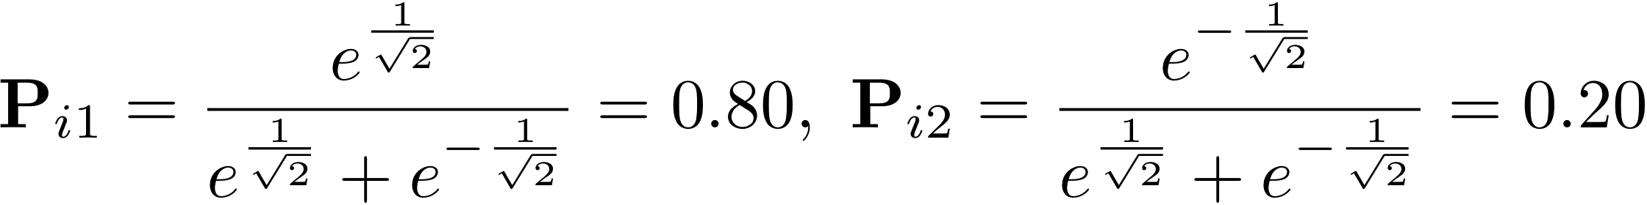
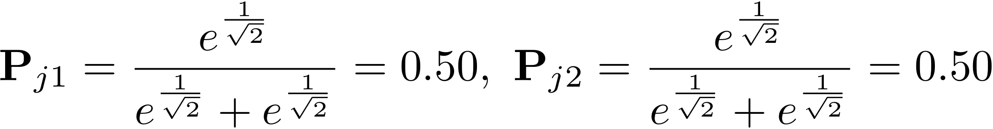
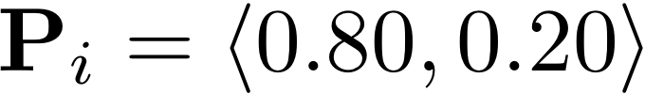
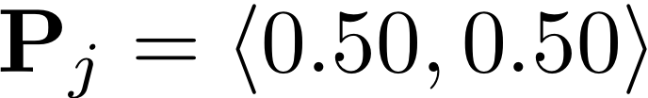
Directional Topic Mixture Model (3)
Latent position X_{i} -> Probability vectors P_{i}
Anti correlation
between topics
No correlation
between topics
1
1
-1
1
-1
1
-1
-1

Slide 12
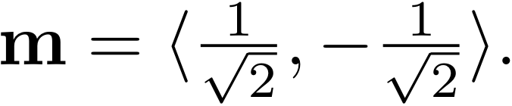
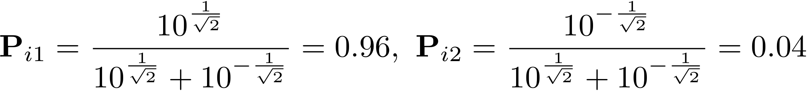
Directional Topic Mixture Model (4)
[2]
Additional parameter ω
To manipulate the extent to which certain topics dominate the creation of a document
    Doc located at
    ω = e
    ω = 10

Slide 13
Experimental Study
We tested four different options:
Spherical k-means, using cosine distance (baseline)
First learn an MoP model, then run k-means on the resulting model
First learn a DTMM model, then run k-means on the resulting model
First learn an LDA model, then run k-means on the resulting model

Slide 14
Experimental Study (2)
Data sets used:
  CMU Newsgroups (5 & 10), Classic 3, Reuters 8, WebKB 4, Stock
Preprocessing:
  Text split into sentences and stopwords removed
  Lemmatizing instead of stemming
  N-grams dictionary (Turbo Topics: Blei et. al)
Models training:
  Stochastic approximation: Markov Chain Monte Carlo (Gibbs sampling)
  5 independent runs for each model
  True number of clusters, True number of clusters x 2
  40 topics
Notes:
Stock is a collection of stock price information for the S&P 500. It is a stock market index based on the market capitalizations of 500 leading companies publicly traded in the U.S. stock market Each stock is considered to be a “document”, so the corpus size is 500. If a stock goes up on a particular day, then the “word” corresponding to that day is added to the document. There are 10 years of data in the set, and so there are approximately 10 × 365 unique “words” in the corpus. The ten clusters in the data correspond to the GICS sector of the company (Industrials, Financials, Health Care, etc.). Since stocks in the same sector tend to move together, one would expect that the stocks (that is, the “documents”) in the same sector would cluster with one another.
Turbo Topics finds multi-word expressions by using a back-off language model defined for arbitrary length expressions, and recursively employs the distribution-free permutation test to find significant phrases. Although the Turbo Topics model was originally developed to better visualize unigram topic models (after the model gets fit), we felt its use would be beneficial in the document pre-processing phase.

Slide 15
Results
Accuracy measured by the maximum matching in bipartite graph algorithm
Significance of results determined by a nonparametric bootstrap test
Notes:
Then the accuracy was measured using the maximum matching in bipartite graph algorithm, where a matching is performed between the true and learned labels. That is, we computed the best possible mapping of data points to “true” clusters, and the fraction of documents assigned to the correct cluster is used to mea- sure the quality of the clustering.
To determine the significance of the results, we performed a simple, nonparametric bootstrap test where for each pair of methods a and b, we repeatedly performed the following: (1) randomly select one of the five data sets; (2) randomly select an observed clustering accuracy on that data set for both a and b; (3) determine which method is most accurate on that data set.

Slide 16
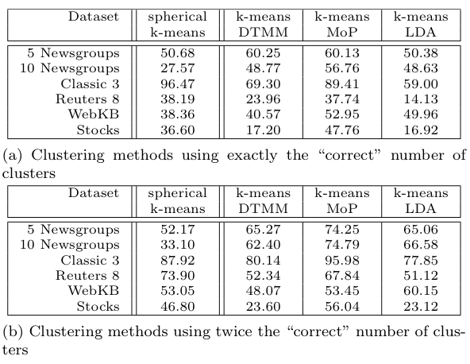
Accuracy (as a %)
Notes:
Tables 1a and 1b show the average accuracy over the five runs for each of the four clustering methods.
We found that the MoP method is the best choice of the methods that we tested for clustering text documents.
This method was followed by spherical k-means and the DTMM model, which performed similarly when the correct number of clusters was used (Table 2a).
We also found that if the correct number of clusters is used, LDA was clearly the poorest choice for document clustering.
Interestingly, LDA performed much better when twice the correct number of clusters were used. Although, in this case it was still only the second poorest performance, LDA was competitive with spherical k-means.

Slide 17
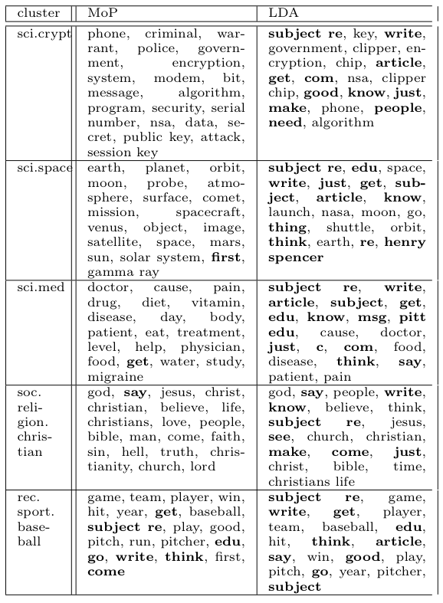
Most frequent words in the most important topic for each learnt cluster
(5 Newsgroups dataset)
Words that are seemingly irrelevant are given in bold
Notes:
We were curious as to why the three topic models performed as they did. The first thing that we checked was the quality of the topics themselves. In Table 4, we list the top words (by probability) for the topic that is most closely associated with each of the five clusters learned over the 5 Newsgroups data set. The words are given both for “vanilla” LDA, and for the topics learned by using the MoP model. In the table, words that are seemingly irrelevant to the newsgroup in question are bolded. It is clear that a much higher percentage of the top words associated with the LDA-based topic model were words that had little to do with the newsgroup in question.

Slide 18
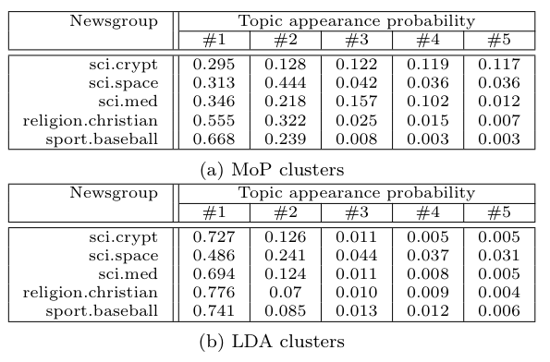
Average appearance probability for the top five topics in each of the clusters (5 Newsgroups data set)
Notes:
But why does LDA underperform, and why are the topics generally poor in this sort of heterogeneous data set? I postulated in the beginning that the Dirichlet prior could be problematic when using LDA as a pre-processing step for clustering data. To examine whether this was a possible explanation for the poor performance, for each cluster, and for each model, we determined the top five topics (that is, the five topics most closely associated with the cluster). We then computed the average prevalence of those five topics in the documents that belonged to the cluster.
As expected, we found that the MoP model tended to produce topic proportion vectors that spread their probability across more topics than LDA did.
For example, consider the sci.med data set. The fourth most common topic under the MoP model still has a 10% prevalence, whereas for LDA, the fourth most common topic had less than a 1% prevalence. One may conjecture that this forces the topics to attempt to model an entire class of documents; hence the inclusion of terms such as “subject re”, which has the effect of drastically reducing the intrinsic dimensionality of the feature space.

Slide 19
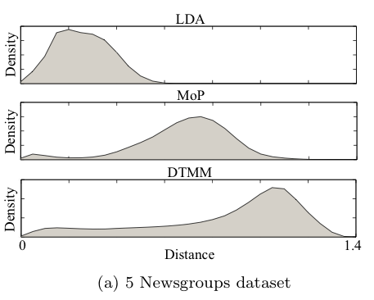
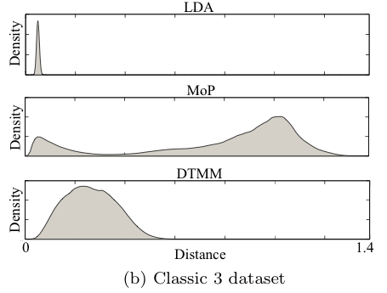
Two point correlation functions
Notes:
To further examine this, we computed (for both the 5 Newsgroups and Classic 3 data sets) the two-point correlation function over all of the topic proportion vectors for the LDA, MoP and DTMM models. The two-point correlation function is essentially the PDF for the distance between two points randomly selected from the data set. In a data set having a good clustering structure, we would expect at least two modes in the correlation function: a small one close to zero (for pairs of points in the same cluster) and a larger mode far from zero (for pairs of points in different clusters).
Consider Figure 3a. This is exactly what we find in the MoP correlation function over the 5 Newsgroups data and in the DTMM function over that data. But the LDA correlation function is not nearly as high quality, showing a lack of clustering structure.
The results are even more striking over the Classic 3 data. This plot shows that the LDA points are almost all equi-distant from one another.
However, the MoP model places the documents into a very nice clustering structure.
The DTMM model over this data set does not have a clear clustering structure, but (unlike the LDA model) the documents are not all equi-distant.
Relatively speaking, the LDA results are poor, with the DTMM results in the middle.

Slide 20
Summary
The topic models can be useful as a pre-processing step in documents clustering
MoP is superior to the other models
DTMM model can perform well on certain data sets, but it is sometimes outperformed by a simple spherical k-means algorithm
Simple LDA model is possibly not a good option for feature selection for unsupervised learning
Notes:
To summarize: the MoP model seems to clearly produce the best clustering structure when used as a preprocessing step for k-means. This would seem to be the preferred approach.
The DTMM model can perform well on certain data sets, but it is sometimes outperformed by a simple spherical k-means algorithm.
We found that a simple LDA model is possibly not a good option for feature selection for unsupervised learning.

Slide 21
References
Blei, D. M., Computer Science Dept, Princeton University http://www.cs.princeton.edu/~blei/index.html
Blei, D. M., Ng, A. Y., Jordan, M. I., 2003. Latent dirichlet allocation. J. Mach. Learn. Res. 3, 993–1022. URL http://portal.acm.org/citation.cfm?id=944919.944937
J. Atchison and S. Shen. Logistic-normal distributions: some properties and uses. Biometrika, 67(2):261, 1980.

