Slide 1
Predicting Kinase Binding Affinity Using Homology Models in CCORPS
Jeffrey Chyan
Advisor: Lydia Kavraki

Slide 2
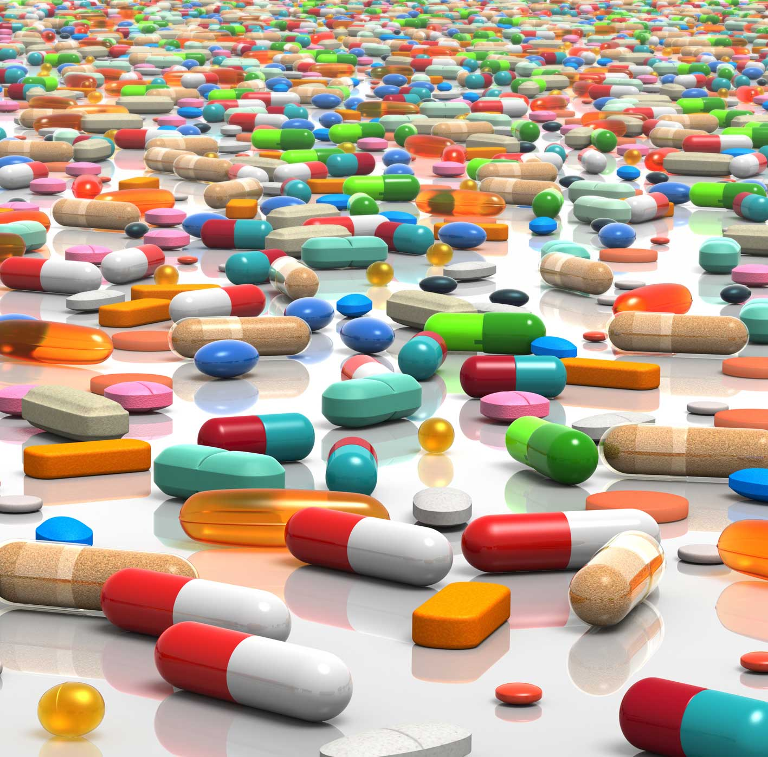
Drug Design is Difficult
Traditional drug design uses trial and error
Computational methods can significantly decrease time and cost
http://www.infiniteunknown.net/2010/11/07/british-medical-journal-statin-drugs-cause-liver-damage-kidney-failure-and-cataracts/

Slide 3
Prediction Problem
Predict binding affinity of proteins and drugs
Binding affinity: The strength of binding between a drug and a protein
Notes:
This idea would be useful in intro. Explain “labels”. What is “structural feature”? “Binding Affinity” “Homology Model” Need gentler big picture.

Slide 4
Outline
Background
CCORPS
Homology Models
Initial Results/Next Steps
Notes:
Maybe not slide 2
Need to get across big picture right away
Why is drug design hard? How will we help?
Need to return to outline during presentation

Slide 5
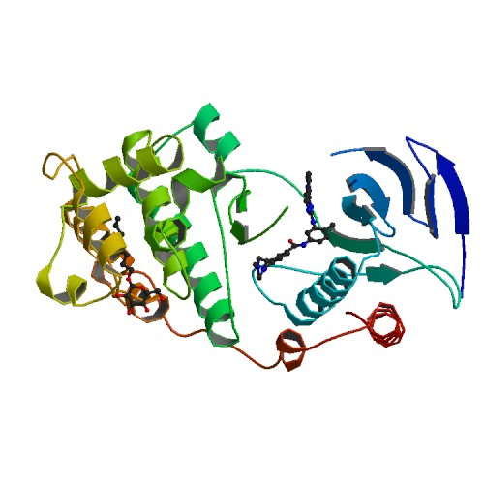
What Are Proteins?
Proteins are complex molecules that are essential for our bodies to function
Notes:
What does this have to do with the topic?

Slide 6
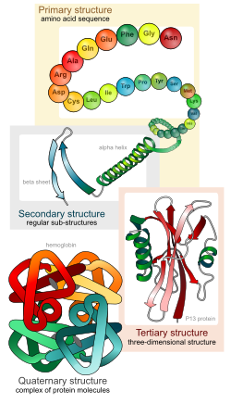
Protein Sequence and Structure
Sequence made up of amino acids
  20 standard amino acids represented by letters
Residue = Amino Acid
Forms 3-D structure of protein
http://simplebooklet.com/publish.php?_escaped_fragment_=wpKey=bJmEPRrjmhtGd3MTZhf7sa
Notes:
Show simple picture of structure and amino acid

Slide 7
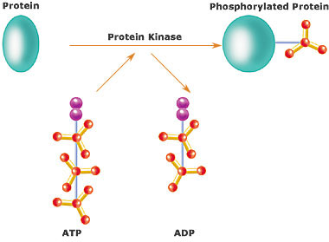
Protein Kinases
Important for many cell signaling pathways in the human body
http://en.wikipedia.org/wiki/Protein_kinase
Notes:
Maybe introduce what a cell signaling pathway is. What aspects are needed to understand the topic.

Slide 8
Kinases Gone Wrong
Mutations can cause kinases to affect our cells and bodies negatively
  Cancer
  Diabetes
  Hypertension
  Neurodegeneration
Want to inhibit the kinases with drugs

Slide 9
Drug Design
Drugs can be designed to bind to target proteins to achieve desired effect
Example: Imatinib binds to P38 to inhibit the kinase, and prevent growth of cancer cells
Notes:
A lot of terminology. Explain terminology relevance to talk and work. Emphasize needed terminology.

Slide 10
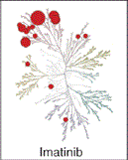
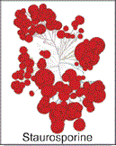
Drug Behavior
Drugs can behave differently
  Cure, poison, side effects
Which drugs will bind to which proteins?
Notes:
Probably don’t need bullet point here. More informative slide title. Be wary of unnecessary bullet points. I used “phylogenetic” without explanation.

Slide 11
Semi-supervised Learning Problem
Find structural properties in a set of proteins that correlate to labels
Proteins: Protein kinases
Labels: Binding affinity for 317 kinases with 38 drugs (True - bind or False - not bind)
Notes:
This idea would be useful in intro. Explain “labels”. What is “structural feature”? “Binding Affinity” “Homology Model” Need gentler big picture.

Slide 12
Protein Data
Protein Data Bank (PDB): experimentally determined structural data
ModBase: computationally created structural data
Pfam: sequential alignment data for protein families

Slide 13
Outline
Background
CCORPS
Homology Models
Initial Results/Next Steps
Notes:
Maybe not slide 2
Need to get across big picture right away
Why is drug design hard? How will we help?
Need to return to outline during presentation

Slide 14
CCORPS
Input: Aligned set of protein substructures and labels for some of the protein substructures
Output: Predicted labels for protein substructures with no label
Substructure: Set of residues grouped together in 3-D
Notes:
Need some visualization

Slide 15
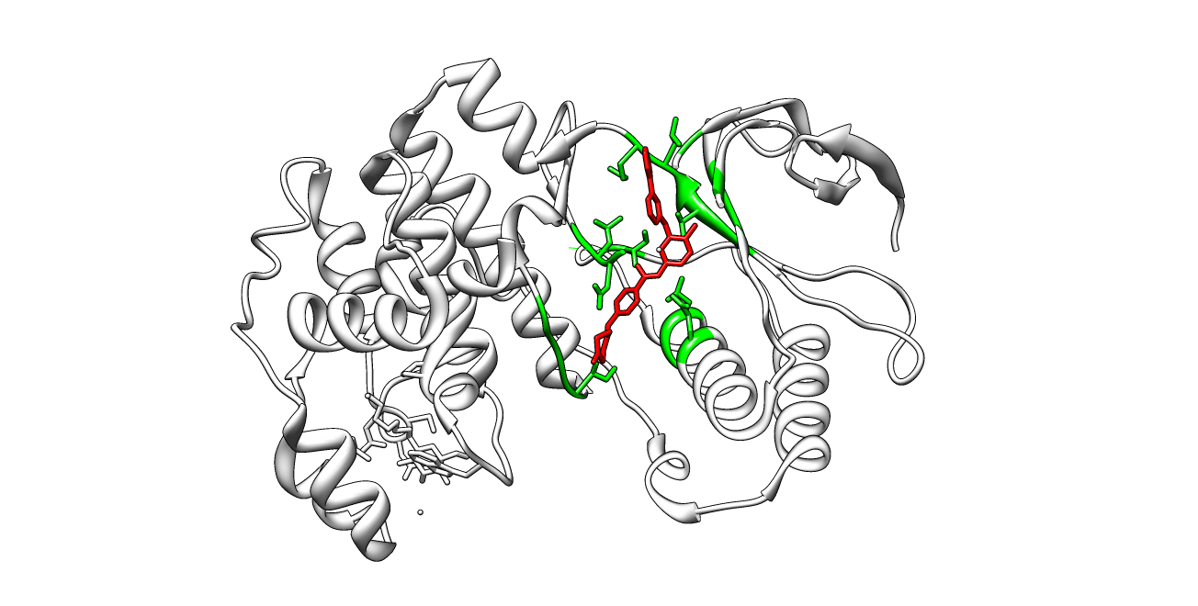
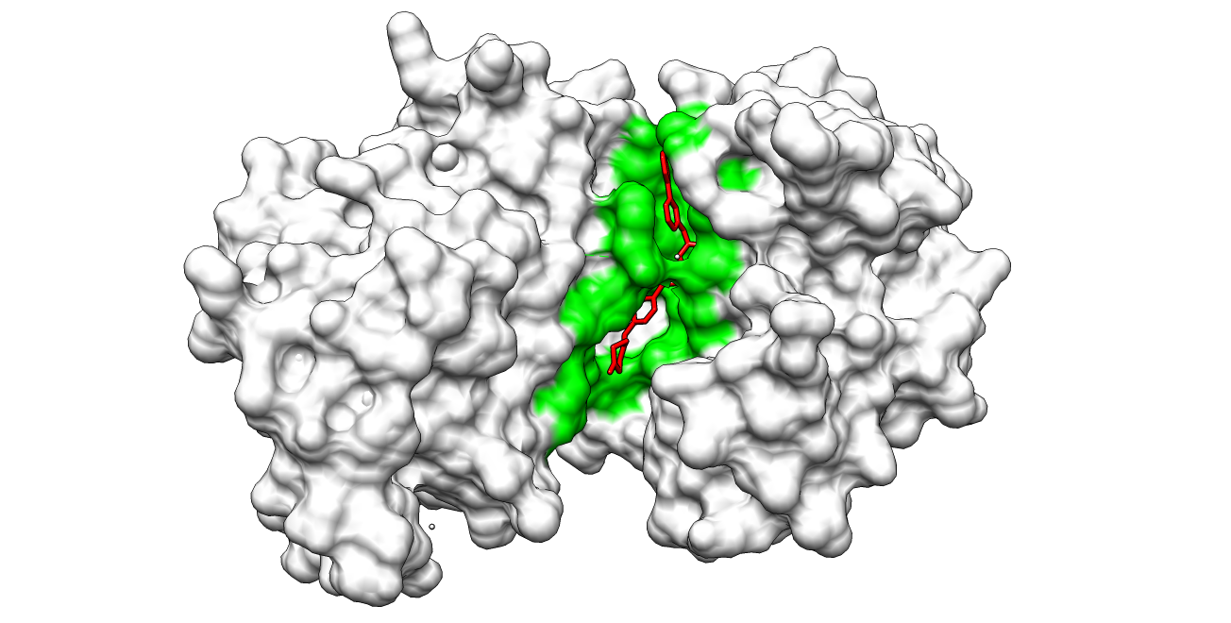
Binding Site Substructure
Look at binding site of protein kinases
  PDB:3HEC binding site contains 27 residues
Notes:
Bullet point problem. Red on black is low contrast.

Slide 16




Triplet Subsets
Subset combinations of binding site residues
For each triplet subset, perform clustering on all protein kinase structures
Notes:
Slide doesn’t explain triplet. Could use picture here. What about the num or formula is important?

Slide 17
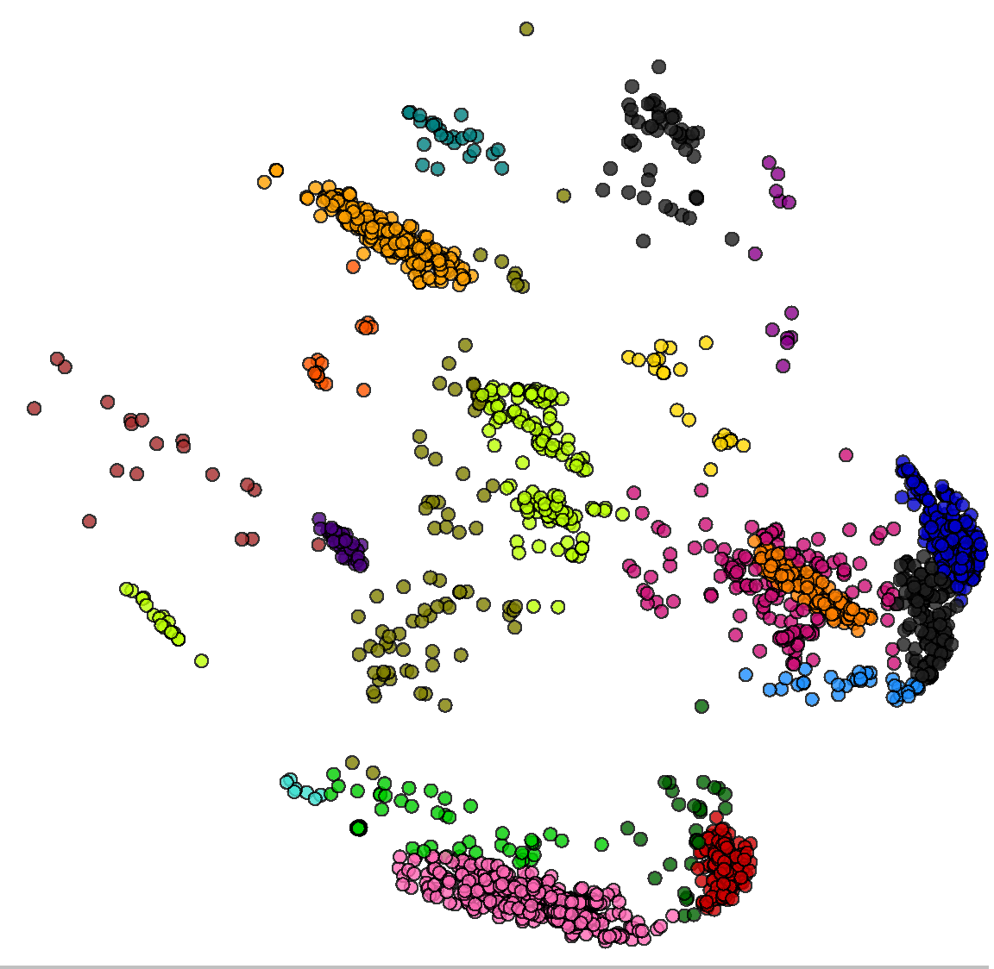
Clustering
Cluster proteins based on the triplet subset
Identifies substructures that are similar
Allows us to observe how the structural and chemical similarities correlate to labels

Slide 18
Steps For Each Triplet Subset
Given a triplet substructure from the binding site substructure of a specific protein
Identify corresponding triplet substructure for all protein structures based on alignment
Generate geometric feature vector comparing proteins against other proteins
PCA dimensionality reduction
Cluster with Gaussian mixture models
Notes:
Need Visualization. Numbers instead of bullets. Probably need to get across why clustering? How is clustering beneficial? Cluster what? What is the clustering telling me? Might need to throw out some details based on time.
Didn’t motivate why talk about protein substructures. When introducing concepts, make sure make clear why concepts important.
GFV and PCA candidates for removing because they are common to clustering methods. Can just state these are standard tools we use.

Slide 19
Geometric Feature Vector
Each component of the vector for a substructure is its distance from another substructure
  Able to preserve same cluster membership with 20 “landmark” substructures instead of all substructures
Notes:
“Landmark substructures”. Could have a picture.

Slide 20

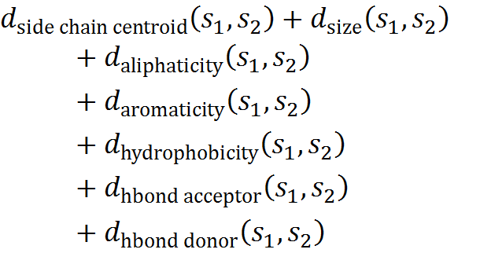
Distance Metric
Need distance metric for comparing substructures
Use structural and chemical properties
Notes:
“sclrmsd” lots of buzz words here. More broad description. Picture.

Slide 21
Non-Redundancy
Some protein sequences have a lot more structural data than others
Need to prevent overrepresentation
Identify redundant structural data based on sequence identity
Sequence identity: measure of similarity between sequences
Notes:
“Non-redundancy” “PDB” more explanation/pictures maybe

Slide 22
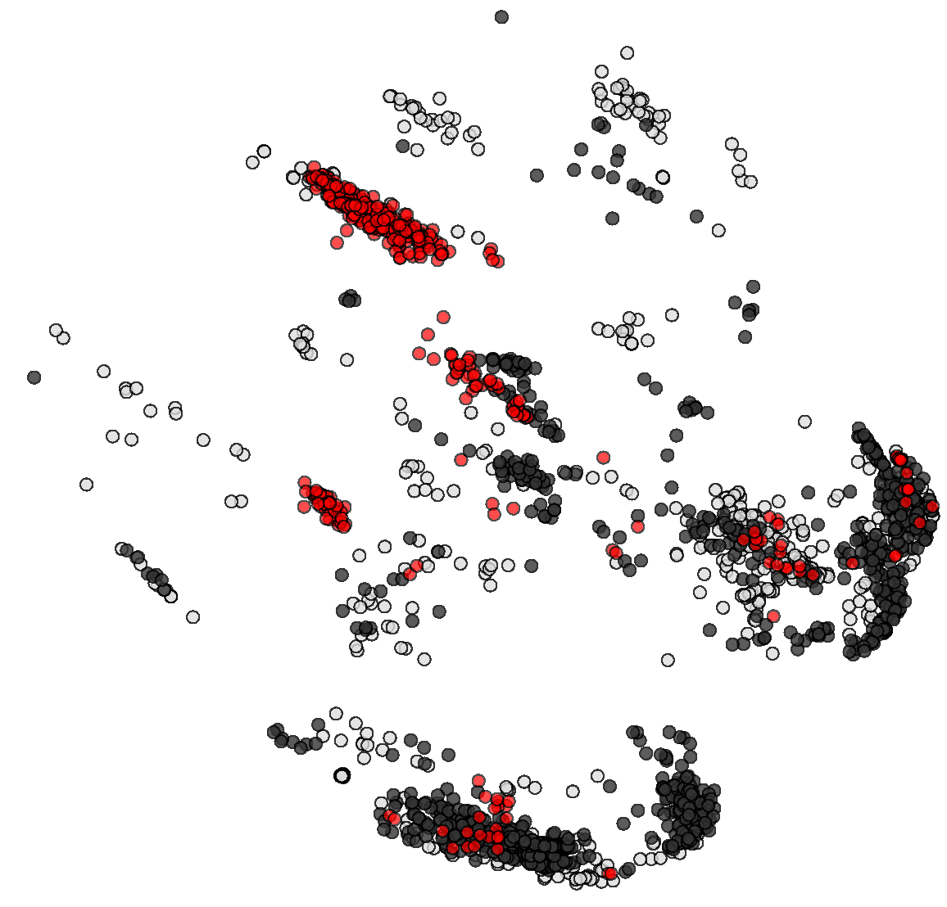
Apply Labels to Clustering
After all the clustering is complete, we apply labels to the data to observe correlation
Red - True Black - False

Slide 23
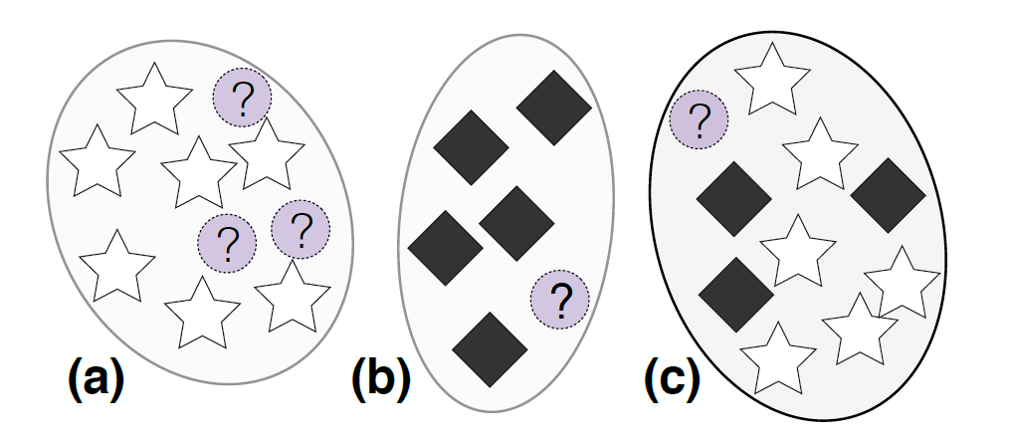
Highly Predictive Clusters
After performing all clustering, identify highly predictive clusters (HPC)
HPC: cluster where the label purity is 100%
Notes:
“label purity” “low silhoette scores” “overrepresentation” Needs more explanation of big picture on clustering. What are we predicting? Picture.

Slide 24
Degree of Separation
Use silhouette scores to measure “distinctness” of clusters
Average silhouette score of a cluster measures how tightly grouped the data in the cluster are
HPC with negative average silhouette scores are thrown out

Slide 25
Prediction
For an unlabeled protein, tally votes for HPCs it falls in for each clustering
Use support vector machine to determine decision boundary using proteins with known labels
Label unlabeled protein using determined threshold
Notes:
Lost, what are we predicting? “SVM”

Slide 26
Outline
Background
CCORPS
Homology Models
Initial Results/Next Steps
Notes:
Maybe not slide 2
Need to get across big picture right away
Why is drug design hard? How will we help?
Need to return to outline during presentation

Slide 27
Missing Structural Data

Slide 28
Homology Models
Structural model created based on a template of known structural data
Potential additional information from homology models
264,286 potential models for Pkinase family from Sali Lab generated from MODELLER
Notes:
Are they standard? Are there other models? Why these models? Why use homology models?

Slide 29
Selecting Models
Select models with strict rule for model quality
  E-value (<0.0001), GA341 (>=0.7), MPQS (>=1.1), zDOPE (<0)
Filtered out models that are more than 5Å distance from input substructure (3HEC binding site)
Notes:
Homology models. What do we mean by model quality? Explain why distance metric earlier. This is potential reason for it.

Slide 30
Implementing Homology Models
Challenges:
  Clustering originally built around using only PDB structures
  Lots of mapping between different IDs and aliasing issues
Separate workflow for homology models
PCA done on only PDB and then used for all structures

Slide 31
Outline
Background
CCORPS
Homology Models
Initial Results/Next Steps
Notes:
Maybe not slide 2
Need to get across big picture right away
Why is drug design hard? How will we help?
Need to return to outline during presentation

Slide 32
Initial Experiment
Ran clustering on full binding site of PDB:3HEC with homology models and PDB structures
Observed phylogenetic family labels on clusters
Notes:
In the beginning of talk, say this talk focuses on method and approach and we only have some preliminary results. Explain work in progress.

Slide 33
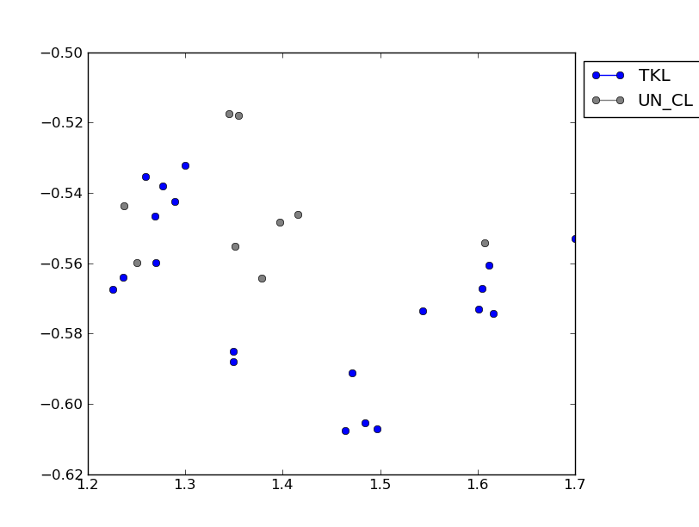
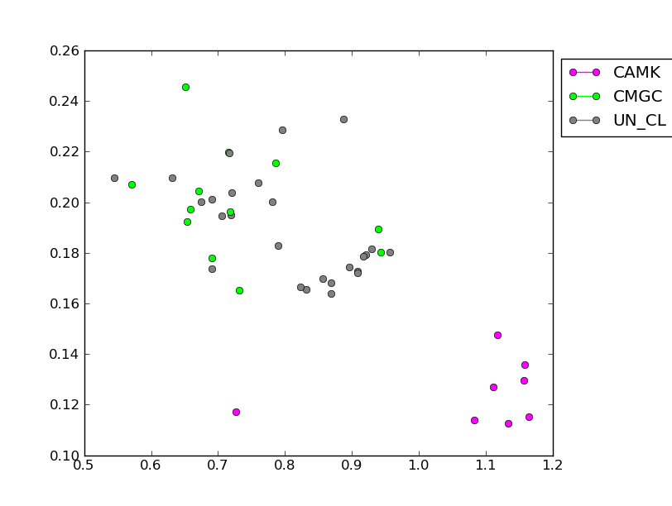
Initial Clustering Results
Clusters on full binding site show addition of homology models conserve phylogenetic families in clustering
Notes:
Bad visuals. Maybe put plots on different slides. Maybe move legend into plot. Points are small. Don’t need bullet. Make sure it is clear how diagram relate to words.

Slide 34
Next Steps
Gradually add homology models to CCORPS experiment
Compare against previous baseline in CCORPS
Notes:
Reiterate primary conclusions. Hammer on main things we’ve done and what to remember.

Slide 35
Summary
Computational methods can enhance and aid drug design
Looked at CCORPS method for predicting protein labels and its application to kinase binding affinity
Homology models provide more structural data to potentially see a better picture of protein clustering

Slide 36
References
[1] Bryant, D. H., Moll, M., and Kavraki, L. E. (2012). Combinatorial clustering of residue position subsets identiﬁes speciﬁcity-determining substructures. (Submitted.)
[2] Karaman MW, Herrgard S, Treiber DK, Gallant P, Atteridge CE, et al. (2008) A quantitative analysis of kinase inhibitor selectivity. Nat Biotechnol 26: 127-32.
[3] Berman, H., Westbrook, J., Feng, Z., Gilliland, G., Bhat, T., Weissig, H., Shindyalov, I., and Bourne, P. (2000). The Protein Data Bank. Nucleic Acids Research, 28(1), 235–242.
[4] Finn, R. D., Tate, J., Mistry, J., Coggill, P. C., Sammut, S. J., Hotz, H.-R., Ceric, G., Forslund, K., Eddy, S. R., Sonnhammer, E. L. L., and Bateman, A. (2008). The Pfam protein families database. Nucleic Acids Res, 36(Database issue), D281–8.
[5] Pieper, Ursula, et al. (2011). ModBase, a database of annotated comparative protein structure models, and associated resources. Nucleic Acids Research, 39: 465-474
[6] Bryant, D. H., Moll, M., Chen, B. Y., Fofanov, V. Y., and Kavraki, L. E. (2010). Analysis of substructural variation in families of enzymatic proteins with applications to protein function prediction. BMC Bioinformatics, 11, 242.
[7] Pettersen, E. F., Goddard, T. D., Huang, C. C., Couch, G. S., Greenblatt, D. M., Meng, E. C., and Ferrin, T. E. (2004). UCSF Chimera–a visualization system for exploratory research and analysis. J Comput Chem, 25(13), 1605–1612.

